Slide 1

Module 1
Arizona Department of Education
Arizona Professional Learning Series: Increasing Literacy Achievement for All Students
Module 1
Notes:
Welcome to the Arizona Professional Learning Series (AZPLS) to Increase Literacy Achievement for All Students. The focus is to close the gap in literacy achievement between students with specific learning disabilities and their peers without specific learning disabilities in grades 4–8.

Slide 2
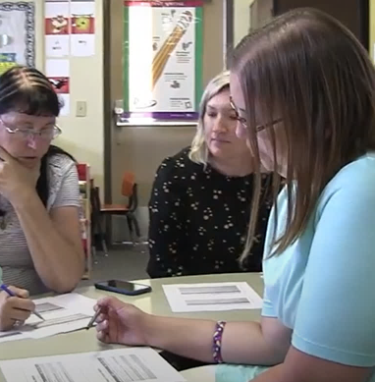
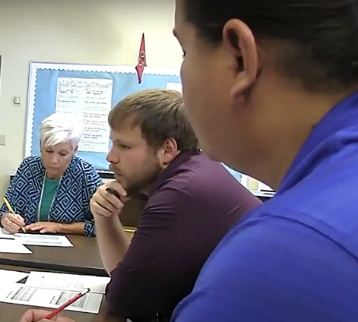
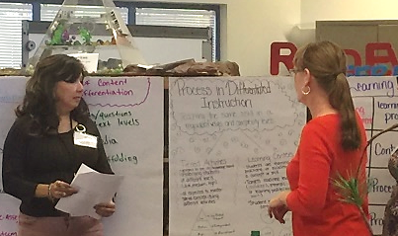
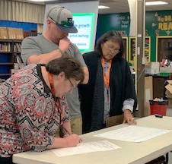
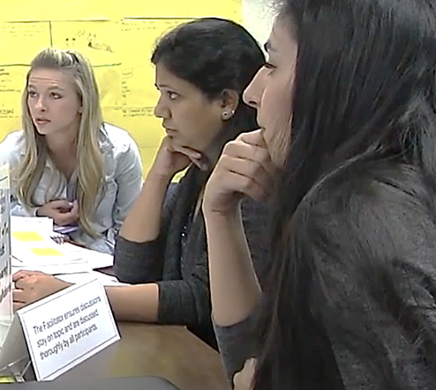
Professional Learning Series
Professional Learning for Arizona
Notes:
This comprehensive professional learning series was developed with and for Arizona schools. It is inclusive of the entire school community. Collaborative involvement includes the district, school staff, students, and parents.
The foundation is based on systems change, so the professional learning and implementation is schoolwide for grades K–8. The teaching and learning strategies presented in the modules work for all student populations in grades 4–8 and can be adapted and introduced in the primary grades.

Slide 3







Series Module Overview
Module 3 Formative Assessment
Module 4 Literacy Strategies
Module 5
Literacy
Strategies
Module 2 Collaboration
Module 1 Introduction
Module 6 Differentiation
Notes:
The module framework progressively builds to support sustainable systems change. The organization of the modules, coaching, and implementation provides the structure for increasing knowledge, skills, and achievement. Everyone in the school community is aware and involved in the step-by-step process to implement the common use of specific teaching and learning strategies in every class. Handout 1: Arizona Professional Learning Series Module Overview is a brief explanation of the modules and indicates how they build on each other.
Module 1 is the introduction and overview of the comprehensive professional learning series. It identifies support for the systems change process through a collaborative culture of high expectations for all students.
Module 2 is the connection and collaboration of all general education teachers, special education teachers, content area teachers, paraprofessionals, parents, and students. You will learn strategies of intentional collaboration to support your collaborative teamwork for collective learning and implementation.
You will see the connection of using strategies to support the Arizona English Language Arts Anchor Standards, Handout 2: Arizona English Language Arts Anchor Standards, in every class, including the content areas.
Modules 3 identifies the Dimensions of Formative Assessment with Learning Goals, Criteria for Success, and strategies to move learning forward for all students. Ongoing classroom data will drive instruction, and staff implementation will be supported by your Collaborative Team and your coach.
Modules 4 and 5 continue the systems change process by introducing and collaboratively using research-based literacy strategies to support all students and increase their achievement in all disciplines. Strategies will strengthen vocabulary, comprehension, higher-level questioning, and discussion skills.
Module 6 examines inclusive practices to meet the needs of all learners by planning and implementing instructional strategies to support differentiated content, process, and product.
By the end of this professional learning series, you will have gained the knowledge and skills to impact literacy learning for every student in all classrooms across your campus.

Slide 4
Professional Learning Process
Professional Learning Process
Where are we headed?
Where are we now?
How will we close the gap?
Notes:
Throughout the modules, we will refer to these three questions to frame our work. Let’s use them to look at the big picture.
Where are we headed? We want to increase literacy achievement for all students.
Where are we now? We are developing the skills defined in the Arizona English Language Arts Anchor Standards that are essential for all students to succeed in every class.
How will we close the gap? Working collaboratively, we will implement the teaching and learning strategies from each module. These strategies will support learning and increase the literacy skills of every student.

Slide 5







Program Design
Program Design
Professional Learning
Teams
Data
Rooted in Systems Change
Coaching
Leadership
Action Planning
Notes:
Handout 3: AZPLS Program Design Overview provides an overview of the AZPLS comprehensive plan with checks and balances. The research-based components collectively drive the process that leads to success. Let’s look at each component.

Slide 6
Professional Learning
Strategic Implementation
Intentional Collaboration
Invested School Community
Professional
Learning
Notes:
The overall goal of the series is to increase literacy achievement for all students through professional learning and support for systems change. This growth occurs from strategic implementation, intentional collaboration, and an invested school community.
Step-by-step procedures provide a solid foundation for the learning of district and building personnel. It provides support for strategic implementation of high-leverage and evidence-based practices for teaching and learning strategies.
The series reinforces intentional collaboration. It brings general education and special education personnel together. District Leadership Teams, Building Leadership Teams, and grade level teams will work together throughout the professional learning. Everyone will continue their collaborative work to intentionally implement and sustain practices leading to successful outcomes for all students.
Investment from the entire school community is a critical component. This includes staff, parents, and students. Everyone understands the purpose for participation, and everyone is committed to the success and sustainability of the process.

Slide 7
Collaborative Teams
Teams
Notes:
The AZPLS design is organized to provide maximum participation and support. All staff are part of a team and have an active role in implementing strategies and sustaining the systems change that will support the increased literacy achievement for all students.
The District Leadership Team (DLT) has an ongoing role to support the needs of our school. It is the DLT’s responsibility to ensure there will be no obstacles to our implementation.
Let’s take a moment to recognize our District Leadership Team. Will the District Leadership Team please stand to be recognized?
The Building Leadership Team (BLT) attends and participates with the staff in every module professional learning. The BLT will share each Action Plan and the school’s progress with the DLT.
Will the Building Leadership Team please stand to be recognized?
The staff work in collaborative grade level teams throughout the professional learning and the implementation process. These Collaborative Teams will include general education teachers, special education teachers, content area teachers, specialists, and paraprofessionals.
Will everyone that will be part of a Collaborative Team please stand to be recognized?
The interaction of our teams and our collective commitment to increase literacy achievement will bring great success to our school community!

Slide 8

Action Planning
Action
Planning
Collective Input
Final Action Plan
Implementation
Coaching
Notes:
Shared responsibility continues with action planning. An Action Plan is critical to the organization and support of implementation. Creating an Action Plan for each module begins during the module professional learning. At specific points during the module, the staff will be guided to offer input of ideas and needs to accomplish module goals. There will be topic headings on an Action Planning Wall for you to post your suggestions.
After each professional learning, the BLT will use that information to create the Action Plan. The focus of each action item will be fully connected to the module content and include specific steps, a timeline, and evidence of progress. The BLT will share the completed Action Plan with the DLT and the staff. The DLT will support the school’s work and the coach will support the staff throughout their implementation process.

Slide 9
Coaching
Action Plan
Data
Coaching
Coaching
Notes:
Our coach is the boots on the ground support for implementation with sustainability and will attend every module professional learning with the BLT and staff.
The coach role is critical to supporting Collaborative Teams through the implementation process by observing and modeling best practices. A Coach Service Delivery Plan will be created directly from the site Action Plan to assist in whole school, grade level, and individual needs to move the systems change process forward. Everyone will receive coaching support as part of this job-embedded professional learning.
Will the Coach please stand to be recognized?

Slide 10
Data
Comprehensive Plan for
Data Collection and Analysis
Supports Implementation Fidelity and Sustainability
Data
Notes:
The AZPLS design includes a comprehensive data collection and analysis plan. Each data piece was created specifically for the Arizona Professional Learning Series to identify progress, drive implementation, and ensure fidelity throughout the process of systems change. Our coach has access to the AZPLS Data Portal that houses all data collection documents and provides real-time analyses and results. That information will be shared with all of you, so you can make decisions that will advance your work.

Slide 11
Survey Says
Examine
DATA
Survey Says…
Notes:
The first data will be collected between now and our next professional learning with Module 2. Your students, their parents, and you will complete surveys regarding the level of inclusive practices in our school.
The information will indicate perceptions of the school culture for supporting the concepts that all students can learn and all students are held to high standards. Analysis of the survey data during the next module will provide a foundational component to creating relationships that promote increased student achievement. This data will provide a baseline. The surveys will be completed again near the end of this school year, then annually thereafter. The data analyses will determine areas for improvement and areas to celebrate.
You have a copy of each survey in Handout 4: Inclusive Practices and Collaboration Staff Perception Survey; Handout 5A: Student Perception Survey Grades 3–8; Handout 5B: Student Perception Survey Grades K–2; and Handout 6: Parent Perception Survey. Take a few minutes to review the surveys and discuss at your table.

Slide 12

Parents and Students
Parents
and
Students
Notes:
“At the end of the day, the most overwhelming key to a child’s success is the positive involvement of parents.” ~Jane D. Hall
Parents will play an active role in helping their children become more successful in school by contributing to the data and participating in parent meetings that support each module. Parents will learn specific strategies and how to use those strategies at home to support their children.
Students will be active participants in the learning process. They will be taught strategies to help them better engage in their individual and collaborative learning. All students will be able to identify Learning Goals with Criteria for Success and monitor their own progress in achieving those goals.

Slide 13
Leadership
Leadership
Shared Responsibility:
Collaborative Teams
Coaching Culture
Teacher Empowerment
Notes:
Everyone collaboratively works towards the same outcomes through shared leadership responsibilities and decision making. This inclusiveness ensures everyone is engaged in fostering an environment that is focused on the success of all students.
In the next module, grade level Collaborative Teams are established to work together in all module professional learning and support each other in implementation. The format of the Collaborative Teams, Building Leadership Team, and District Leadership Team creates a natural feedback loop where practice informs policy and policy supports practice.

Slide 14

It’s a great fit!
Mission/Vision
Current Initiatives
It’s a great fit!
Notes:
The Arizona Professional Learning Series (AZPLS) is not another initiative. It is professional learning that supports and enhances our current initiatives and provides strategies to continue that work.
Read the information in Handout 7: Standards—School—AZPLS Alignment and write down our mission, current initiatives, and vision.
When individuals are finished: Turn to a partner, discuss your answers, synthesize the information, and answer the questions at the bottom of the handout:
1. How does the AZPLS fit our mission and vision?
2. How is our school meeting our current initiatives?
3. How could the AZPLS support our current initiatives?
When the pairs are finished: Partners, find another pair to form a quad and share your answers. Identify how everything ties together and how the AZPLS supports and enhances the needs of our school and community.
When the quads are finished, ask a few to share their thoughts.

Slide 15


AZPLS strategy implementation
Planting the Seeds of Change
AZPLS
Notes:
Today, you planted the seeds of change to increase literacy achievement for your students. Take a moment and think about how this professional learning will take root and provide growth for you, your students, and their families.
There are green leaves and markers on your tables. Please take a leaf, write down one thing you are looking forward to with the AZPLS and attach it to the tree poster.

Slide 16
Arizona Dept of Ed Exceptional Student Services
Arizona Department of Education
Exceptional Student Services
Notes:
Optional Professional Learning Survey: Ask participants to complete surveys before they leave.

