Slide 1

Literacy Strategies Parent Meeting
Arizona Department of Education
Arizona Professional Learning Series:
Parent Meeting
Literacy Strategies
Notes:
Welcome, parents, students, and teachers to our Literacy Strategies Parent Meeting.
Our staff is participating in the Arizona Professional Learning Series to learn strategies to increase literacy achievement for every student. Our students are learning new strategies to empower their learning. Parents, you will learn some of the same strategies to support your children’s learning at home.

Slide 2

Thanks for being here!
Thanks for
being here!
Notes:
You are important partners in this project, and we want to recognize everyone who is here.
Please raise your hand if you are a parent of a child, you are a teacher, or you are a student in:
Grades K-2
Grades 3-5
Grades 6-8
Thank you all for your time, support, and dedication to our collaborative efforts to increase literacy achievement for every student. We are excited to have you here tonight!

Slide 3


Vocabulary and Comprehension Strategies
Vocabulary and Comprehension Strategies
Notes:
It is important to recognize that there is not just one way to connect to learning. Using strategies helps all students learn more effectively. Today, we will explain how your children and their teachers use vocabulary and comprehension strategies to increase learning every day.
We will also teach you a vocabulary and comprehension strategy that you can use with your children at home to support their learning.

Slide 4

Vocabulary Strategies
Vocabulary Strategies
Notes:
Let’s first look at learning new vocabulary.
Think back to when you were in the same grade as your child. Did you write definitions for vocabulary words? Was it enough for you to understand each word and how it is used?
Share your experience with your child or a table partner.
After sharing: Your children will be using vocabulary strategies to further their understanding of new words and meanings in all their classes.

Slide 5
Frayer Model
Parents supporting literacy learning by using the same strategies with students at home
Understanding ~ Involved ~ Supportive
Mr. Martinez
Ms. Olney
Mrs. Carson
My brother
My neighbor
My apartment manager
Notes:
Some of those strategies are in the form of graphic organizers. A graphic organizer is a visual display that guides student thinking. There are many types that help students learn in effective ways.
We are going to work with a vocabulary graphic organizer called a Frayer Model that helps students explore new vocabulary words in more than one way. Our vocabulary example is Parent Partners.
I will take you through the steps. First, there needs to be a definition. I ask myself: What do the words Parent Partners mean? Click to show answer. My definition is: Parents supporting literacy learning by using the same strategies with students at home.
Next, I need to identify some characteristics of Parent Partners. I ask myself: What are three words to describe a Parent Partner. Click to show answer. My characteristics are: Understanding—Parent Partners understand that parents have a role in the AZPLS. Involved—Parent Partners attend parent meetings to learn strategies. Supportive—Parent Partners use strategies at home to support student learning.
Now, I want to give examples that support my definition and characteristics.
Click to show answer. Parent Partners are parents who attend parent meetings, parents who participate in doing activities, and parents who support student learning.
To continue to clarify who a Parent Partner is, I will identify who is not. Click to show answer. Parents who are not Parent Partners are parents who do not have children in our school or who do not attend parent meetings.
The final piece is to add an illustration. Click to show answer.
5

Slide 6
Teamwork
Notes:
Note: Divide the group into smaller groups with each group around a poster. A staff member should facilitate each small group’s activity and engage parents to respond. Provide each facilitator with a facilitation card with the steps and example answers below for a reference.
Allow time to answer but watch the groups so it doesn’t take too long. Group facilitators should help keep groups on task and answering in a timely fashion. Ask one or two groups to share their answers for each step. Honor their sharing.
Let’s create one together. Our word is Teachers. First, we need a definition. What is a teacher? Answer example: A person whose job is to teach students about certain subjects.
Next, we need to identify three characteristics of a teacher. What are some words that describe a teacher? Answer examples: passionate—has a passion for teaching, loving—loves kids, patient—knows learning takes time.
That’s a good list of characteristics! Now, let’s list three examples of teachers. Answer examples: teacher names, 4th grade teacher, math teacher
Now, what are three non-examples? Non-examples can
be anyone who is not a teacher. Answer examples: principal, doctor, mechanic, clerk
That leaves illustration. Example: stick figure at a blackboard

Slide 7


I do, We do. You Do!
I Do.
We do.
You Do!
Notes:
Teachers model strategies first. They let students know what the strategy is and its purpose. I explained the strategy purpose and modeled with the Parent Partners Frayer Model.
The next step was to do one together. We did that with the Teacher Frayer Model.
Now, it’s your turn. Yours will be for the word student. You will find your Handout 1: Frayer Model Vocabulary Graphic Organizer: Student in your folder.
Work in pairs. You can work with another parent or your child. Communicate with each other as you complete one graphic organizer.
The staff small group facilitators should keep things moving and on track.
When everyone is finished: Share your answers within your groups. Discuss how the I Do and We Do activities helped you complete your Frayer Model for Student. Ask a couple of parents to share their experience.

Slide 8
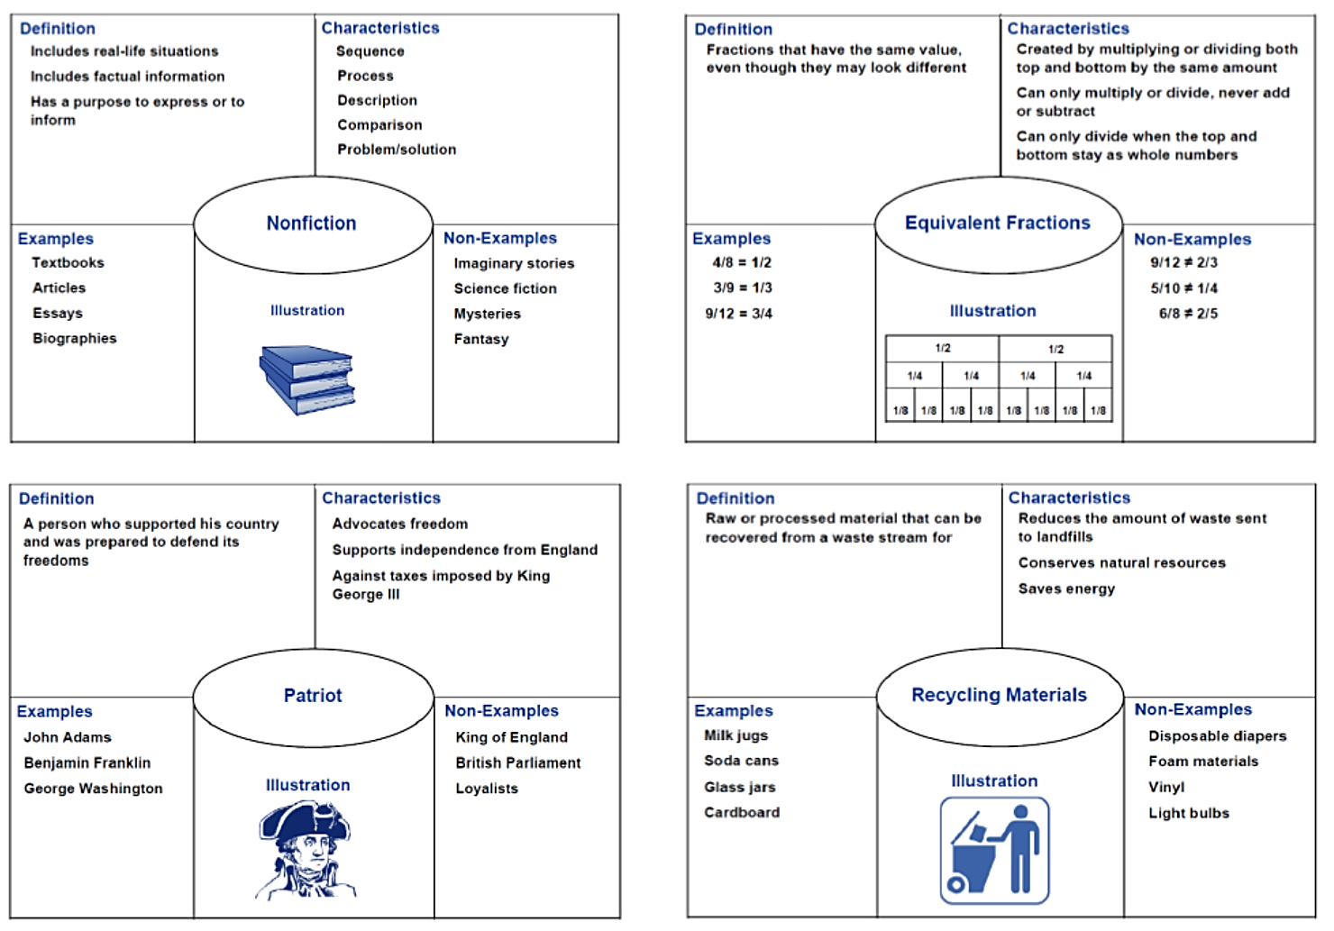
Frayer Model Vocabulary Graphic Organizer
Frayer Model
Notes:
This strategy works in every class. Your folder includes Handout 2: Frayer Model Vocabulary Graphic Organizer: Examples for All Classes, a page of examples for history/social studies, mathematics, language arts, and science. Take a moment to review these.
At your table, discuss what advantage you see to all teachers using the same type of strategy for learning new vocabulary words. Ask a few to share their thoughts.
Your folder includes a few blank copies of Handout 3: Frayer Model Vocabulary Graphic Organizer that you can use at home. When you need more, you and your child can draw the Frayer Model.
This is one vocabulary strategy. Your children’s teachers are using other vocabulary strategies throughout the year. Ask your child to teach you a new vocabulary strategy from time to time and to share different vocabulary graphic organizers with you.

Slide 9

Comprehension Strategies
Comprehension Strategies
Notes:
Comprehension is the understanding and interpretation of what is read. The reader must be able to put the pieces together to make sense of the text.
Again, think back to when you were in the same grade as your child. Did a reading assignment in social studies feel overwhelming? Did you automatically understand what you were given to read in science? Did you feel like you were the only one who didn’t understand? Share your experience with your child or a table partner.
After sharing: Reading informational text does not come naturally for all readers so our students are learning strategies to better understand informational text in all their classes. Whether they are in language arts, history, social studies, mathematics, or science class, they will be better prepared to understand what they read.
Comprehension strategies are routines and procedures that readers actively use to help them make sense of texts. There are many comprehension strategies, but let’s look at one.

Slide 10
Think Aloud
Think
Aloud
Notes:
Because it is not expected that all students understand everything on their own, this strategy allows students to hear every step of an activity. Think aloud literally calls for the teacher to speak what she or he is thinking. Teachers model step-by-step thinking for students, so students can identify that steps lead to accomplishing a task or comprehending the text.
I used the think aloud strategy as I introduced how to do the vocabulary strategy. Imagine if you were just shown the example then told to complete one on your own.
Turn to a partner and share how the think aloud strategy and step-by-step modeling supported your learning.

Slide 11
Before During After
Before During After
Notes:
Our teachers and students are learning many strategies to support the comprehension of written text. One way is to investigate the text before, during, and after reading. Instead of asking you to read several texts, we are going to use pictures to model the strategy.
Each picture tells a story. Before we “read” a picture, our investigation will be to preview the picture or identify what we see and predict what we think the picture is communicating.
As we “read” further into a picture, we will determine what is happening, or we will connect the main idea to the picture.
To complete our strategy, we will think about how we respond to the picture. What does it make us think about? Let’s get started.

Slide 12
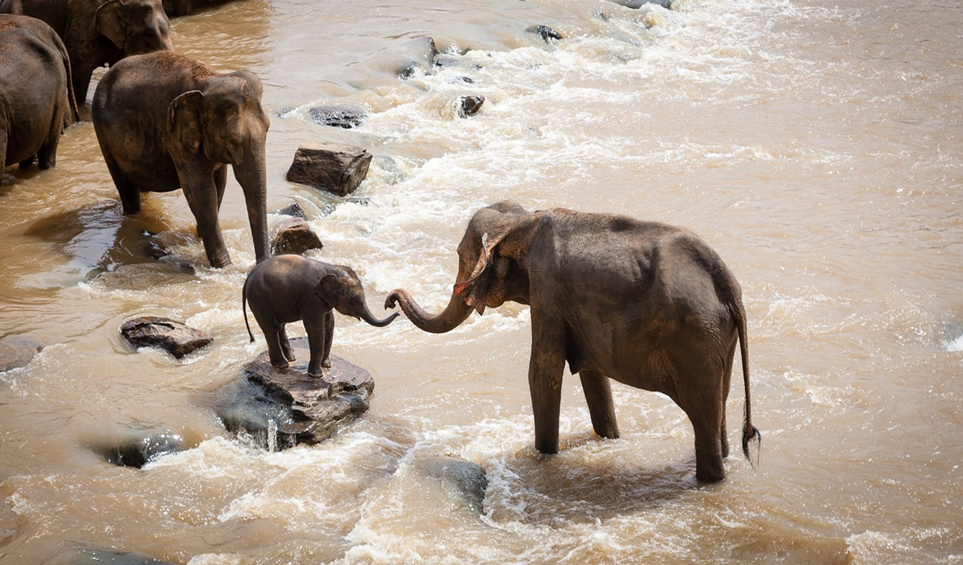
Baby elephant in the water
Notes:
I am going to think aloud and model the strategy of reading before, during, and after to comprehend informational text, or in this case, the picture.
Before reading:
As I preview the picture, I need to think about what is happening. I notice that the baby elephant looks like he doesn’t want to get into the river. I would ask myself the question, why won’t the baby elephant get into the water?
“Reading” the picture, I think the baby elephant won’t get into the water because he is afraid.
Then, I would ask myself what can the mother elephant do to help her calf get into the water? It looks like she is trying to help her calf by holding his trunk with hers to guide him into the water. I think that is what she is doing because that’s exactly what mothers do!
During reading: I am going to read a few sentences about this picture that would be the written text. Try to connect what I am reading to what you are seeing.
This picture represents informational text about the maternal instincts of a mother elephant with her calf. In the first few months of life, calves are so small that they walk under their mother seeking shade and protection. Mother and calf remain very close, regularly touching and smelling each other. The mother often touches her calf with her trunk and legs to guide her baby. Elephants bathe in rivers, and the mother will use her trunk to spray her calf with water and then scrub it. Female elephants stick together and form strong bonds with other elephants in the herd.
After reading: Because mother elephants are close to their calves and bathe them in rivers, I think I know what the mother is saying, and I can guess what the calf is thinking. I think the mother is saying, come on and get in the water, and the baby is thinking, NO WAY!! ☺
I responded to this picture because it reminded me of what my mother would do to help me.

Slide 13
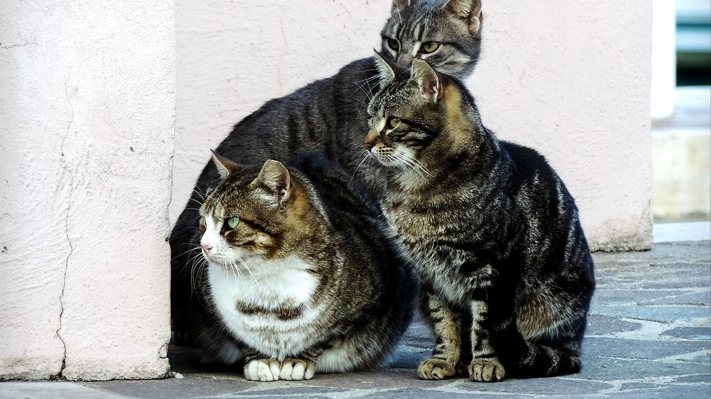
Three cats watching something
Notes:
I modeled my thinking and my thought process. Now let’s practice thinking aloud together.
Before reading: Let’s preview this picture. It looks like three cats watching something. Maybe they are watching someone walking down the sidewalk. What do you think the cats are doing? Ask for a few answers.
During reading: I am going to read a few sentences about this picture that would be the written text. Try to connect what I am reading to what you are seeing.
Community cats typically live in a colony—a group of related cats. The colony occupies and defends a specific territory where food like a restaurant dumpster and shelter like an abandoned building are available. Cats are territorial animals who can survive for weeks without food and will not easily or quickly abandon their territory. As they grow hungrier and more desperate, they tend to venture closer to homes and businesses in search of food.
After reading: I responded to this because I have seen cats like these in my neighborhood. It’s good to know that they form their own community. How did you respond? Ask for a few answers.

Slide 14
I do. We do.
I Do.
We do.
You Do!
Notes:
You are going to do one with your partner. This time you will use Handout 4: Before, During, and After Reading: Wildfires. You will find it in your folder. I will guide you through the steps.
Before you begin let’s “read” the handout. This is an important step. It helps you know what you are expected to do. It has three pictures. One is a forest. One is a forest fire, and one is a forest after a fire. Beside the pictures there is a paragraph titled Healthy Forests.
Below that are words and blanks that let you know you will have to write something.
Below that there are three sections.
The preview section says: We predict the information will say ___________.
The connect section says: The main idea of the article is ____________.
The respond section says: The article made us think about ______________.

Slide 15
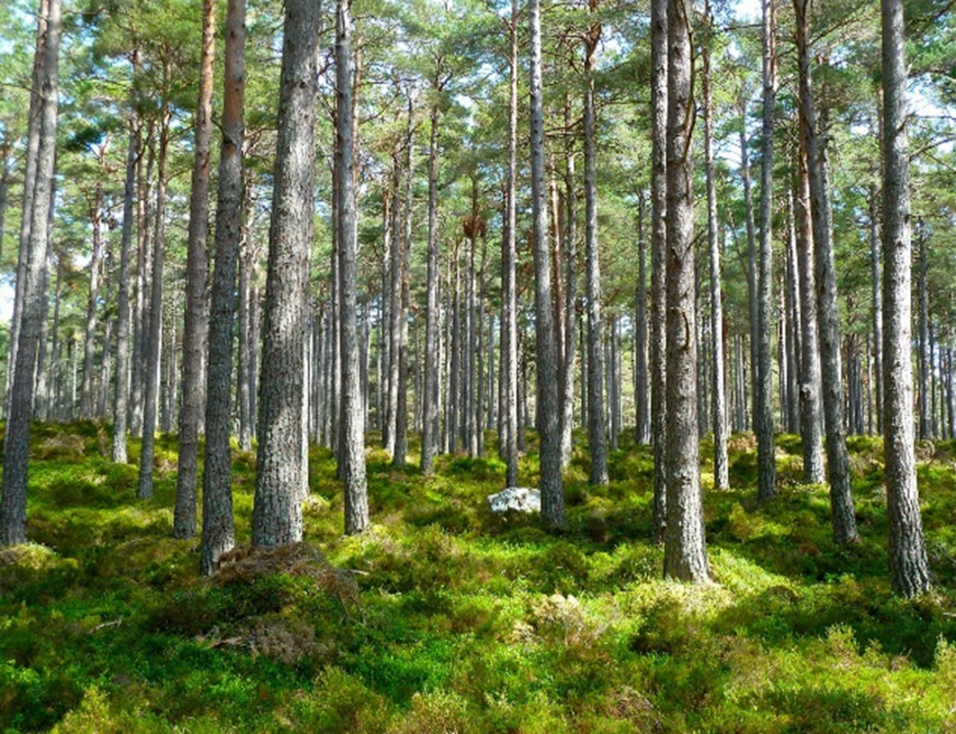
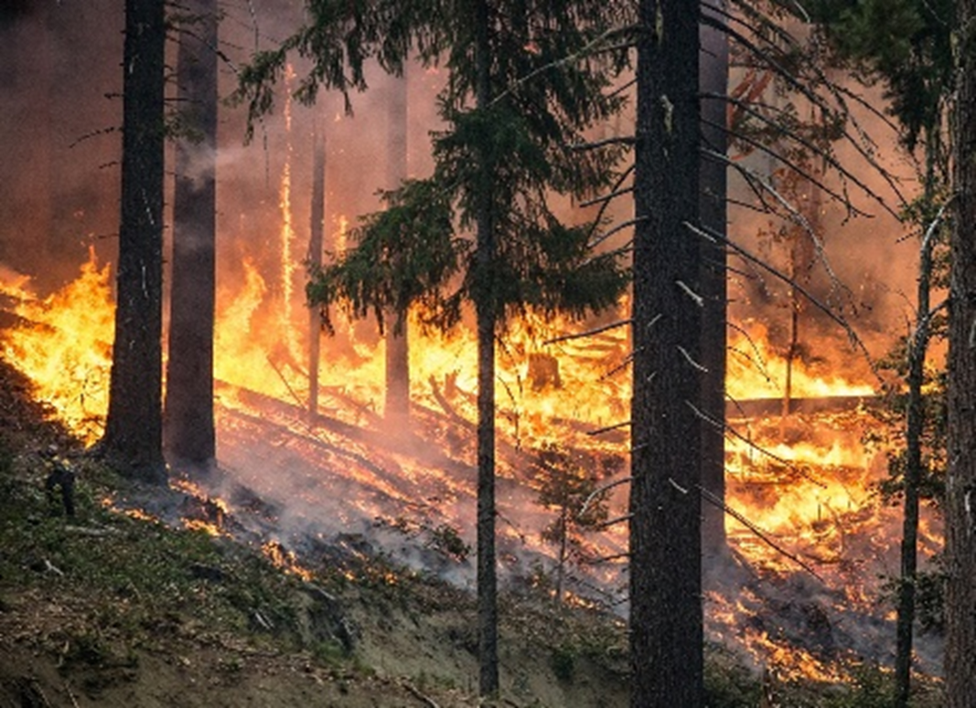
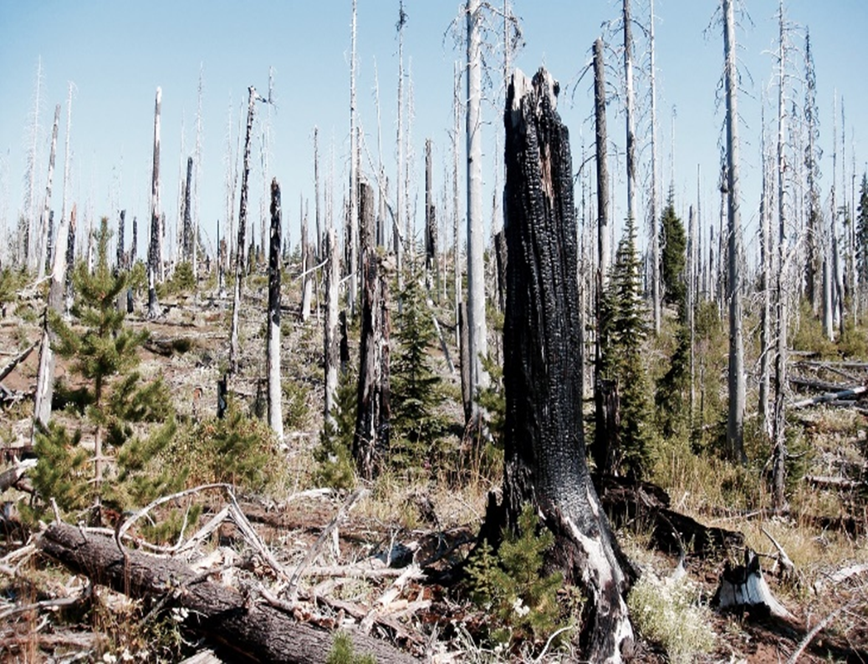
Forest fire before and after
Notes:
Now that we have “read” the handout, let’s begin with the before reading task on the bottom left. With your partner, preview the pictures and discuss what you see and what you predict the informational text will say. You can write your answers in the space provided.
Allow time to complete this before moving on.
During reading, you should be listening for clues as to what the paragraph says. I will now read the paragraph:
Arizona has six National Forests where wildfires occur. While they are harmful to humans, wildfires are part of nature and are critical to maintaining the health of forests. A natural wildfire caused by lightning is part of the forest’s cycle of a life. When the forest is no longer able to support the plants and animals, the wildfire burns away the dead and decaying trees returning nutrients to the soil. After a wildfire, sunlight can reach the forest floor, helping a new generation of seedlings to grow.
With your partner, discuss the main idea of the paragraph. If you had to describe what the paragraph says in a few words, what would that be? You can write your answers in the middle space.
Allow time to complete this before moving on.
For after reading, discuss how you responded to the information. What did it make you think about? You can record your answer in the space on the right.
Allow time to complete this before moving on.
With your table group, share how this activity helped with better understanding what the paragraph was about and how this strategy can benefit students.

Slide 16
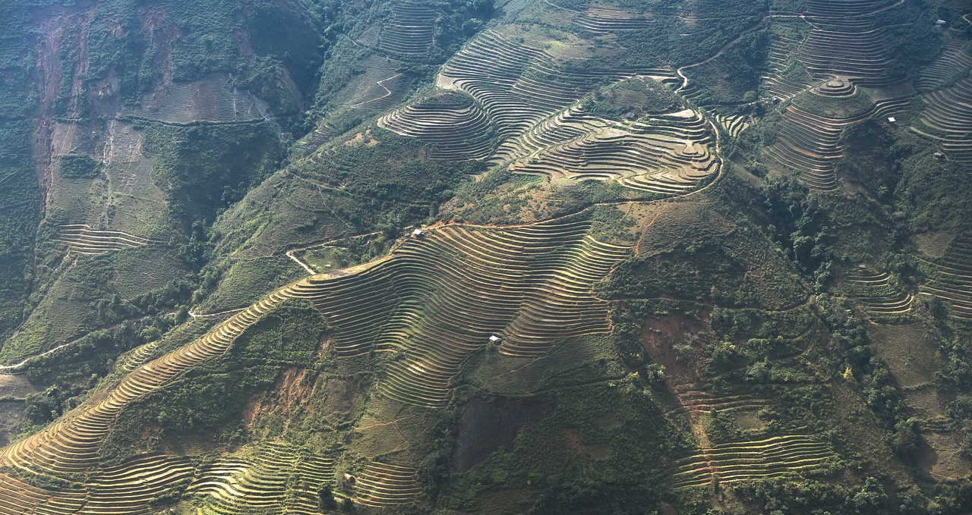
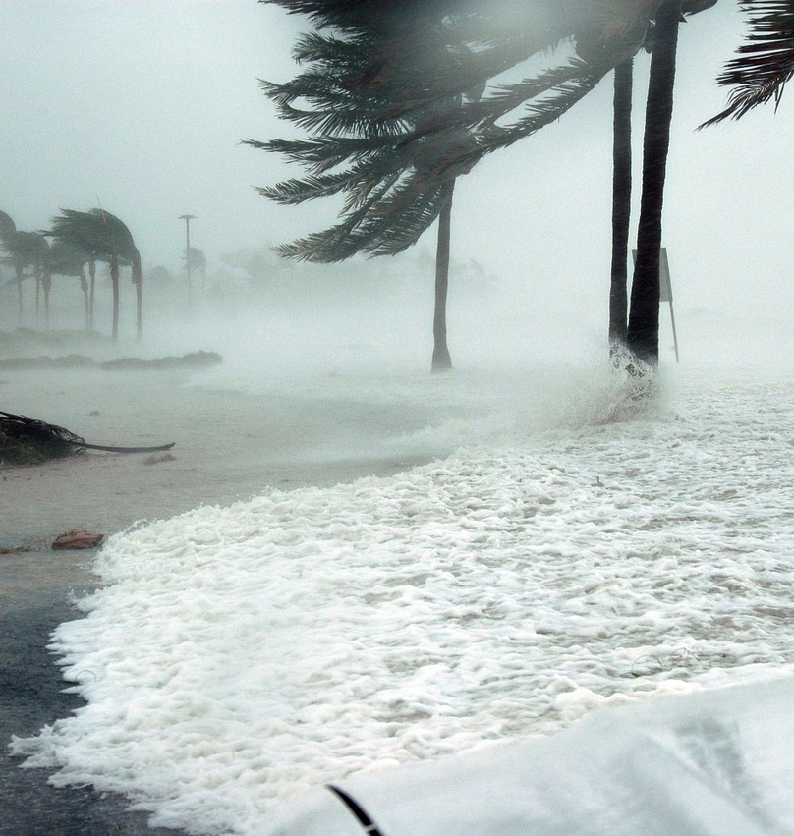
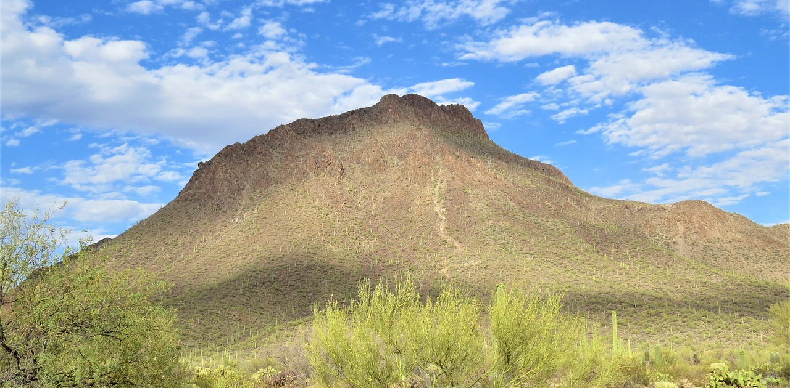
Hurricanes; Before, During, and After
Notes:
Your folder includes Handout 5: Before, During, and After Reading: Hurricanes; Handout 6: Before, During, and After Reading: Sky Islands; and Handout 7: Before, During, and After Reading: Terrace Farming to practice the before, during, and after reading strategy at home with your child.
This is one comprehension strategy. Your child will use other comprehension strategies throughout the year. Ask your child to teach you a new comprehension strategy from time to time.

Slide 17

Parents
You’ve
Got This!
PARENTS
Notes:
Parents, thank you for collaborating with us today and for supporting your child’s learning every day. We look forward to seeing you at the next AZPLS Parent Meeting so we can share more strategies with you.
Optional: Ask the parents to fill out a survey about the presentation.

Slide 18
AZ Department of Education ESS
Arizona Department of Education
Exceptional Student Services

