Slide 1

Module 4
Arizona Department of Education
Arizona Professional Learning Series: Increasing Literacy Achievement for All Students
Module 4
Notes:
Today, we continue our AZPLS journey of schoolwide systems change that will lead to increased literacy achievement for all students. Specifically, we will focus on explicit vocabulary and direct and explicit comprehension instructional strategies to meet the needs of all learners.

Slide 2
AZPLS Norms
AZPLS
Begin and end on time.
Silence cell phones.
Limit distractions to breaks.
Respect all voices.
Others?
NORMS
Notes:
Process norms set ground rules or expectations for how people treat each other at a meeting or professional learning. The AZPLS Norms focus on respecting all participants. Look over the norms listed on the poster. Are there additional norms you would like to discuss?
Please raise your hand if you agree with the norms we have.

Slide 3

Collaborative Teams
Collaborative Teams
Notes:
To assign roles for our work today, add the number of letters in your first and last names. The team member with the highest number is assigned the Facilitator role. The person with the lowest number is the Recorder.
Next, use your middle names. The name closest to the beginning of the alphabet is the Reporter, and the name closest to the end of the alphabet is the Timekeeper. The remaining team members are Engaged Participants.
Please place your Role Cards in front of you.
Take a moment to review your Team Norms and come to consensus on your learning culture for today. If any norms need to be discussed or added, please do so. This sets the tone for your collective commitment as a team.
Your individual commitment today will support your team. Review Handout 19: Collaboration Skills. Don’t write anything down. Just read through it and reflect on how you can effectively collaborate with your team. We will come back to this handout and self-assess at the end of our professional learning today.

Slide 4







Series Module Overview
Module 3 Formative Assessment
Module 4 Literacy Strategies
Module 5
Literacy
Strategies
Module 2 Collaboration
Module 1 Introduction
Module 6 Differentiation
Notes:
Handout 1: Arizona Professional Learning Series Module Overview is a brief outline of the modules and indicates how they build on each other.
Modules 1 and 2 outlined the frameworks for the systems change that leads to increased literacy achievement for every student.
Module 3 identified the Dimensions of Formative Assessment with Learning Goals, Criteria for Success, and strategies to move learning forward for all students.
The first three modules built the foundation that supports the evidence-based teaching and learning strategies in the remaining modules.
This module continues the systems change process by introducing and collaboratively using explicit vocabulary and direct and explicit comprehension strategies to support all students and increase their achievement in all content areas.

Slide 5

Explicit comprehension strategies
Explicit Vocabulary Strategies
Direct and Explicit Comprehension Strategies
Action Plan Priorities
4
Notes:
Today, our focus is on explicit vocabulary and direct and explicit comprehension strategies that can be used by all teachers, including content teachers.
The strategies we will explore today are not only for you. They are also for your students. We want all students to be engaged in their learning and teaching them strategies gives them tools to be successful.
Collaborative strategy implementation positively impacts every student and will improve learning for struggling readers and students with specific learning disabilities. All students will understand that everyone is working towards the same goal, but individual students may have a different way to get there. This is accepted and supported by all.
When strategies are implemented in a collaborative way by all teachers, students will be able to identify stable and supportive efforts in all classes. This will reinforce high expectations for all students, and student achievement will increase.
Remember everyone has input as to what the Action Plan should include. At specific points during today’s work, you will clarify action items to continue your learning and systems change. From that input, the Building Leadership Team will create and share the formal Action Plan with you. Everyone will be responsible for implementation and will be supported by the Building Leadership Team and coach.

Slide 6

What literacy skills do students need to have success?
How could specific literacy strategies link to increased literacy achievement for all students?
How could collaboration reinforce evidence-based literacy strategies across all content areas?
Notes:
Collaboration takes place when all members of an inclusive learning community work together as equals to assist students to succeed in the classroom.
To help frame your thinking around the Learning Goals for today, take a few minutes to reflect on these two ideas and how they can impact your teaching and student learning.
Share your thoughts with an elbow partner.

Slide 7
Professional Learning Process
Professional Learning Process
Where are we headed?
Where are we now?
How will we close the gap?
Notes:
Let’s review our strategy that centers your professional learning for this module.
Where are we headed? We are building on our foundation for increasing literacy achievement by collaboratively implementing literacy strategies across all content areas to increase student outcomes.
Where are we now? We are implementing Learning Goals and Criteria for Success from the Dimensions of Formative Assessment. This is the foundation for building instructional practices that support all students becoming independent learners.
How do we close the gap between our current reality and where we are headed? All teachers will share the responsibility of implementing teaching and learning strategies that connect to Handout 2: Arizona English Language Arts Anchor Standards and support literacy strategies across all content areas.

Slide 8
Individual and Team Implementation
Where are we headed?
Where are we now?
Individual and Team Implementation
How will we close the gap?
Notes:
Review the rubrics for Dimensions 1 and 2 on pages 8 and 9 in your Formative Assessment Rubrics, Reflection, and Observation Tools for Teachers. Reflect on your individual implementation of Learning Goals and Criteria for Success. Think about where you are on the rubric: Not Observed, Beginning, Developing, Progressing, or Extending. Using Handout 3: Individual Implementation of Learning Goals and Criteria for Success, record where you are headed, where you are now, and how you will close the gap.
When individuals finish: Share your reflections with your Collaborative Team members as you work together using the three questions to examine your implementation as a Collaborative Team. Recorders, add team responses to Poster 7: Collaborative Team Implementation of Learning Goals and Criteria for Success.
Reporters, share a summary of your teams’ reflections.
The Building Leadership Team (BLT) and coach will use this information to address your challenges and provide support.

Slide 9
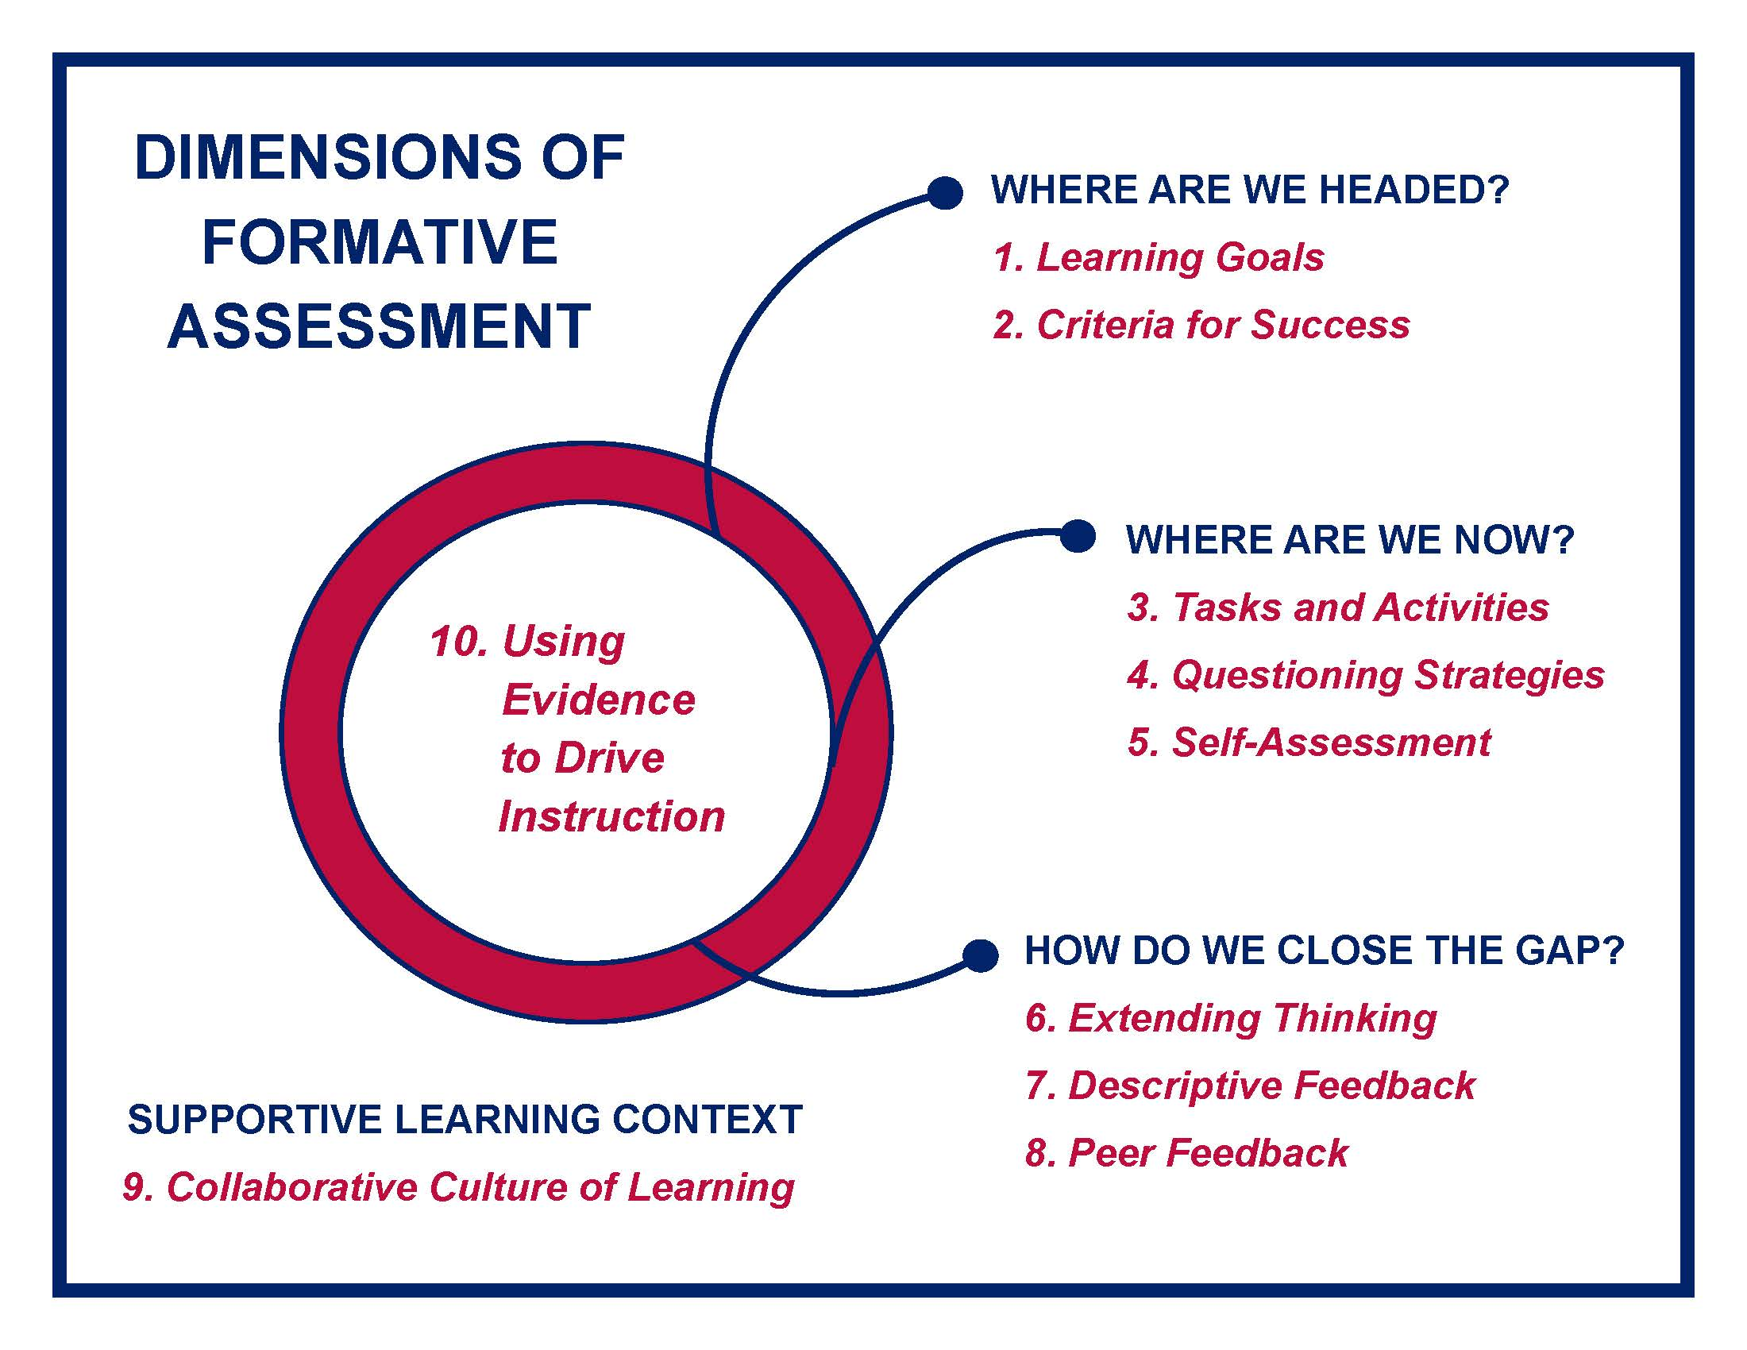
Dimensions of formative assessment
Notes:
Our work today builds onto Dimensions 1 and 2. We will identify explicit vocabulary and explicit and direct comprehension teaching and learning strategies to support Dimension 3, Tasks and Activities that Elicit Evidence of Student Learning.
Read the Dimension 3 description on the top of page 10 in your Formative Assessment Guide.

Slide 10
If/Then
IF
THEN
teachers have rich evidence of student learning and make instructional adjustments based on that evidence,
student
learning improves!
Notes:
Dimension 3 focuses on those things with which students engage that potentially produce evidence of student learning. We will identify what they are, their importance for student success, and how to use them effectively.
The strategies introduced today are representative of active learning strategies for all students to be used individually and in small groups. These explicit vocabulary and direct and explicit comprehension strategies are tools to support all students’ learning while providing teachers a way to quickly assess the students’ levels of understanding and possible needs for additional support.

Slide 11
Simple View of Reading
D
LC
RC
Simple View of Reading
Notes:
The Simple View of Reading provides a foundation for our learning today. It is a scientific theory that attempts to define the skills that contribute to early reading comprehension. Over 150 scientific studies have been conducted to validate the formula’s premise across age levels, reading skill levels, multiple languages, and a variety of educational disabilities (Kilpatrick, 2020).
According to the original theory (Gough and Tunmer, 1986), an individual's reading comprehension is the product of decoding skill and language comprehension. The key idea is that both the ability to decode and language comprehension are necessary for reading comprehension.
The formula is D times LC equals RC. D stands for decoding, the ability to apply sound-symbol relationships to read words. LC stands for language comprehension, the ability to understand spoken language. Decoding times language comprehension equals reading comprehension (Gough and Tunmer,1986 and Hoover and Gough, 1990).

Slide 12
Decoding and Language Comprehension
D(0) X LC(1) = No RC
D(1) X LC(0) = No RC
D(1) X LC(1) = RC
Language Comprehension
Reading Comprehension
Decoding
Notes:
Notice that Decoding and Language Comprehension are not added together to predict Reading Comprehension. They are multiplied. In the Simple View of Reading formula, the values of D and LC are 0 or 1. This represents 0% and 100%. A score of 0 means no skill or ability at all and 1 indicates perfection. If either D or LC is 0, Reading Comprehension will not occur because 0 X 1 = 0 or 1 X 0 = 0. Both D and LC must be a 1 (1 X 1 = 1) for reading comprehension (Farrell, Hunter, Davidson, and Osenga, 2019).
Dr. Louisa Moats, a nationally recognized authority on how children learn to read, stated that reading comprehension is the product of word recognition and language comprehension, and without strong skills in either domain, an individual’s reading comprehension will be compromised (2020).
We must provide early reading instruction that ensures students become strong decoders because once decoding is strong, the only limit to reading comprehension is the student’s knowledge of the subject he is reading about and his ability to synthesize the information. (Farrell, Hunter, Davidson, and Osenga, 2019).

Slide 13
Institute of Educational Sciences
Vocabulary Knowledge
Analyze Word Parts
Connect to Text
Comprehension
Institute of Education Sciences
Notes:
Keeping the Simple View of Reading in mind, we will identify the first two research-based recommendations from the Institute of Education Sciences (IES) for teaching and learning strategies with Handout 4: Institute of Education Sciences (IES) Reading K–3 and 4–8 Recommendations. This shows how the skills for grades K–3 and grades 4–8 fuse together. Skills for grades 4–8 develop and build from the foundational skills for grades K–3.
As we work with each activity, K–3 teachers should be thinking how it fits into their instruction. By incorporating the same strategies, you will be building the literacy strength of your students as they move into grades 4–8.
The teaching and learning strategies that benefit students with specific learning disabilities will benefit every student in your classes, including students at-risk, students with English as their second language, and students at and above grade level.
Throughout this module, we encourage you to identify how these strategies can fit the needs of your students and how you can collaborate with your team to collectively reinforce strategic teaching and learning.

Slide 14

Aligning Efforts
ELA Standards
Aligning
Efforts
Increased Achievement
IES Recommendations
Notes:
To increase literacy achievement for all students in all classes, we are making the connection between the Arizona K–12 English Language Arts Anchor Standards, the Simple View of Reading, and the Institute of Education Sciences (IES) evidenced-based recommendations for improving literacy levels among adolescents in upper elementary, middle school, and high school.
The IES purposefully included students in 4th and 5th grades within the realm of adolescents because their instructional needs related to literacy have more in common with those of students in middle school and high school than they do with students in early elementary grades.
These recommendations and the vertical alignment of the Arizona K–12 ELA Standards fit the AZPLS goal of increasing literacy achievement for the collaborative literacy work of teachers in grades 4–8.
Many students in grades 4 and up experience difficulty acquiring the advanced literacy skills needed to read in the content areas (IES, 2008; Biancarosa and Snow, 2004; Heller and Greenleaf, 2007). The Simple View of Reading and the Reading Standards for Foundational Skills in Grades K-3 form the basis for Improving Adolescent Literacy through Effective Classroom and Intervention Practices. Students in grades 4–8 build on the foundation of decoding skills and language comprehension that supports continued use with higher-level mental processes that include thinking, reasoning, imagining, and interpreting for reading comprehension (Kamhi, 2007).

Slide 15
Provide explicit vocabulary instruction
1
Provide explicit
vocabulary instruction.
Notes:
The first IES recommendation is to provide explicit vocabulary instruction. The term vocabulary refers to a student’s knowledge of, and memory for, word meanings. Vocabulary knowledge is demonstrated not only through reading and writing, but also through oral language of listening and speaking.
The high correlation in the research literature of word knowledge with reading comprehension indicates that if students do not adequately and steadily grow their vocabulary knowledge, reading comprehension will be affected (Chall and Jacobs, 2003).
According to Stahl and Nagy (2006), teachers can help students establish high-quality, elaborate mental connections in memory as student learn new words by:
Multiple encounters with words, most likely through reading, being read to, and/or being surrounded by a language-rich environment.
Direct, planned, explicit teaching of selected words.
Handout 5: Standard Vertical Alignment and IES Recommendation 1 connects the Arizona ELA Anchor Standard to interpret words and phrases as they are used in a text, including determining technical, connotative, and figurative meanings, and analyze how specific word choices shape meaning or tone to Recommendation 1.
The literacy strategies being shared for teaching and learning explicit vocabulary apply to what students need to know and understand under the Arizona English Language Arts Standards: Reading Standards for Literature and Reading Standards for Informational Text for grades K–8. The K–3 foundational decoding skills support the vocabulary needs of students in grades 4–8.
Review the Standard’s progression and discuss the importance of your grade level work building on the Standard from the grade level before yours and supporting the grade level after yours.
When teams finish: Handout 5 also provides a checklist to support implementing Recommendation 1. Informational text is used in all classes so all teachers should implement the checklist items.
Review the checklist and discuss how your team can collaborate to support vocabulary across all classes in your grade level.

Slide 16
Tiered Academic Vocabulary
Tiered Academic Vocabulary
3
Technical Words
2
Frequent Words
1
Basic Words
Notes:
To expand and accelerate vocabulary growth, students need explicit instruction in the words they will encounter frequently in textbooks and other print materials and media (Beck et al., 2002; Beck et al., 2005; Beck et al., 2007; Stahl et al., 1986).
All teachers should provide students with explicit vocabulary instruction both as part of reading and language arts classes and content area classes such as math, science, history, and social studies. By giving students explicit instruction in vocabulary, teachers help them learn the meaning of new words and strengthen their independent skills of constructing the meaning of text.
Bringing Words to Life: Robust Vocabulary Instruction (Beck, McKeown, and Kucan, 2013) describes tiered academic vocabulary. Tier One consists of the most basic words—clock, baby, happy—rarely requiring instruction in school. Tier Three includes words whose frequency of use is quite low, often being limited to specific domains—isotope, lathe, peninsula—and probably best learned when needed in a content area. Tier Two words are high-frequency words for mature language users—coincidence, absurd, industrious—and thus instruction in these words can add productively to an individual's language ability.
With your team members, share one vocabulary strategy you currently use with your students for Tier Two and Tier Three words. Use the top section, Current Vocabulary Strategies Used, of Handout 6: Strategic Conversations for Vocabulary to record the shared strategies.

Slide 17
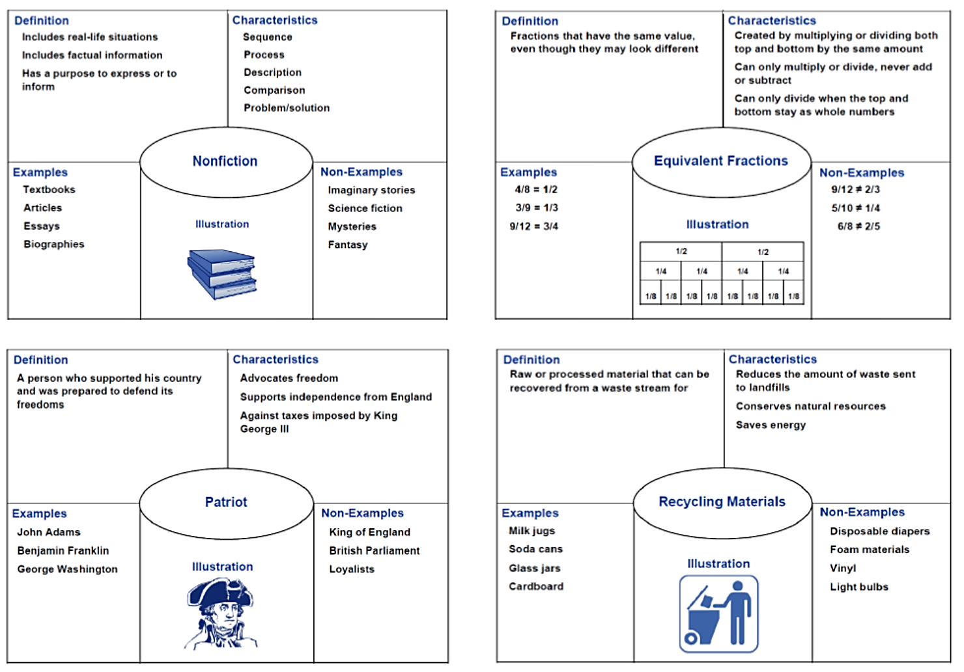
Frayer Model
Frayer Model
Notes:
As you are introduced to strategies today, it is important to think about how you can use them with all students in all classes.
Graphic organizers are proven effective for students with and without learning disabilities across all grade levels and in all content areas (Ellis & Howard, 2007). Graphic organizers support students through visualizing their learning.
As with all strategies when introducing a graphic organizer, it is essential to teach students the purpose for the tool and how to use it. Teachers need to think-aloud through the process to model how to use the graphic organizer.
The Frayer Model prompts students to explore vocabulary beyond the definition. Listing characteristics help the students relate to the word. Examples and non-examples help the students clearly distinguish the word. Illustrating the word provides a visual connection.
Take a moment to review Handout 7: Frayer Model Vocabulary Strategy Examples for All Classes. Share your thoughts on how this same strategy can support students in all classes and discuss the benefits of all classes using this vocabulary strategy.
Using Handout 6: Strategic Conversations for Vocabulary, record your notes in the middle section, Module Explicit Vocabulary Strategies.

Slide 18
Word Web
Word Web
Notes:
A word web is a vocabulary strategy that provides a better understanding and connection with multiple meanings of a vocabulary word. Handout 8: Word Web is an example for the word, chunk. The word is often referenced in literacy skills as we teach students how to chunk parts of words, sentences, paragraphs, and larger text structures.
Take a moment to review Handout 8: Word Web. Share your thoughts on how this same strategy can support students in all classes and discuss the benefits of all classes using this vocabulary strategy.
Using Handout 6: Strategic Conversations for Vocabulary, record your notes in the middle section, Module Explicit Vocabulary Strategies.

Slide 19
Word Parts
Related to pronunciation of words
Syllable
Word Parts
Related to meaning and structure of a word
Morpheme
Notes:
Understanding syllable types and morphological awareness with new vocabulary is helpful for every student. Syllable types are taught early in the Arizona Reading Standards: Foundational Reading Skills. It is important for students to recognize syllables in words for both decoding and learning new vocabulary.
Starting in grade 4, the Arizona Reading Standards: Foundational Reading Skills require students to use combined knowledge of morphology (e.g., roots and affixes) to read grade level words accurately.
As students become more proficient readers, understanding morphological awareness is important. It helps students identify and understand difficult academic vocabulary by identifying morphemes, or meaningful word parts, such as prefixes, bases, roots, and suffixes. Knowledge of morphemes plays a valuable role in learning vocabulary because it provides readers with information that can be used to examine unfamiliar words and figure out their meanings (Edwards, Font, Baumann & Boland, 2004; Stahl & Nagy, 2006).
Morphology should be taught as a cognitive strategy to be learned. To break a word down into morphemes, or word parts, students must complete the following four steps:
1. Recognize that they do not know the word.
2. Analyze the word for recognizable morphemes, both in the roots and
suffixes.
3. Think of a possible meaning based upon the parts of the word.
4. Check the meaning of the word against the context of the reading.
Students who understand how words are formed by combining prefixes, suffixes, and roots tend to have larger vocabularies and better reading comprehension than peers without such knowledge and skills (Prince, 2009). A deep and full knowledge and understanding of vocabulary will improve outcomes for students who struggle.

Slide 20
Root word
dis-order
bio-sphere
tri-angle
hemi-sphere
Notes:
When teaching word parts, make sure students know the terms: root word, prefix, and suffix.
A root word is the most basic part of a word. It has no prefix or suffix.
A prefix is a morpheme placed before the root of a word.
A suffix is a morpheme placed after the root of a word.
An example for history is the word dis-order. The word includes the prefix dis. The root word is order. The prefix dis, from Latin, means lack of or not (American Institute of Research). Other examples include bio-sphere for science, tri-angle for math, and hemi-sphere for geography.
All teachers can scaffold the learning of all students in all classes by chunking vocabulary words by morphemes. When a specific vocabulary word comes up in your lesson, chunk words into sub-parts. Explicitly point out the word’s morphologic structure and meaning.
Handouts 9A–9D: Common Latin Origins, Common Greek Origins, Common Prefixes, and Common Suffixes are reference sheets. Take a few minutes to review these examples. Share your thoughts on how this same strategy can support students in all classes and discuss the benefits of all classes using this vocabulary strategy.
Using Handout 6: Strategic Conversations for Vocabulary, record your notes in the middle section, Module Explicit Vocabulary Strategies.

Slide 21

Context Clues
Definition
Synonym
Antonym
Example
General
Context Clues
Notes:
Context clues are hints provided by the author to support readers connecting their prior knowledge to interpret the vocabulary and message.
Using context clues is a process to help students determine the meaning of an unknown word that is critical to understanding the text. It is important to explicitly teach the process to identify context clues, interactively model the process, and provide ongoing practice opportunities. It is important to explain that context clues are the words, phrases, and sentences surrounding an unfamiliar word that can give hints or clues to its meaning. Caution students that although these clues can prove to be helpful, they can sometimes be misleading (Diamond and Gutlohn, 2006).
Handout 10: Context Clues includes the four-step process and examples of context clues for vocabulary. Read the handout and discuss how context clues can improve learning for every student in every class.
Record your notes on Handout 6: Strategic Conversations for Vocabulary in the middle section, Explicit Vocabulary Strategies.

Slide 22
STAR
S Select
T Teach
A Activate
R Revisit
Notes:
One guideline for providing explicit vocabulary instruction is to use the STAR framework (Blachowicz, Fisher, and Watts-Taffe, 2005).
Select words that are specific to understanding and comprehending the text. The premise of “less is more” should be followed. Three to five words should be selected if they are too difficult to understand without any background knowledge and are critical to comprehending the text (PREL, 2008).
Teach by using definitional, contextual, and usage information when teaching vocabulary. For example, present the word in context, discuss possible meanings, ask for a definition, ask students to use the words in a personal way.
Activate by giving students the opportunity to connect new words with other words they already know. Offer activities to make sure students repeatedly hear, read, write, and use the targeted words.
Use additional activities to revisit important words. Possible activities include unit reviews, games, writing assignments, vocabulary journals, and word books.

Slide 23
STAR Technique
S Search
T Translate
A Answer
R Review
Notes:
We want you to identify how every strategy can fit into all classes. The previous STAR technique works for reading, science, and social studies; however, the strategy can be adapted to work with math to solve any word problem (Maccini & Hughes, 2000; Maccini & Ruhl, 2000).
Search the problem for the vital information. Students read the problem aloud, underline the vital information, and then write important information.
The second step is to translate. Students represent the information with mathematical manipulatives, pictorial representations, or equations.
Students use their manipulatives, drawings, or numeric expressions to answer the given question. Students identify the appropriate operation, or sequence of operations, that will enable them to solve for the solution.
Students review the solution by checking their computation and ensuring their solution matches the given question.
Review the STAR Strategy. Share your thoughts on how this same strategy can support students in all classes and discuss the benefits of all classes using this vocabulary strategy.
Using Handout 6: Strategic Conversations for Vocabulary, record notes in the middle section, Module Explicit Vocabulary Strategies.

Slide 24
Concept Circles
AZPLS
Strategy Instruction
Concept Circles
Effective Learning
Increased Achievement
Notes:
It is important for students to move beyond memorization of terms and definitions. Handout 11: Concept Circles is an example of how to help students visually analyze the relationships between words (Vacca & Vacca, 2001). In this strategy, students can use a circle graphic organizer to analyze how vocabulary words are or are not related through a concept or topic.
Review Handout 11: Concept Circles. Share your thoughts on how this same strategy can support students in all classes and discuss the benefits of all classes using this vocabulary strategy.
Using Handout 6: Strategic Conversations for Vocabulary, record your notes in the middle section, Module Explicit Vocabulary Strategies.

Slide 25
Student Impact Implementation Action Planning
Student Impact
Implementation
Action Planning
Notes:
In the bottom section of Handout 6: Strategic Conversations for Vocabulary, use the sentence stems for if/then statements to discuss the student impact of collaboratively using explicit vocabulary strategies.
As a team choose one module explicit vocabulary strategy to implement across your grade level next week.
Answer the action planning question: What is needed to create, support, and sustain a schoolwide effort to collaboratively use evidence-based explicit vocabulary strategies?
Reporters, share the support your team needs for collectively implementing explicit vocabulary strategies.
Recorders, use the half sheets of paper and markers to add each team’s needs under the Action Planning Wall Heading: Explicit Vocabulary Strategies.

Slide 26
Strategic Conversations for Comprehension
2
Provide direct and explicit comprehension strategy instruction.
Notes:
Sometimes it is difficult to understand why struggling students don’t comprehend what they read. Those who read well seem to do so naturally. They can rapidly synthesize the information.
Reading does not come naturally for struggling readers. They have difficulty understanding what they read, and many students just stop trying. They are aware that they don’t read like other students, and they don’t want attention drawn to that. Their energy is spent on hiding their inabilities.
Comprehension strategies can help all readers through routines and procedures that readers actively use to help them make sense of texts. The second IES recommendation is to provide direct and explicit instruction in comprehension strategies to improve reading comprehension for all students.
The first page of Handout 12: Standard Vertical Alignment and IES Recommendation 2 connects Recommendation 2 with the Arizona ELA Anchor Standard to read and comprehend complex literary and informational texts independently and proficiently. It shows the vertical alignment for grades K–8.
Let’s take a few minutes to review the alignment, how the standard relates to Recommendation 2, and how both fit in with all classes.
When individuals finish: Handout 12 also provides a checklist to support implementing Recommendation 2. Informational text is used in all classes so all teachers should implement the checklist items.
Review the checklist and discuss how your team can collaborate to support comprehension across all classes in your grade level.
Share a comprehension strategy you currently use. Using the top section of Handout 13: Strategic Conversations for Comprehension, record the shared strategies.

Slide 27
Interactive Modeling
THINK
ALOUD
Interactive Modeling
Notes:
Learning how to learn cannot be left to students. It must be taught. (Gall, etal., 1990). The interactive modeling comprehension strategy is incorporated easily into daily teaching in every area. By thinking aloud, the teacher models a task or process. Modeling is a form of scaffolding, or a way of showing students how to approach a task such as identifying the main idea of a story (Sweet, 2000).
By verbalizing thought processes, teachers model step-by-step thinking for students. Students can identify those steps lead to accomplishing a task or comprehending the text. When teachers model how they address unfamiliar vocabulary, challenging concepts, and complicated text features, they build their students’ ability to succeed (Lapp et al., 2008).
In traditional modeling, the teacher shows students how to do something with the expectation that it will help them learn it. Interactive modeling also shows students how to do something, but it goes well beyond that basic step. Students will also learn exactly why the skill, routine, or procedure is important to their learning. Instead of being told to just watch the teacher, students are asked what they noticed about the teacher’s modeling. Students imbed learning by modeling for other students. Both the teacher and students provide positive feedback throughout the exercise.
Using Handout 14: Interactive Modeling Steps, take turns reading the steps aloud and clarifying how they impact the learning of all students. Discuss how you could implement interactive modeling collaboratively to support student learning.
Using Handout 13: Strategic Conversations for Comprehension, record your notes in the middle section, Direct and Explicit Comprehension Strategies.

Slide 28

Text Structures
Text Structures
Notes:
Teach your students to use the text structure strategy to unlock text for comprehension. Text structure is integrated throughout the Standards, is prominent in standardized tests, and refers to how the text is organized. Text structure strategies should be explicitly taught and practiced in all classes.
Students who have little knowledge of text structure have difficulty understanding how ideas are organized (Saenz and Fuchs, 2002). Being able to identify text structure and sort information accordingly supports students to better comprehend the text. It reveals the author’s purpose and allows one to focus attention better on the key information—the content (Shanahan, 2019).
Handouts 15A–15B: Informational Text Structures features the text structure strategies that are used to organize text in every content area. Using Handout 15A, read the information under Read and Review.
With Handout 15B, review the table of text structures and their purpose, guiding questions, signal words, and graphic organizer examples.
When individuals finish: Pick a partner to apply your knowledge of text features using Handout 15B. For each graphic organizer, choose two content areas: reading, mathematics, science, and history/social studies. Think of what you have recently taught or are going to teach to answer the questions for the first text structure. Change partners for each of the remaining text structures.
When partners finish: As a Collaborative Team discuss and answer the questions at the bottom of Handout 15A.
Using Handout 13: Strategic Conversations for Comprehension, record your notes in the middle section, Direct and Explicit Comprehension Strategies.

Slide 29


Text Features
Text Features
Notes:
Informational text features are the descriptive characteristics that help a reader move through informational text more easily. Informational text features are parts of a reading passage that stand out from the rest of the information. They are used to bring attention to important information. Text features chunk the information in an organized fashion.
Using Handout 16A–16B: Informational Text Features, read the information under Read and the table under Review. Read and Review provides information about text features, their purpose, and the text feature walk strategy.
When individuals finish: It is important to teach your students to use text features. One way to practice that is to do text feature walks. In a text feature walk, students work in small groups to read each feature in the order that it appears and discuss what they think they will be learning. Each feature discussion should relate to the main idea of the text.
To apply what you learned take a text feature walk with Handout 17: Paraeducators in Inclusive Classrooms. Take turns identifying a text feature and sharing what it might mean to the main idea of the text.
When you finish, discuss and answer the questions at the end of Handout 16B.
Using Handout 13: Strategic Conversations for Comprehension, record your notes in the middle section, Direct and Explicit Comprehension Strategies.

Slide 30
Before During After
Before During After
Notes:
Do we have any paraeducators in the room? How many teachers currently have paraeducators supporting students with disabilities in your classes? It is important to include paraeducators in the AZPLS. If time constraints limit paraeducator participation in AZPLS professional learning or Collaborative Team meetings, it is essential to have a plan to keep them informed.
We are going to use Handout 17: Paraeducators in Inclusive Classrooms as our informational text to practice the Before, During, and After Reading strategies.
The Before Reading strategies include setting a purpose for reading, activating students' prior knowledge, and making predictions. You have background knowledge about paraeducators, and you predicted what the article is about during the last activity. With a partner, review the Before Reading points in the top half of Handout 18: Before, During, and After Reading. Then, finish the Before Reading sentence starters.
When partners complete Before Reading: During Reading strategies help students make connections, monitor their understanding, generate questions, and stay focused. Review the During Reading points. While reading the informational text, look for connections to text structures, your background knowledge, and the main idea. When you finish reading, complete the During Reading sentence starters with your partner.
When partners complete During Reading: After Reading strategies provide students an opportunity to summarize, question, reflect, discuss, and respond to text. Review and discuss your connections to the After Reading points and finish the sentence starters.
When partners complete After Reading: Share your last statement with your Collaborative Team. Discuss how you can collaboratively incorporate the Before, During, and After strategy into your teaching. Using Handout 13: Strategic Conversations for Comprehension, record your notes in the middle section, Direct and Explicit Comprehension Strategies.

Slide 31
Student Impact
Student Impact
Implementation
Action Planning
Notes:
Using the bottom section of Handout 13: Strategic Conversations for Comprehension, use the sentence stems for if/then statements to discuss the student impact of collaboratively using direct and explicit comprehension strategies.
Then, as a team choose one module direct and explicit comprehension strategy to implement across your grade level next week.
Finally, answer the action planning question: What is needed to create, support, and sustain a schoolwide effort to collaboratively use evidence-based direct and explicit comprehension strategies?
Reporters, share the support your team needs for collectively implementing direct and explicit comprehension strategies.
Recorders, add your team’s needs under the Action Planning Wall Heading: Explicit and Direct Comprehension Strategies.

Slide 32
Let’s Review Our Learning Goals
How could specific literacy strategies link to increased literacy achievement for all students?
How could collaboration reinforce evidence-based literacy strategies across all content areas?
Notes:
As we wrap up our work today, let’s review our Learning Goals.
Reflect on how the strategies we explored will support increased literacy achievement.
Discuss the benefits of Collaborative Team implementation of the strategies we explored for all students, all teachers, in all classes.

Slide 33

Your Collaboration Skills
Your Collaboration Skills
Notes:
You participated in many collaborative activities today. Take a moment to reflect on your personal collaboration skills. Turn to Handout 19: Collaboration Skills and complete the checklist.
Discuss how each team member’s participation supported each other and the work of your Collaborative Team.

Slide 34

Action Planning
Action
Planning
Collective Input
Final Action Plan
Implementation
Coaching
Notes:
Today, you started creating a sustainable schoolwide collaborative learning culture with collective use of explicit vocabulary and direct and explicit comprehension teaching and learning strategies to increase literacy achievement for all students, including students with specific learning disabilities.
The Building Leadership Team will review your input and combine the information to create measurable Action Plan items for Module 4. The final Action Plan will be shared with every team. These are the items that everyone will work toward while implementing your Collaborative Team’s specific module strategies. Your AZPLS Coach will provide support for both activities. Handout 20: Module 4 Action Plan is the form the Building Leadership Team will use.

Slide 35


AZPLS strategy implementation
Supporting Literacy Achievement
For All Students
Notes:
Nurturing skill development with AZPLS strategy implementation increases literacy achievement. Collaboratively use these teaching and learning strategies and watch your students’ growth in vocabulary and comprehension skills in all classes.

Slide 36
Arizona Dept of Ed Exceptional Student Services
Arizona Department of Education
Exceptional Student Services

