Slide 1

Module 5
Arizona Department of Education
Arizona Professional Learning Series: Increasing Literacy Achievement for All Students
Module 5
Notes:
Today, we continue our AZPLS journey of schoolwide systems change that will lead to increased literacy achievement for all students. Specifically, we will focus on the Institute of Education Sciences Recommendation 3: Provide opportunities for extended discussion of text meaning and interpretation and feedback strategies to meet the needs of all learners.

Slide 2
AZPLS Norms
AZPLS
Begin and end on time.
Silence cell phones.
Limit distractions to breaks.
Respect all voices.
Others?
NORMS
Notes:
Process norms set ground rules or expectations for how people treat each other at a meeting or professional learning. The AZPLS Norms focus on respecting all participants. Look over the norms listed on the poster. Are there additional norms you would like to discuss?
Please raise your hand if you agree with the norms we have.

Slide 3

Collaborative Teams
Collaborative Teams
Notes:
To assign roles for our work today, add the number of states in which you have lived. The team member with the highest number is assigned the Facilitator role. The person with the lowest number is the Recorder.
Next, add the letters in the state in which you were born. The team member with the highest number is assigned the Reporter role, and the team member with the lowest number is the Timekeeper. The remaining team members are Engaged Participants.
Please place your Role Cards in front of you.
Take a moment to review your Team Norms and come to consensus on your learning culture for today. If any norms need to be discussed or added, please do so. This sets the tone for your collective commitment as a team.
Your individual commitment today will support your team. Review Handout 13: Collaboration Skills. Don’t write anything down. Just read through it and reflect on how you can effectively collaborate with your team. We will come back to this handout and self-assess at the end of our professional learning today.

Slide 4







Series Module Overview
Module 3 Formative Assessment
Module 4 Literacy Strategies
Module 5
Literacy
Strategies
Module 2 Collaboration
Module 1 Introduction
Module 6 Differentiation
Notes:
Handout 1: Arizona Professional Learning Series Module Overview is the brief outline of the modules and indicates how they build on each other.
Modules 1 and 2 outlined the frameworks for the systems change that leads to increased literacy achievement for every student.
Module 3 identified the Dimensions of Formative Assessment with Learning Goals, Criteria for Success, and strategies to move learning forward for all students.
The first three modules built the foundation that supports the teaching and learning strategies in the remaining modules.
Module 4 started building on that foundation with all teachers connecting with the Arizona English Language Arts Standards and Institute of Education Sciences (IES) Recommendations 1 and 2 for specific strategies that support explicit vocabulary and direct and explicit comprehension skills throughout the grade levels and content areas.
Today, we continue with Module 5 and IES Recommendation 3: Provide opportunities for extended discussion of text meaning and interpretation.

Slide 5

Explicit comprehension strategies
Extended Discussion of Text Meaning and Interpretation
Descriptive and Peer Feedback
Action Plan Priorities
5
Notes:
Today’s focus connects Handout 2: Arizona English Language Arts Standards and IES Recommendation 3: Provide opportunities for extended discussion of text meaning and interpretation. We will identify information and strategies that can be used by all teachers, including content teachers, and all students. Collaborative strategy implementation positively impacts every student and will improve learning for struggling readers and students with specific learning disabilities.
Our focus continues with the Dimensions of Formative Assessment for Descriptive and Peer Feedback. We will identify strategies linked to Learning Goals and Criteria for Success that improve the quality of students’ work.
Everyone has input as to what the Action Plan should include. At specific points during today’s work, you will clarify action items to continue your learning and support. From that input, the Building Leadership Team will create and share the formal Action Plan with you. Everyone will be responsible for implementation and will be supported by the Building Leadership Team and coach.

Slide 6

What literacy skills do students need to have success?
How can strategies for extended discussion of text meaning and interpretation and peer feedback impact the learning of all students in all classes?
Notes:
Collaboration takes place when all members of an inclusive learning community work together as equals assisting students to succeed in the classroom.
To frame your thinking around the module’s focus, take a few minutes to reflect on how using strategies to extend discussion of text meaning and interpretation and peer feedback could impact your teaching and all students’ learning.
Share your thoughts with an elbow partner.

Slide 7
Professional Learning Process
Professional Learning Process
Where are we headed?
Where are we now?
How will we close the gap?
Notes:
Let’s review our strategy that centers your professional learning for this module and frames our intention.
Where are we headed? We support the Dimensions of Formative Assessment Learning Goals, Criteria for Success, and Tasks and Activities by applying Questioning Strategies, Self-Assessment, Extending Thinking, Descriptive Feedback, and Peer Feedback. We implement strategies to support IES Recommendation 3: Provide opportunities for extended discussion of text meaning and interpretation.
Where are we now? We apply the Dimensions of Formative Assessment Learning Goals, Criteria for Success, and Tasks and Activities; connect with the Arizona English Language Arts Anchor Standards; and implement strategies that support IES Recommendation 1: Provide explicit vocabulary instruction and IES Recommendation 2: Provide direct and explicit comprehension strategy instruction.
How do we close the gap between our current reality and where we are headed? We close the gap between where we are now and where we are headed with all teachers collaboratively implementing teaching and learning strategies aligned to the Dimensions of Formative Assessment, Arizona English Language Arts Anchor Standards, and IES Recommendations for improving adolescent literacy.

Slide 8
Individual and Team Implementation
Where are we headed?
Where are we now?
Individual and Team Implementation
How will we close the gap?
Notes:
Review the rubric for Dimension 3 on page 10 of your Formative Assessment Guide and reflect on your individual implementation of Tasks and Activities. Think about where you are on the rubric: Not Observed, Beginning, Developing, Progressing, or Extending. Using Handout 3: Individual Implementation of Tasks and Activities, record where you are headed, where you are now, and how you will close the gap.
When individuals finish: Facilitators, ask your Collaborative Team members to share their reflections. Work together using the three questions to examine your implementation as a Collaborative Team. Think about how your work relates to Handout 2: Arizona English Language Arts Anchor Standards.
Recorders, add team responses to Poster 7: Collaborative Team Implementation of Tasks and Activities.
When teams finish: Reporters, share a summary of your teams’ reflections.

Slide 9

Aligning Efforts
ELA Standards
Aligning
Efforts
Increased Achievement
IES Recommendations
Notes:
In our last module, we made the connection of the Arizona K–12 English Language Arts Standards, the Simple View of Reading, and the Reading Standards for Foundational Skills in Grades K–3 forming the basis for Improving Adolescent Literacy through Effective Classroom and Intervention Practices. Students in grades 4–8 build on the foundation of decoding skills and language comprehension that supports continued use with higher-level mental processes that include thinking, reasoning, imagining, and interpreting for reading comprehension (Kamhi, 2007).
IES Recommendation 3 and the vertical alignment of the Arizona K–12 English Language Arts Standards fit the goal of increasing literacy achievement for students in grades 4–8 and the collaborative literacy work of teachers in grades K–8.

Slide 10
Provide explicit vocabulary instruction
3
Provide opportunities for extended discussion of text meaning and interpretation.
Notes:
For the IES Recommendation 3: Provide opportunities for extended discussion of text meaning and interpretation, teachers should provide opportunities for students to engage in high-quality discussions of the meaning and interpretation of texts in various content areas as one important way to improve their reading comprehension.
These discussions can occur in whole classroom groups or in small student groups under the general guidance of the teacher. Discussions that are particularly effective in promoting students’ comprehension of complex text are those that focus on building a deeper understanding of the author’s meaning or critically analyzing and perhaps challenging the author’s conclusions through reasoning or applying personal experiences and knowledge.
In effective discussions students have the opportunity to have sustained exchanges with the teacher or other students; present and defend individual interpretations and points of view; use text content, background knowledge, and reasoning to support interpretations and conclusions; and listen to the points of view and reasoned arguments of others participating in the discussion (Kamil, et al, 2008).
Handout 4: Standard Vertical Alignment and IES Recommendation 3 connects Arizona English Language Arts Anchor Standard SL.1 for comprehension and collaboration to IES Recommendation 3: Provide opportunities for extended discussion of text meaning and interpretation.
Take a few minutes to review the alignment, how the standard relates to
Recommendation 3, and how both fit in with all classes.
When teams are finished: Review the Standard’s progression and discuss the importance of your grade level work building on the Standard from the grade level before yours and supporting the grade level after yours.
Handout 4: Standard Vertical Alignment and IES Recommendation 3 also
provides a checklist to support implementing IES Recommendation 3. Review
the checklist and discuss how your team can collaborate to provide opportunities for extended discussion of text meaning and interpretation across all classes in your grade level.
When teams are finished: Reporters, share one collaboration with the group.

Slide 11
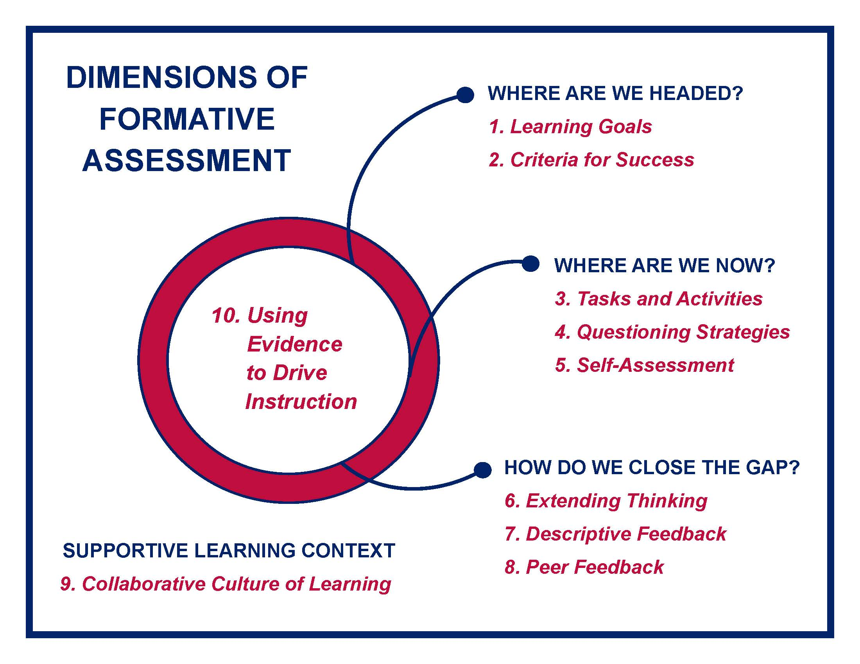
Dimensions of formative assessment
Notes:
Remember that the numbers of the Dimensions of Formative Assessment are only there as references for our work. The Dimensions are fluid.
We are going to examine Questioning Strategies and Extending Thinking first. Read the paragraphs at the top of pages 11 and 12 of your Formative Assessment Guide and skim the rubrics.
When teams are finished: In your Collaborative Teams, share one questioning and extending discussion strategy you currently use with your students. Use the top section of Handout 5: Strategic Conversations for Questioning and Extending Thinking to record the shared strategies.

Slide 12

Extended Discussion Activity
Extended Discussion Activity
Notes:
The U.S. Department of Education created a document that explains how teachers should provide opportunities for students to engage in high-quality discussions of the meaning and interpretation of texts in various content areas as one important way to improve their reading comprehension.
This informational text is in Handout 6: Extended Discussion of Text Meaning and Interpretation. We will also use Handout 7: Two Column Notes, a variation of the two-column note-taking strategy. The two-column note-taking strategy (Pauk, 2001) helps students organize topics and details supporting that topic. This strategy can be helpful to students during instruction or while reading informational text. The notes can then be used as a study guide.
Rather than read an entire article, we are going to use the Jigsaw strategy. This collaborative learning strategy asks a small group to become “experts” of a specific text and then share that material with another group. This strategy offers a way to help students understand and retain information while they develop their collaboration skills. Because students know they will be responsible for teaching the new content to their peers, they often feel more accountable for learning the material. Within your Collaborative Teams, number off 1 through 4.
Designate numbers 1–4 for the corners of the room. Taking Handout 6: Extended Discussion of Text Meaning and Interpretation and Handout 7: Two Column Notes, move to the corner of the room that matches your number.
After groups are settled: To engage students in high-quality discussions of text meaning and interpretation, teachers can do four things. Read only your corresponding numbered section of Handout 6: Extended Discussion of Text Meaning and Interpretation and discuss. Record notes on Handout 7: Two Column Notes.
When numbered groups are finished: Return to your Collaborative Teams to share and discuss your information.
After all team members have shared: Now that you all have shared your information, discuss how to summarize the information. Fill in your summary statement in the last section of Handout 7: Two Column Notes.
Ask Reporters to share their summary statements. Pull their comments together to demonstrate how each Collaborative Team’s input adds to the school’s goals.
Share your thoughts on how the Jigsaw strategy can support students in all classes and discuss the benefits of all classes using this strategy. Using Handout 5: Strategic Conversations for Questioning and Extending Thinking, record your notes in the middle section, Questioning and Extending Thinking Strategies.
Go back to Handout 6: Extended Discussion of Text Meaning and Interpretation and independently read the potential roadblocks and solutions on pages 2 and 3.

Slide 13
Structured Academic Conversation
Structured Academic Conversation
Establish purpose.
Provide scaffolds.
Allow opportunities for discussion.
Notes:
By implementing AZPLS teaching and learning strategies you can work through roadblocks for extended discussion of text meaning and interpretation. For example, as students talk, teachers can gain a greater understanding of students’ mastery of the subject matter. But talk does not just happen. Teachers must establish purposes for the classroom talk, provide scaffolds such that the talk remains academic in nature, and allow students opportunities to talk. When these structures are in place, classroom talk becomes a regular feature of the learning environment (Frey and Fisher, 2011).
Explicitly teach your students structured academic conversation protocols. For active listening, teach them a gesture to show they are listening. That could be a head nod, thumbs up/thumbs down, sign language for yes/no, or any sign that works with your students.
Explicitly teach answering questions in complete sentences. For example: What are the three factors of structured academic conversation? Answer: The three factors of structured academic conversation are establish purpose, provide scaffolds, and allow opportunities for discussion. This strategy improves the teaching and learning process and supports the learning connection for students. Saying and hearing answers in complete sentences is foundational to retaining information.
Model these practices throughout the day and provide structured discussion activities. The more opportunities students have to practice active listening and answering questions with complete sentences, the quicker it will become routine. Handout 8: Discussion Response Sentence Stems can be shared with your students to scaffold their participation in discussions. Teach them how to use each discussion response stem category and provide them opportunities to practice.
Review Handout 8: Discussion Response Sentence Stems and share your thoughts on how structured academic conversation can support students in all classes and discuss the benefits of all teachers using this strategy. Participants will practice this strategy in an upcoming activity. Using Handout 5: Strategic Conversations for Questioning and Extending Thinking, record your notes in the middle section, Questioning and Extending Thinking Strategies.

Slide 14

Effective Questions
Ineffective Questions
DO NOT Stimulate Thinking
Effective Questions
DO
Stimulate Thinking
Notes:
Keep in mind that to encourage structured academic conversation, you must ask questions that stimulate thinking.
Ineffective questions lead to dead ends in discussions. Examples of ineffective questions include questions with simple yes-no answers, questions that are too vague or unclear, and questions that are leading and provide the answer.
Effective questions lead to thoughtful, sustained discussions developed from thoughtful lesson planning. Preparation involves selecting and developing questions that can stimulate students to think reflectively about the text and make high-level connections or inferences. Add effective questions to your lesson plans.
Examples of effective questions include questions beginning with Why—How would you explain—What is the importance of—What is the meaning of. These questions promote analytical thinking.
Other questions that promote higher level thinking include questions that compare and contrast like What is the difference between—What is the similarity between; questions that explain cause and effect like What are the causes/results of—What connection is there between; and questions that clarify like What is meant by—Explain how.
Share your thoughts on how effective questioning can support students in all classes and discuss the benefits of all teachers using this strategy. Using Handout 5: Strategic Conversations for Questioning and Extending Thinking, record your notes in the middle section, Questioning and Extending Thinking Strategies.

Slide 15
Webb’s Depth of Knowledge
Webb’s Depth of Knowledge
1. Recall and Reproduction
2. Skills and Concepts
3. Strategic Thinking and Reasoning
4. Extended Thinking
Notes:
To help you identify effective discussion questions at various levels of learning in all classes and what students could do to demonstrate their understanding, look at Handout 9A–9L: Webb’s Depth of Knowledge, Hess Cognitive Rigor Matrices, and Revised Bloom’s Taxonomy. First, I will introduce each level, then we will connect the levels to practice.
Each level is categorized by different levels of cognitive expectation, or depth of knowledge. Each level offers potential activities and possible products to demonstrate understanding.
Page 9A, Level 1, involves basic tasks that require students to recall or reproduce knowledge and/or skills. It may also involve use of simple procedures or formulas. A student answering a Level 1 item either knows the answer or does not; that is, the answer does not need to be figured out or solved.
Pages 9B and 9C show the Hess Cognitive Rigor Matrices for English Language Arts, History, Social Studies, Math, and Science that matches the Revised Bloom’s Taxonomy and Webb’s Depth of Knowledge Level 1: Recall and Reproduction.
Page 9D, Level 2, includes the engagement of mental processing beyond recalling, reproducing, or locating an answer. At this level, students are asked to transform/process target knowledge before responding. Example mental processes that often denote this particular level include summarize, estimate, organize, classify, extend, and make basic inferences.
Pages 9E and 9F show the Hess Cognitive Rigor Matrices for English Language Arts, History, Social Studies, Math, And Science that matches the Revised Bloom’s Taxonomy and Webb’s Depth of Knowledge Level 2: Skills and Concepts.
Page 9G, Level 3, includes key markers for stating one’s reasoning and providing relevant supporting evidence of tasks. The expectation established for tasks at this level require an in-depth integration of conceptual knowledge and multiple skills to reach a solution or produce a final product. Level 3 tasks and classroom discourse focus on in-depth understanding of one text, one data set, one investigation, or one key source.
Pages 9H and 9I show the Hess Cognitive Rigor Matrices for English Language Arts, History, Social Studies, Math, And Science that matches the Revised Bloom’s Taxonomy and Webb’s Depth of Knowledge Level 3: Strategic Thinking and Reasoning.
Page 9J, Level 4, includes curricular elements that demand extended and integrated use of higher order thinking processes such as critical and creative-productive thinking, reflection, and adjustment of plans over time. Students are engaged in conducting multi-faceted investigations to solve real-world problems with unpredictable solutions. Employing and sustaining strategic thinking processes over a longer period to solve the problem or produce an authentic product is a key feature and typically includes authentic problems and collaboration within a project-based setting (Hess, 2013).
Pages 9K and 9L show the Hess Cognitive Rigor Matrices for English Language Arts, History, Social Studies, Math, And Science that matches the Revised Bloom’s Taxonomy and Webb’s Depth of Knowledge Level 4: Extended Thinking.
We are going to use Handout 9A–9L: Webb’s Depth of Knowledge, Hess Cognitive Rigor Matrices, and Revised Bloom’s Taxonomy and Handout 10: Think, Write, Pair, Share.
This modification of Think, Pair, Share provides students time to think about the task or problem individually and write their thoughts. Then, students work in pairs to solve the task or problem, and finally, share their ideas with the class.
Individually, think of a grade level topic that will be covered with your students. Use Handout 9A–9L: Webb’s Depth of Knowledge, Hess Cognitive Rigor Matrices, and Revised Bloom’s Taxonomy to create a product, activity, and question for each level. Write them in the levels on Handout 10: Think, Write, Pair, Share.
When all individuals are ready: Review your work with a partner and discuss the benefits of collaboratively using Webb’s Depth of Knowledge, Hess Cognitive Rigor Matrices, and Revised Bloom’s Taxonomy to teach all students.
When all pairs are ready: Share your work and thoughts with your Collaborative Team.
When all teams are ready: Share your thoughts on how Webb’s Depth of Knowledge, Hess Cognitive Rigor Matrices, and Revised Bloom’s Taxonomy and the Think, Write, Pair, Share strategy can support students in all classes and discuss the benefits of all classes using these strategies. Using Handout 5: Strategic Conversations for Questioning and Extending Thinking, record your notes in the middle section, Questioning and Extending Thinking Strategies.

Slide 16
Learning Connection Poster
What Do You Want to Know?
Criteria for Success
Learning
Topic
Learning
Goal
Learning
Task
Discussion Questions
Notes:
Let’s build on this by putting our learning into practice. There is a Learning Connection poster for each grade level, and each poster provides a basic example.
The Learning Topic is from the Arizona English Language Arts Standards for your grade level.
The Learning Goal states the intended learning outcome that connects to the Standard.
The Criteria for Success states what needs to be accomplished to reach the Learning Goal.
The Learning Task describes the activity to promote learning and provide evidence of student understanding.
The Discussion Question provides an example to extend thinking and develop ideas for understanding the content.
Go to the Learning Connection Poster for your grade level. Read the example. In your team, count off by twos. Group 1 will take two content areas, and Group 2 will take the other two content areas.
Think of a Learning Topic in your curriculum and grade level. Use Handout 2: Arizona English Language Arts Standards and Handout 9A–9L: Webb’s Depth of Knowledge, Hess Cognitive Rigor Matrices, and Revised Bloom’s Taxonomy to create your own examples for Literacy, Mathematics, Science, and Social Studies. The intention is to identify the basic connection of a Learning Topic to a Learning Goal, Criteria for Success, Learning Task, and Discussion Questions.
When all teams are finished: Review all the poster examples for your grade level, then return to your seats. We will continue working with the posters in a few minutes.
16

Slide 17
Student Impact Implementation Action Planning
Student Impact
Implementation
Action Planning
Notes:
Using the bottom section of Handout 5: Strategic Conversations for Questioning and Extending Thinking, finish the if/then sentence stem to discuss the student impact of collaboratively using peer feedback strategies.
Then, as a team, choose one module questioning and extending thinking strategy to implement across your grade level next week.
When all teams are finished: Answer the action planning question: What is needed to create, support, and sustain a schoolwide effort to collaboratively use evidence-based questioning and extending thinking strategies?
Recorders, using the half sheets of paper and markers, add your teams’ needs under the Action Planning Wall Heading: Questioning and Extending Thinking.
When Recorders are finished: Reporters, share the support your teams need for collectively implementing questioning and extending thinking strategies.

Slide 18
Key Attributes
Descriptive Feedback
Learning Goals and Criteria for Success
Self- and
Peer
Assessment
Key
Attributes
Learning
Progressions
Collaboration
Notes:
The key attributes of the Dimensions of Formative Assessment were introduced in Module 3. In Module 4, we identified Learning Progressions as connections to the Arizona English Language Arts Anchor Standards across content areas and grade levels. We associated Learning Goals with what students are to know and be able to do by the end of a learning period and Criteria for Success with what successful achievement of the Learning Goal looks like.
Today, we are going to extend our learning and relate Descriptive Feedback to what was done well, what needs improvement, and how to improve (Black, et al, 2003; Dixon, 2005; Hattie and Timperley, 2007). Self- and Peer Assessment will enable you to independently assess your own work and other Collaborative Teams’ work by identifying how well the Tasks and Activities reflect the Learning Goals and Criteria for Success. We will extend that to include providing feedback to revise it accordingly.
Think about the various ways feedback can be provided. A teacher or parent can provide corrective information, a peer can provide an alternative strategy, a book can provide information to clarify ideas, a parent can provide encouragement, and a learner can look up the answer to evaluate the correctness of a response (Hattie, 2007).
With your team members, share one feedback strategy currently being used with your students. Use the top section of Handout 11: Strategic Conversations for Providing Feedback to Students to record the shared strategies.

Slide 19


Descriptive Feedback
Descriptive Feedback
How do you know this is correct? What strategy can you use?
You are on the right track. What conclusion can you draw from this?
You put a lot of thought into your ideas! Can you add a summary?
Notes:
The purpose of feedback is to help the learner get from where he is currently to where he needs to be (Hattie, 2007). It’s more than “It’s great!” or “It needs work.” There needs to be a specific note that moves learning forward.
The Descriptive Feedback Rubric on page 13 of the Formative Assessment Guide centers on the teacher’s role in providing focused feedback to individual students or small groups of students on a specific piece of work. Feedback should link to the Learning Goal and Criteria for Success with evidence that the students attended to the feedback by revising work.
Read the paragraph at the top of page 13 in the Formative
Assessment Guide and scan the rubric. When you are finished, discuss how descriptive feedback could be used to support student learning. Record your thoughts in the middle section of Handout 11: Strategic Conversations for Providing Feedback to Students.

Slide 20

Teamwork
Notes:
Collaboration is key to accomplishing the best outcome for all
students. An essential part of implementing the Dimensions of Formative Assessment is to work within your Collaborative Team and with other Collaborative Teams. To do that you must be willing to assess your own work and accept feedback from your peers. To understand how this works, we are going to break down the process into three steps.
Step One: You are going to assess your own team’s work. The Self-Assessment description at the top of page 15 in the Formative Assessment Guide states: Self-assessment is important because it provides students with an opportunity to think metacognitively about their learning. Research suggests that improved understanding of one’s own learning is a critical strategy that can lead to improvements in learning.
Scan the rubric on page 15, then go back to your Learning Connection Poster. Use Handout 12: Self-Assessment and Peer Feedback to determine how well you included each feature of Learning Goals, Criteria for Success, Tasks and Activities, and Questioning Strategies. Work together as a team. Each team member should record the team’s thoughts on Handout 12: Self-Assessment and Peer Feedback under Self-Assessment Notes only. Stress the importance of everyone completing the Self-Assessment column. This is essential for Step Two.
When teams are finished: At the bottom of Handout 12: Self-Assessment and Peer Feedback under Self-Assessment, discuss and record one element your team did well, one element you need to work on, and one step you can take to improve.
When teams are finished: In the middle section of Handout 11: Strategic Conversations for Providing Feedback to Students discuss how self-assessment could be used to support student learning and record your notes.

Slide 21
Peer Feedback
Peer Feedback
Notes:
Step Two: You are going to offer peer feedback. First, read the paragraph at the top of page 14 in your Formative Assessment Guide and scan the rubric.
When teams are finished: Partner with another Collaborative Team. Each person trades Handout 12: Self-Assessment and Peer Feedback with a member of their partner team.
Go to your partner team’s Learning Connection Poster. Using your partner team’s Handout 12: Self-Assessment and Peer Feedback, go through the assessment process. Record your thoughts under Peer Feedback. Remember this is descriptive feedback pertaining to the features of these Dimensions of Formative Assessment. Do this even if you agree with the self-assessment.
When teams are finished: Go to your partner team and trade back your Handout 12: Self-Assessment and Peer Feedback. With your own team, review their peer feedback for your work. Look at the bottom of Handout 12: Self-Assessment and Peer Feedback under Peer Feedback. Record one element your partner team identified that you did well, one element they identified that you need to work on, and one step you can take to improve.
When teams are finished: In the middle section of Handout 11: Strategic Conversations for Providing Feedback to Students discuss how peer feedback could be used to support student learning and record your notes.

Slide 22

Peer Support
Peer Support
Notes:
Step Three: Peer feedback extends to peer support. Use Handout 9A–9L: Webb’s Depth of Knowledge, Hess Cognitive Rigor Matrices, and Revised Bloom’s Taxonomy; Handout 12: Self-Assessment and Peer Feedback; and your partner team’s Learning Connection Poster. For each subject area, formulate one effective question that supports the team’s work and will help them move their thinking forward. Write your questions on sticky notes and stick them on your partner team’s poster.
When teams are finished: Go back to your own Learning Connection Poster and review the questions. Use Handout 8: Discussion Response Sentence Stems to formulate responses to the questions.
When teams are finished: Partner teams get together first at one team’s Learning Connection Poster. You are going to practice questioning and extending thinking. Ask the questions one at a time and allow the receiving team to respond using the discussion response sentence stems. Discuss how well the questions and responses moved learning forward. Then, move to the partner team’s Learning Connection Poster so you can respond to the questions using discussion response sentence stems. Discuss how well the questions and responses moved learning forward.
When teams are finished: In the middle section of Handout 11: Strategic Conversations for Providing Feedback to Students discuss how peer support could be used to aid student learning with formulating effective questions and discussion response sentence stems.

Slide 23
Strategic Conversations for Providing Feedback to Students
Student Impact
Implementation
Action Planning
Notes:
Using the bottom section of Handout 11: Strategic Conversations for Providing Feedback to Students, finish the sentence stem for the if/then statement to discuss the student impact of collaboratively using peer feedback strategies.
Then, as a team choose one module feedback strategy to implement across your grade level next week.
Finally, answer the action planning question: What is needed to create, support, and sustain a schoolwide effort to collaboratively use evidence-based feedback strategies?
Recorders, using the half sheets of paper and markers, add your teams’ needs under the Action Planning Wall Heading: Providing Feedback to Students.
When teams are finished: Reporters, share the support your teams need for collectively implementing feedback strategies.

Slide 24

Your Collaboration Skills
Your Collaboration Skills
Notes:
You participated in many collaborative activities today. Take a moment to reflect on your personal collaboration skills. Turn to Handout 13: Collaboration Skills and complete the checklist. Discuss how each team member’s participation supported each other and the work of your Collaborative Team.

Slide 25

Action Planning
Action
Planning
Collective Input
Final Action Plan
Implementation
Coaching
Notes:
Today, you continued creating a sustainable schoolwide collaborative learning culture with collective use of providing opportunities for extended discussion of text meaning and interpretation teaching and learning strategies to increase literacy achievement for all students, including students with specific learning disabilities.
The Building Leadership Team will review your input and synthesize the information to create measurable Action Plan items for Module 5. The final Action Plan will be shared with every team. These are the items that everyone will work toward while implementing your Collaborative Team’s specific module strategies. Your AZPLS Coach will provide support for both activities. Handout 14: Module 5 Action Plan is the form the Building Leadership Team will use.

Slide 26
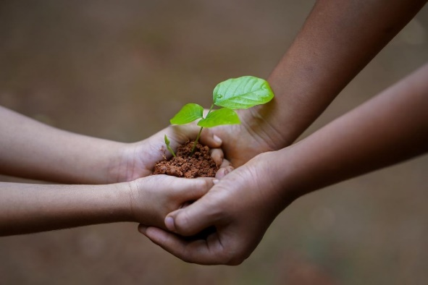

AZPLS strategy implementation
Supporting Literacy Achievement
For All Students
Notes:
AZPLS is rooted in systems change to increase literacy achievement for every student in every class. Your encouragement of each other, the care in your implementation of teaching and learning strategies, and the inclusive practices in all classes provide the support every student needs to grow their literacy skills.

Slide 27
Arizona Dept of Ed Exceptional Student Services
Arizona Department of Education
Exceptional Student Services
Notes:
Optional Professional Learning Survey: Ask participants to complete surveys before they leave.

