Slide 1

Collaboration
Arizona Department of Education
Arizona Professional Learning Series:
Parent Meeting
Collaboration
Notes:
Welcome to the Arizona Professional Learning Series (AZPLS) Parent Meeting. The Arizona Department of Education received funding to create a professional learning series to guide schools in implementing inclusionary practices and creating partnerships to increase literacy achievement for all students. These partnerships include school staff, students, and parents.

Slide 2

Thanks for being here!
Thanks for
being here!
Notes:
You are important partners in this project, and we want to recognize everyone who is here.
Please raise your hand if you are a parent of a child, you are a teacher, or you are a student in:
Grades K-2
Grades 3-5
Grades 6-8
Thank you all for your time, support, and dedication to our collaborative efforts to increase literacy achievement for every student. We are excited to have you here tonight!

Slide 3
Intentional Collaboration
AZPLS
Building Staff
All Students
Parents
COLLABORATION
Notes:
Parents play an active role in the AZPLS inclusive school community by being partners in learning. Parent information meetings accompany the school staff’s professional learning series. The information will help you understand what the school staff is learning and implementing, and it will teach you strategies you can use at home to support your children. Your participation is essential to increase literacy achievement for all students.

Slide 4







Series Module Overview
Module 3 Formative Assessment
Module 4 Literacy Strategies
Module 5
Literacy
Strategies
Module 2 Collaboration
Module 1 Introduction
Module 6 Differentiation
Notes:
The AZPLS includes six modules. Handout 1: Arizona Professional Learning Series Module Overview is the brief outline of the modules and indicates how they build on each other.
Modules 1 was an introduction for the staff to get things started. You contributed by completing the AZPLS Parent Perception Survey. This is the Parent Meeting for Module 2: Collaboration. Your collaboration is essential. You will impact learning for all students.
Module 3 identifies the Dimensions of Formative Assessment with Learning Goals, Criteria for Success, and strategies to move learning forward for every students. Teachers and students will learn how to use real-time data to guide learning.
Modules 4 and 5 provide strategies to strengthen vocabulary, comprehension, higher-level questioning, and discussion skills.
Module 6 presents inclusive practices to meet the needs of all learners by designing planning and instruction to include differentiated content, process, and product.
By the end of the AZPLS Parent Meetings, you will have gained the knowledge and skills to impact literacy learning for your child.

Slide 5
Professional Learning Process
Where are we headed?
Where are we now?
Three Questions
How will we close the gap?
Notes:
Throughout our staff professional learning modules, we use these three questions to guide the work. Let’s use them to look further into the process of how parents can better support all students.
Where are we headed? We want parents to use strategies that are used in class to support their children’s learning at home.
Where are we now? We know parents support their children’s learning, in general, but we need to give parents specific strategies to increase literacy achievement.
How will we close the gap? The AZPLS will give parents specific strategies to support their children’s day-to-day learning and improve their literacy skills.

Slide 6
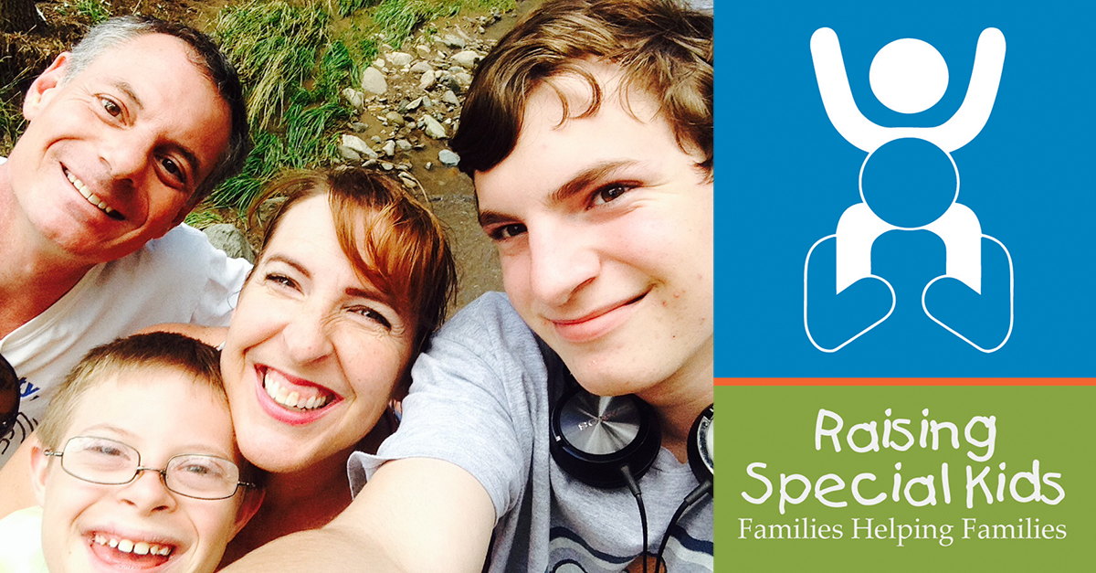
Raising Special Kids
Notes:
To support parent involvement in strengthening student learning, ADE partnered with Raising Special Kids, Arizona’s Parent Training and Information Center. The Arizona Department of Education and Raising Special Kids have worked together for many years to provide support for Arizona families. Expanding this partnership was a natural fit for creating and supporting these AZPLS parent meetings.
Raising Special Kids works to improve the lives of children with disabilities, from birth to 26, by providing families training, information, and individual assistance. It is a cornerstone belief at Raising Special Kids that collaboration between families and professionals results in the best possible outcomes for children with disabilities. We believe that, too.

Slide 7
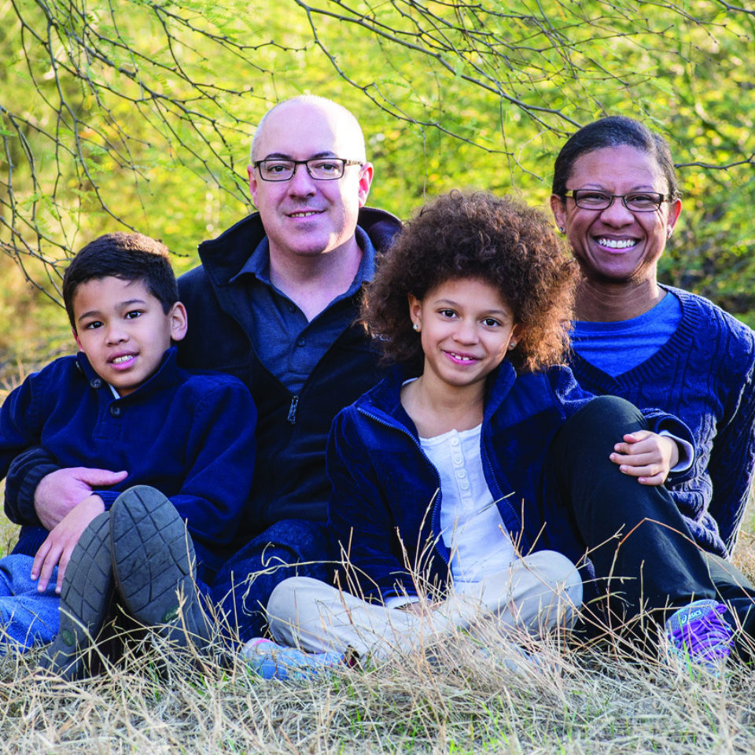
Child’s First Teacher
Child’s
First
Teacher
Notes:
The Executive Director of Raising Special Kids points out that parents have extraordinary insight about their children’s learning needs that is valuable to teachers.
As their child’s first teacher, parents know:
How their child is likely to respond in different situations.
Their child’s strengths and needs and likes and dislikes.
What has worked.
What hasn’t worked.

Slide 8

Parents
What has your child learned from you?
Parents
Notes:
Let’s take a moment to look at what you’ve taught your child. Working with your table groups, list things you’ve taught your children on the Parent Portraits poster. Students, you can help create the lists.
After completing the poster: Have each group share their feelings about the lists they created.
These are amazing lists. You can see that you are highly qualified at teaching your children, and your experience makes you a highly qualified partner in our AZPLS work.

Slide 9

It’s a great fit!
Successful
Parents
Teachers
Students
It’s a great fit!
Notes:
The basis for teachers and parents to successfully collaborate is to acknowledge the shared responsibility, support, and high expectations for all students to achieve.
In your table group, discuss: How can parents and teachers collaborate to support all students? Staff table facilitators should record responses on the copy of Parent-Teacher Shared Responsibility at the table to be shared with staff at a later time.
Have a few parents and teachers share some comments from the groups.

Slide 10



Gallery Walk
Working together is success!
Coming together is a beginning.
Staying together is progress.
Notes:
Our shared responsibility will lead to success. Coming together today is the beginning of a valuable collaboration to support our students. With a commitment to stay together, our successful collaboration will support all students’ learning. Working together using AZPLS strategies to improve every students’ literacy skills will bring success for all.

Slide 11

AZPLS Journey
AZPLS Journey
Notes:
The AZPLS charts the path to increasing literacy achievement for all students by way of inclusion. Inclusion works best when teachers work collaboratively. This means all classrooms will be environments that ensure respect for all students, and learning differences will be valued by all. Each classroom will use inclusive practices with teaching and learning strategies that include every student. To get a better understanding of inclusive practices, let’s look at what that is and is not.

Slide 12

Special Ed and General Ed
Special Education Classroom
General Education Classroom
Notes:
In the past, we’ve seen a significant difference between general education and special education. Here is a very simple explanation of those differences.
With special education, the focus was on students with disabilities. There may have been students from more than one grade in the same class. The teaching methods addressed each student’s individual needs and differences. What was used with one student may have been different from what was used with another student.
With general education, the focus was on students without disabilities. They were taught in grade level classrooms where they received grade specific instruction in all subject areas. Teaching methods mostly addressed the entire class.

Slide 13

Inclusive Classroom
Special Education Classroom
Inclusive
Classroom
General Education Classroom
Notes:
The inclusive classroom combines, or includes, both special education and general education students. It is an equal opportunity learning environment. Together, students with and without disabilities are fully engaged in learning activities that support each students’ learning needs. This means that general education teachers and special education teachers collaborate to support the needs of all students.
We are now expanding our school and classrooms so that all students can learn and participate together in a supportive environment. Teachers will be using strategies that support all students and their individual needs. Students will learn to work together and support each other’s learning, and parents will learn strategies to support students at home.

Slide 14

Group Activity
Group Activity
1 | 2 | 3 | 4
Notes:
Table facilitators should give each group member an activity card turned face down. Note: Only one group will have Reading Riddle A Cards with correct directions. All other groups should have Reading Riddle B Cards with directions that are difficult to read.
You all are getting cards that you should keep face down.
When I tell you to start, you will turn your card over and read the directions telling you what to draw in each of the numbered squares.
When all your group members have completed the four squares, raise your hands.
You will have 1 minute to complete the card.
Does everyone understand the directions?
Ok. Ready…Set…GO! Start your timer.
Set a timer for one minute. Walk around the room to observe the groups and hear their conversations. The group with the correct cards should be moving quickly through the squares. The other groups will not be able to read the instructions and will quickly become frustrated. When the timer runs out tell everyone to stop.

Slide 15
What happened and how did you feel?
How did this learning experience make you feel?
Parents
Notes:
Let’s talk about what happened and how you felt.
What were some of the challenges you experienced in trying to complete the activity? Take a few answers from both the one group with the correct cards and all other groups with the incorrect cards. The comments will center around the fact that most people couldn’t read the directions. As they express their challenges, ask them how they felt when they couldn’t complete the task.
What you all didn’t know is that everyone had the same cards except the group that completed the task. Their cards had the directions written correctly.
For the rest of you to complete the task, you would have needed help. If I had told you that the words were written backwards, you would have done better. You may have needed more time or support, but you could have completed the task.

Slide 16

Activity Answers
1 | 2 | 3 | 4
Activity Answers
Notes:
The actual directions were:
1. Draw the AZPLS logo: roots, tree trunk, leafy branches.
2. Draw a triangle to represent the AZPLS partners: staff, students, and teachers.
3. Draw a checkmark to represent learning needs of all students are met.
4. Draw an arrow pointing to the top of the square to represent increasing student achievement.
This was an example to help you understand the importance of supporting every student. In an inclusive classroom, every student will receive the support they need. No student in an inclusive classroom would have the struggles you experienced.

Slide 17
Examine Data
Examine
DATA
Survey Says…
Notes:
To examine everyone’s understanding of inclusive practices, we needed a starting point. Prior to this meeting, we used staff, student, and parent perception surveys completed by our school community.
The parent survey on inclusive practices was used to determine parent perceptions of the school culture for including all students and providing the support that every student needs.
Handout 2: Parent Perception Survey Results shows the results of our parent survey. Point out a couple of the highest and lowest scores. Explain how the results help teachers know what they are doing well and what they can improve.
Having responses from all parents is important to supporting our collaboration. Turn to a partner and identify one way to improve the number of responses the next time.

Slide 18
Table Talk
What can teachers do to support this partnership with you?
Table Talk
Notes:
We’re excited that you are collaborating with us, and we want to support your continued collaboration. Using Table Talk, share and write your thoughts on what we can do to grow this partnership with you. Table facilitators can record on Table Talk. Ask a few participants to share a comment from their table groups.

Slide 19
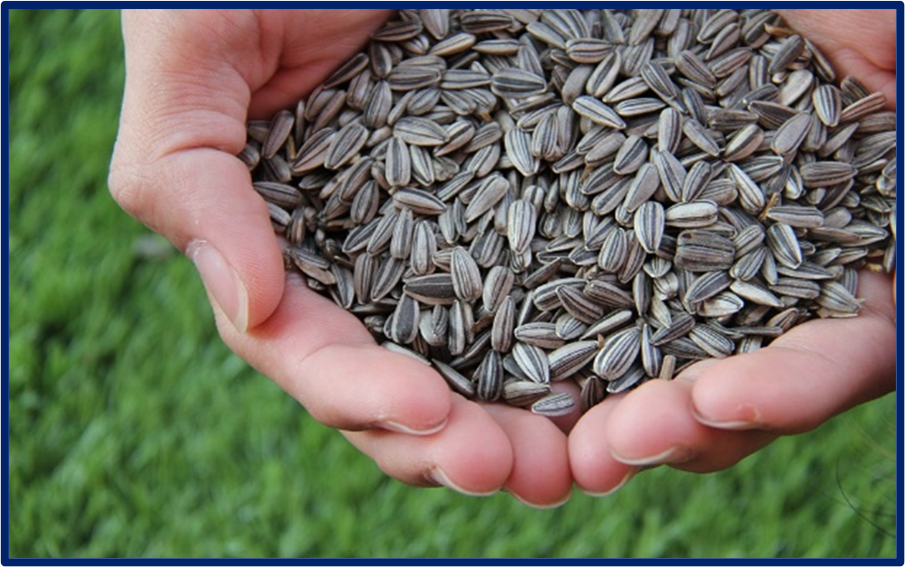

AZPLS strategy implementation
Planting the Seeds of Change
AZPLS
Notes:
It takes collaboration of the entire school community of staff, students, and parents to increase literacy achievement for all students. The AZPLS is rooted in schoolwide change, and now seeds of increasing collaboration are sprouting!
Thank you for attending tonight. We hope to see you at the next AZPLS Parent Information Meeting.
Optional: Give each parent an AZPLS Parent Seed Packet.

Slide 20
Arizona Dept of Ed Exceptional Student Services
Arizona Department of Education
Exceptional Student Services
Notes:
If using the Module 3 Professional Learning Survey, ask participants to complete it now.
Optional: Ask the parents to fill out a survey about the presentation.

