Slide 1

Arizona Department of Education
Arizona Professional Learning Series:
Parent Meeting
Formative Assessment
Notes:
Welcome, parents, students, and teachers to our Formative Assessment Parent Meeting.
Our staff is participating in the Arizona Professional Learning Series to learn strategies to increase literacy achievement for every student. Our students are learning new strategies to empower their learning. Parents, you will learn some of the same strategies to support your children’s learning at home.

Slide 2

Thanks for
being here!
Notes:
You are important partners in this project, and we want to recognize everyone who is here.
Please raise your hand if you are a parent of a child, you are a teacher, or you are a student in:
Grades K-2
Grades 3-5
Grades 6-8
Thank you all for your time, support, and dedication to our collaborative efforts to increase literacy achievement for every student. We are excited to have you here tonight!

Slide 3


Understand Formative Assessment
Learn a Strategy to Use at Home
Notes:
Today, we will identify what formative assessment is and is not. We will explain how your children and their teachers use formative assessment as a method to increase learning every day.
We will also teach you a formative assessment strategy that you can use with your children at home to receive a more specific answer when you ask, “What did you learn at school today?”

Slide 4

Professional Learning Process
My
Learning Focus
Where am I headed?
Where am I now?
How will I close the gap?
Notes:
Let’s begin with Handout 1: My Learning Focus, a strategy teachers and students are using. Part A includes the three questions we introduced in our last meeting and the answers for today’s presentation. Let’s look at how the questions are answered.
You would first ask yourself: Where am I headed? The answer:
I will understand formative assessment.
I will understand how formative assessment is used in my child’s classroom.
I will understand how to use formative assessment at home to support my
child’s learning.
Next, you would ask yourself: Where am I now? The answer:
Today, I am going to learn what formative assessment is and how it is used to
support my child’s learning.
Finally, you would ask: How will I close the gap?
I will follow the presentation and participate in the activities.

Slide 5
Describe what students should know and be able to do after a learning period.
Learning Goal
Notes:
The Learning Goal focuses instruction and learning on the targeted content. It describes what students are to know and be able to do by the end of a learning period.
Part B on your handout lists your Learning Goal for today. Today, you will understand formative assessment, how formative assessment is used in your child’s class, and how to use formative assessment at home to support your child’s learning.

Slide 6
Describe what successful achievement of the Learning Goal looks like.
Criteria for Success
Notes:
Criteria for Success describe what successful achievement of the Learning Goal looks like. This helps teachers and students identify where the students are in reaching the Learning Goal.
Part C on your handout describes today’s Criteria for Success. You will know you have achieved your Learning Goal when you can:
Define formative assessment.
Describe how the teacher and your child use formative assessment.
Identify a strategy you can use at home.

Slide 7
Teachers Use for Learning, Students Use as Learning
Formative Assessment
Teachers Use
for
Learning
Students Use
as Learning
Notes:
Use the Poster to point out each piece referenced in Handout 2 so all parents can easily find it on their handout.
Let’s examine formative assessment in the classroom. Following the information on the left side of the Poster, we will learn what it is and the value of both teachers and students using it. You have the same information in Handout 2: What Is Formative Assessment?
Point to numbers 1–3 on the poster.
1. It is not a test. Tests show what students know after instruction.
2. Formative assessment takes place during instruction. It helps teachers and students to know if the students are understanding the instruction while it is taking place.
3. Teachers ask questions to identify where students are in their understanding. With this information, they can change their teaching to better fit what the students need. So, they still plan their lessons, but they will make adjustments during teaching, if needed.

Slide 8
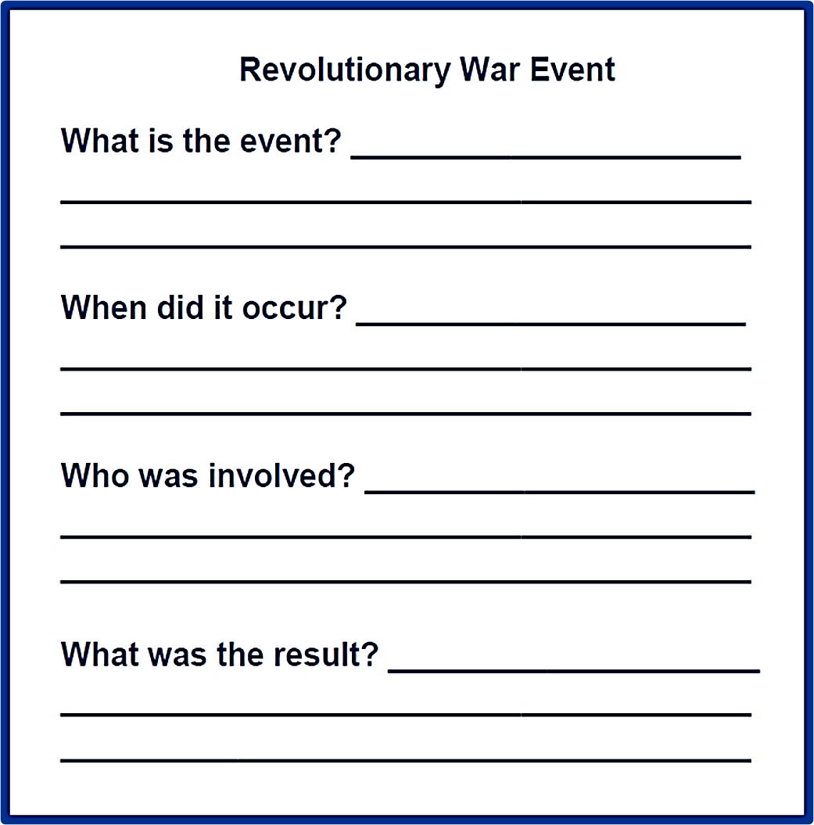


Notes:
Let’s look at a classroom example. After reading about events leading up to the Revolutionary War, Mr. Cooper gave his students questions to answer.
As he walked around the room and talked with his students, he found that they were struggling to answer the questions.
This formative assessment led him to adjust the activity for better learning.

Slide 9

Root word
What is the event?
When did it occur?
Who was involved?
Notes:
He thought about chunking the information into smaller parts to help the students. He put the students in groups of three and gave them each a note card with one question on it. Each student in each group answered one of the first three questions. The students in each group shared their answers with their group members. After the groups completed their assigned questions, they answered the fourth question together.
By using formative assessment to recognize his students’ needs, chunking the information, and having students work together, Mr. Cooper helped his students understand the events that led to the Revolutionary War.
Point to numbers 4 and 5 on the Poster.
Formative assessment pulled the entire class together as they worked individually, in small groups, and with the entire class. They are supporting each other as they learn together.
Share your thoughts on how Mr. Cooper supported his students with your tablemates.
Table facilitators share one positive result of the formative assessment.

Slide 10
Professional Learning Process
Feedback
Notes:
Point to number 6 on the Poster.
Formative assessment is also used to help students identify their level of learning, and students may respond to learning in different ways. Teachers may ask leading questions or give descriptive feedback to help students understand a lesson activity. Descriptive feedback must relate to the learning level of each student.
An example of descriptive feedback would be the teacher telling a student, “Your drawing looks good! You have drawn the water cycle correctly.”
Descriptive feedback includes specific information that can guide understanding and increase learning. The teacher’s feedback first helped the student know that the work was good, but it also confirmed that the student understood the basic water cycle.
The teacher may ask a student to add labels to identify each part of the water cycle. This helps both the teacher and the student know if the vocabulary terms can be matched correctly to the parts in the drawing.
The teacher may ask a student to add labels and a description for each that supports a deeper learning level.
All three students could share their drawings and information with each other. By working together, students can support each other’s learning in a positive way.

Slide 11


Formative Assessment
Notes:
Let’s use a formative assessment strategy to review. Using the Activity Cards and Activity Board, work together to identify what explains formative assessment and what does not. Read the cards and decide together where to place them. Give each other support and descriptive feedback, as you place each card under the correct heading.
DO NOT SHOW NEXT SLIDE UNTIL ACTIVITY IS FINISHED. IT SHOWS THE ANSWERS.
Table facilitators read each card aloud and help the participants’ with placement of cards and descriptive feedback, as needed.

Slide 12
Professional Learning Process
Students are taught strategies to increase their learning. | It is a quiz or test at the end of a unit.
Teachers and all students work together. | It is an assessment given in fall, winter, and spring.
Focus is on student progress during instruction. | Focus is on what students learned after instruction.
Teachers adjust instruction to fit student needs. | Teacher teaches. Students listen.
Answers
Notes:
Check how well you did. These are the answers. They can be in any order.
Discuss how working together helped your understanding and how descriptive feedback supported your work.
Table facilitators assist table discussions.

Slide 13



I’m Finished!
I Need Help.
I Haven’t Started.
Notes:
You already use formative assessment all the time in your daily activities. Think about it. You ask how your children are coming with cleaning their rooms.
Thumbs Up – I’m finished!
Thumbs Sideways – I need help.
Thumbs Down – I haven’t started.
You want it to be a thumbs up. To ensure the behavior is continued give descriptive feedback. You might say, “Your room looks great, and I really like the way you hung up your clean clothes!”
If it isn’t thumbs up, you will need to make adjustments. If it is thumbs sideways, you may say, “I see you are making progress. I like the way you separated your clean and dirty clothes. Could you please hang up the clean clothes and put the dirty clothes by the washer?”
If it’s thumbs down, you need to try a different way. You could break the chore into smaller tasks that you ask one at a time. Instead of expecting the entire room to be cleaned, you might start with just getting the dirty clothes to the washer. Then, you could give descriptive feedback by saying, “The dirty clothes are right where they need to be now. Could you hang up the clean clothes so all the clothes will be taken care of?”
Think of another example when you are using formative assessment at home with your children. Share with your child or another partner.

Slide 14
Professional Learning Process
Tell me about one of your Learning Goals today.
Notes:
Point to numbers 7 and 8 on the Poster.
Throughout the day, students use the three questions to guide their learning and strategies to meet their Learning Goals. On the right side of Handout 2 there is a process you can follow to find out what your child learned at school. Using this strategy will give you a more insightful answer than you may usually receive.
1. Ask your child to tell you one of his or her Learning Goals for that day.
2. Ask your child to give you a thumbs up, sideways, or down for how well they understand that Learning Goal.
3. Ask what the Criteria for Success is to reach the Learning Goal?
4. Ask for one strategy your child used to reach the Learning Goal.
5. Finally, ask what your child’s next step will be.

Slide 15

How will you begin using this strategy?
Parents
Notes:
Think about how you will begin using this strategy. With your child or another partner, discuss how you can make this a regular conversation to be better informed about how your child is learning and to be better prepared to support that learning.
Assigned staff members at each table facilitate discussion.

Slide 16
Notes:
To help you use formative assessment at home, we have Formative Assessment Take Home Cards of the questions for you. Keep this in a handy place so you can ask the formative assessment questions often. This will help your child practice identifying Learning Goals and Criteria for Success, and it will help you know what your child is working on in school.

Slide 17

You’ve
Got This!
PARENTS
Notes:
Parents, thank you for collaborating with us today and for supporting your child’s learning every day. We look forward to seeing you at the next AZPLS Parent Meeting so we can share more strategies with you.

Slide 18
Arizona Department of Education
Exceptional Student Services
Notes:
Optional: Ask the parents to fill out a survey about the presentation.

