Slide 1

Module 3
Arizona Department of Education
Arizona Professional Learning Series: Increasing Literacy Achievement for All Students
Module 3
Notes:
Today, we continue our AZPLS journey of schoolwide systems change that will lead to increased literacy achievement for all students. Specifically, we will focus on using the Dimensions of Formative Assessment to plan teaching and learning that meets the needs of all learners.

Slide 2
AZPLS Norms
AZPLS
Begin and end on time.
Silence cell phones.
Limit distractions to breaks.
Respect all voices.
Others?
NORMS
Notes:
Process norms set ground rules or expectations for how people treat each other at a meeting or professional learning. The AZPLS Norms focus on respecting all participants. Look over the norms listed on the poster. Are there additional norms you would like to discuss?
Please raise your hand if you agree with the norms we have.

Slide 3

Collaborative Teams
Team Roles
Team Norms
Notes:
In our last module, we developed foundational Collaborative Teams and the structure needed to work together efficiently. Let’s establish our Team Roles for today and review our Team Norms.
Add your birthday month and day. The team member with the highest number is assigned the Facilitator role. The person with the lowest number is the Recorder.
Next, use the sum of the numbers in your birth year. The highest number is the Reporter, and the lowest number is the Timekeeper. The remaining team members are Engaged Participants.
Please place your Role Cards in front of you.
Take a moment to review your Team Norms and come to consensus on your learning culture for today. If any norms need to be discussed or added, please do so. This sets the tone for your collective commitment as a team.
After review of Team Norms: Your Collaborative Team’s work is specific to individually and collectively building your knowledge and skills with the expectation of continuing that work. Extending learning and practice in your Collaborative Team meetings through guided discussions and activities will enhance your teaching and the learning of all students. Your coach and principal will provide ongoing support as you build on the foundational information within each module.
Take a few minutes to assess your progress towards creating a recurring common time for all team members to meet. Recorders, please add your meeting day and time to the Common Meeting Day/Time for Collaborative Teams sheet being passed around. If you do not have an established time, please add the challenges your team has in creating one. For teams experiencing challenges, your AZPLS Coach will work with you and the principal to establish the day and time.

Slide 4







Series Module Overview
Module 3 Formative Assessment
Module 4 Literacy Strategies
Module 5
Literacy
Strategies
Module 2 Collaboration
Module 1 Introduction
Module 6 Differentiation
Notes:
As we learned in Module 1, there is a well-planned progression of the AZPLS modules. The organization of the modules, implementation, and coaching provide a supportive process to increasing knowledge, skills, and achievement. Everyone is aware and involved in the step-by-step process to accomplish the common use of specific teaching and learning strategies in every class. Handout 1: Arizona Professional Learning Series Module Overview is the brief outline of the modules and indicates how they build on each other.
Modules 1 and 2 outline the frameworks for your systems change that will lead to increased literacy achievement for every student. You will learn the importance of including your entire school community in creating a culture that supports high expectations for all. You applied strategies of intentional collaboration to support your teamwork for collective learning and implementation. You identified how inclusive collaboration connects every teacher to your AZPLS work.
This module identifies the Dimensions of Formative Assessment and strategies to move learning forward for all students. Ongoing classroom data will drive instruction, and your implementation will be supported by your Collaborative Team and your coach.

Slide 5

Explicit comprehension strategies
Dimensions of Formative Assessment
Learning Goals with Criteria for Success
Action Plan Priorities
3
Notes:
Moving through the step-by-step module series, we are building on our foundational groundwork. All the learning activities demonstrate ways to engage our students in learning.
Today’s focus is using the Dimensions of Formative Assessment, creating Learning Goals with clear Criteria for Success, and developing action priorities for supporting inclusive practices to increase literacy achievement for all students.

Slide 6

Collective and Individual Implementation
Collective
and
Individual
Implementation
Notes:
Today’s intention is to work within your teams to learn how to collectively and individually implement formative assessment practices, create Learning Goals with Criteria for Success, and use data-driven decisions to increase learning outcomes for all students.
Remember everyone has input as to what the Action Plan should include. At specific points during today’s work, you will clarify action items to continue your learning. From that input, the Building Leadership Team will create and share the formal Action Plan with you. Everyone will be responsible for implementation and will be supported by the Building Leadership Team and coach.

Slide 7
Professional Learning Process
Professional Learning Process
Where are we headed?
Where are we now?
How will we close the gap?
Notes:
We are continuing our use of the three questions, a strategy that centers your professional learning throughout the modules, with Handout 3: Our Learning Focus for this module.
Where are we headed with our work today? We are learning how to implement the formative assessment process as defined by the Dimensions of Formative Assessment.
Where are we now? We are reflecting on our practices using the Dimensions of Formative Assessment.
How will we close the gap? We will collaboratively learn and plan how to implement the practices defined in the Dimensions of Formative Assessment.
After gaining the information in this module, you will be able to decide what your next steps will be. In your next Collaborative Team meeting, you will determine your process for closing the gap.
As with all our strategies, think about how you can implement them in the future. Use the three questions when you are planning your lessons to guide your teaching. They will help you focus on what you want the students to learn and what it will take for students to achieve the desired learning.

Slide 8
Individual and Team Implementation
Where are we headed?
Where are we now?
Individual and Team Implementation
How will we close the gap?
Notes:
Using the three questions is also a strategy for your students to use. It will help them become self-directed learners. Handout 4: My Learning Focus is an example form your students can use. Take time to teach your students the strategy. Make sure they understand the strategy will help guide their own learning. Model the strategy process and give them opportunities to practice with you, then with their peers, and finally, individually.
Table Talk: Discuss how the three questions could benefit you and your students if you collectively taught and used the strategy.
When the Table Talk starts to wind down: Reporters, share one insight from discussing how the three questions could benefit teachers and students if you collectively taught and implemented the strategy.

Slide 9

Assessment Review
Summative
Assessment
Review
Interim
Formative
Notes:
Let’s begin by briefly distinguishing between the three broad assessment categories: summative, interim, and formative (Northwest Evaluation Association, 2014).
We know that summative assessments provide data that is evaluative. For example, state proficiency tests measure student achievement at the end of a year. It answers the question, what did the students learn? Another example of summative assessment would be end of chapter tests.
Interim or benchmark assessments guide and track learning throughout the year. Your interim or benchmark assessments help predict students' achievement on state tests, offer snapshots of students' growth throughout the year, and give guidance to changing instructional plans to assist students' improvement. These assessments answer the questions: Where are the students now? What will change their trajectory for increasing their achievement?
The ultimate purpose of formative assessment is to use evidence of learning to inform teaching and learning in order to advance learning. Formative assessments are done during the instructional process. It is ongoing and is used by both teachers and students to evaluate evidence so teachers can make adjustments to their teaching and students to their learning. Formative assessments answer the questions: What do the students know? What do they need to know? How can the teacher use that information to guide real-time instruction?

Slide 10

Formative Assessment
What Do You Want to Know?
What Do You Know?
What Did You Learn?
Formative Assessment
Notes:
KWL is a strategy that serves several purposes. It elicits your prior knowledge of formative assessment by asking the question: What do you know?
It sets a purpose for learning by asking the question: What do you want to know?
After learning, it monitors understanding by asking the question: What did you learn?
Using Handout 5: Formative Assessment KWL Chart, answer the first two questions regarding formative assessment: What do you know? and What do you want to know?
When everyone is finished answering the first two questions: Discuss what you wrote down with your team. Recorders, fill in your Formative Assessment KWL Chart poster with collective team responses in the columns for what you know and what you want to know.
When all teams are finished with their posters: Reporters, share your team responses, and let’s all look for similarities and differences.
After sharing: We will return to these posters later.

Slide 11
Let’s dig deeper
Let’s Dig Deeper
Formative Assessment
AZPLS
Notes:
It is important to note that formative assessment is not a thing. It is a process that occurs during teaching and learning. It involves both teachers and students in gathering information, so they can take steps to keep learning moving forward to meet the Learning Goals.
A major landmark in the emergence of formative assessment was a synthesis of research findings conducted by Paul Black and Dylan Wiliam in 1998. This review led to the widespread recognition of formative assessment as a powerful method for improving all students’ learning. They concluded that student learning gains triggered by formative assessment were “amongst the largest ever reported for educational interventions,” with the largest gains being realized by low achievers (1998b).
Black (2014) went on to say that formative assessment is at the heart of effective instruction. This was, and remains, powerful evidence for the value of formative assessment (Heritage, 2010). Professor John Hattie (2009) provided evidence to support the view that there will be a noticeable difference to student learning as a result of formative assessment. Effect size 1.33.
As we explore formative assessment, we will identify a step-by-step process to implement formative assessment in your classrooms with support from your Collaborative Team and your coach.

Slide 12
Teachers Use for Learning, Students Use as Learning
Formative Assessment
Teachers Use
for
Learning
Students Use
as Learning
Notes:
The first step is to recognize that formative assessment is a main component of an effective classroom. The National Research Council compiled an overview of research on learners and learning and on teachers and teaching in the book, How People Learn: Brain, Mind, Experience, and School. They concluded effective classrooms have four defining characteristics that are foundational to our work.
Effective classrooms are student-centered. Teaching is focused on where individual students are in their learning journey to becoming proficient. Teachers can adapt instruction based on evidence, making changes and improvements that will yield immediate benefits to student learning. Formative assessment for learning improves student learning and, in addition, helps students become independent, self‐monitoring learners (Black and Wiliam, 1998; Clarke, 2008).
Effective classrooms are knowledge-centered. Formative assessment as learning signals the active role students play in the learning process (Earl, 2003). Information is provided that allows students to make connections and relationships among ideas. Students can use evidence of their current progress to actively manage and adjust their own learning (Stiggins, Arter, Chappuis, and Chappuis, 2006).
Effective classrooms are community-centered. Formative assessment is something teachers do with students. Students and teachers are partners that share responsibility for learning. Teachers and students need to share and learn from one another. Everyone understands what they are supposed to learn and support each other in succeeding at that.
Effective classrooms are assessment-rich. Using formative assessments throughout learning help teachers and students know where they are in the moment and where they need to go next.
Formative assessment for learning can take many different forms in the classroom. It consists of anything teachers do to help students answer the three questions of Where am I headed? Where am I now? and How will I close the gap? (Atkin, Black, and Coffey, 2001).

Slide 13

Thumbs
Notes:
How comfortable are you with your current knowledge of formative assessment and implementing the ongoing use in your classrooms?
I am going to give you explanations for the Thumbs Up, Thumbs Sideways, Thumbs Down strategy that fit what we are doing today. Wait until I give all the explanations before raising your thumbs.
If you understand formative assessment and feel comfortable using formative assessment you will raise your hands with thumbs up. Model by holding your thumb up.
If you are not sure exactly what formative assessment is or how to use formative assessment, you will raise your hands with your thumbs sideways. Model by holding your thumb sideways.
If you don’t know what formative assessment is or how to use it, you will raise your hands with thumbs down. Model by holding your thumb down.
Now, raise your thumbs to show me your level of understanding for formative assessment.
This was a quick way to see how well everyone understands using formative assessment at this point. It is important to note that for this formative assessment practice to be informative, teachers must first provide the criteria for the thumbs up, thumbs sideways, thumbs down strategy. Providing the criteria is essential for students to accurately self-assess. This precise feedback is key to their learning and should guide teachers’ actions.

Slide 14

What literacy skills do students need to have success?
How do you collect evidence to inform immediate teaching and learning?
What tasks and activities do you use as an ongoing part of your teaching to elicit evidence of student learning?
Notes:
Reflect on these questions and discuss.
How do you collect evidence to inform immediate teaching and learning?
What tasks and activities do you use as an ongoing part of your teaching to elicit evidence of student learning?

Slide 15
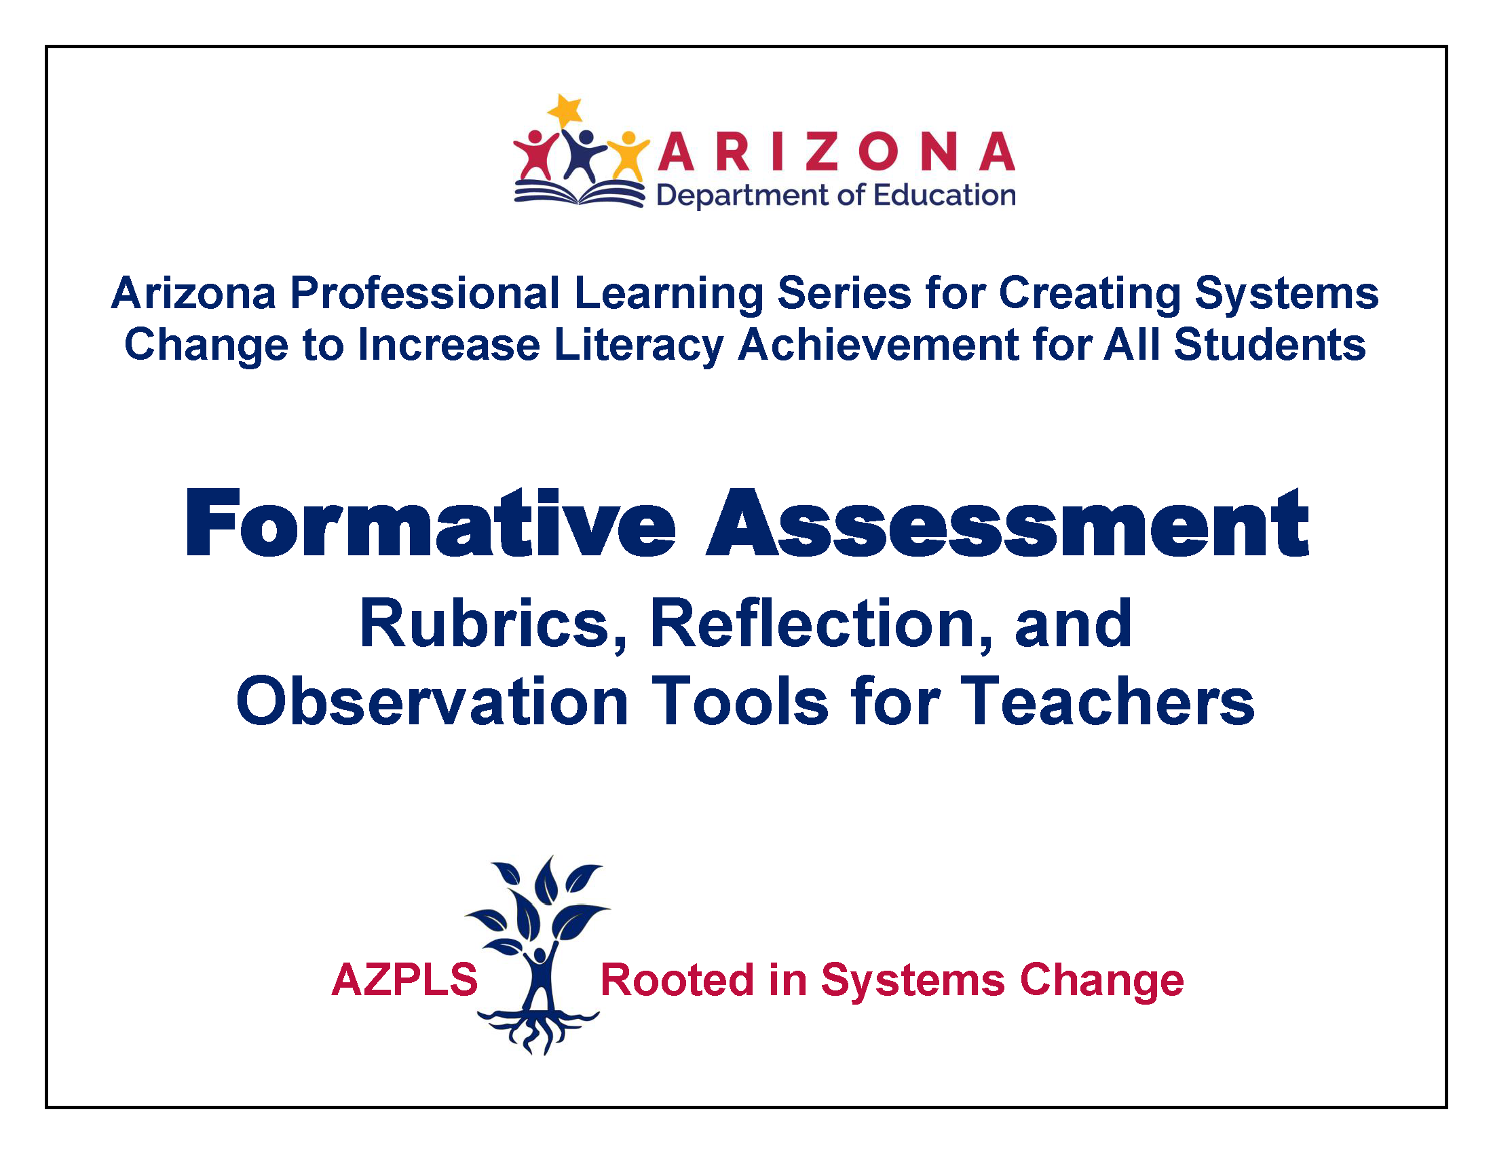
Formative Assessment Rubrics
Notes:
The Council of Chief State School Officers commissioned a guide for formative assessment for 18 states that included Arizona (2016). You will use these guidelines to assess your formative assessment implementation, so we created a spiral bound guide for your use.
The primary motivation for using an observation tool focused on formative assessment is to improve teaching practice that includes formative assessment practice. Just as student learning can be supported through the appropriate use of self-assessment and peer assessment, teaching practice can also be improved through self- or peer assessment. In this guide, these activities are referred to as self-reflection and peer observation.
Before we move on, take a few minutes to review the Table of Contents and skim through the guide.
We will refer to this guide throughout the rest of the modules, and you will need to bring it to every session.

Slide 16
Collaborative Learning
Collaborative Learning
Notes:
Please turn to page 3 in the guide. In the second paragraph, you will see a research-based definition of formative assessment.
Ask someone to read the definition aloud: Formative assessment is a planned, ongoing process used by all students and teachers during learning and teaching to elicit and use evidence of student learning to improve student understanding of intended disciplinary learning outcomes and support students to become self-directed learners (Revised December 2018).
Gaining knowledge and skills for implementation will be a step-by-step process with direct support from your Collaborative Team and AZPLS Coach.
You will work within your Collaborative Teams to implement and sustain the use of formative assessment in your daily teaching. Together, you will improve the learning culture within your classrooms and the actual learning of all your students, including students with specific learning disabilities.
As you progress with your implementation of formative assessment, your coach will do observations to help you identify areas of success, recognize opportunities for growth, and guide your use of a self- and peer assessment process. One of the most important things to remember is this is a process that improves with collaboration and practice over time.

Slide 17

Color Coding
Color-Coding
Notes:
Turning to Handout 6: Defining Formative Assessment, you will see the same definition, but it is color-coded. This color-coding strategy draws attention to important words. It can be introduced to all students as a way to increase understanding. Then, it can be used in the future by those who benefit from the strategy.
Because an effective, inclusive classroom is an equal opportunity learning environment, every student will understand that strategies help learning. Some strategies will be used by all. Some will be used by a few, and some may be used by an individual.
Part 1: On page one of the handout, the table offers explanations of the key color-coded words. Facilitators, assign each of the colored table entries (pink, blue, green, purple, orange) to individual team members to read and share. Then, everyone should read the last piece in red and discuss.
Part 2: We are going to continue with the same strategy, but without the scaffolding of color-coding. To gain more insight, read the second page and highlight key words. Work with a partner to review the words you highlighted. Together, choose four key words to add to the table below. Add comments to explain how they relate to your current or future teaching or add questions to gain more understanding.
After partner activity: Partners, share your information with your team.
Ask Reporters to share one key word and explanation or question their team had in common.

Slide 18
Key Attributes
Descriptive Feedback
Learning Goals and Criteria for Success
Self- and
Peer
Assessment
Key
Attributes
Learning
Progressions
Collaboration
Notes:
The key attributes of effective formative assessment are listed at the bottom of page 3 in the guide. For your reference, Handout 7: Key Attributes of Effective Formative Assessment offers additional information.
The core concept of Learning Progressions is connecting the Arizona English Language Arts Anchor Standards across content areas and grade levels.
Learning Goals should describe what students are to know and be able to do by the end of a learning period. Criteria for Success should describe what successful achievement of the Learning Goal looks like.
Descriptive Feedback should identify what was done well, what needs improvement, and how to improve (Black, et al, 2003; Dixon, 2005; Hattie and Timperley, 2007).
Self- and Peer Assessment enable students to independently assess their own and other students’ work by identifying how well it reflects the Learning Goals and Criteria for Success and how to revise it accordingly.
Successful formative assessment takes place in the context of a classroom culture where all students feel respected and see that their contribution to the learning community is valued.
We will focus on these attributes throughout the modules.

Slide 19
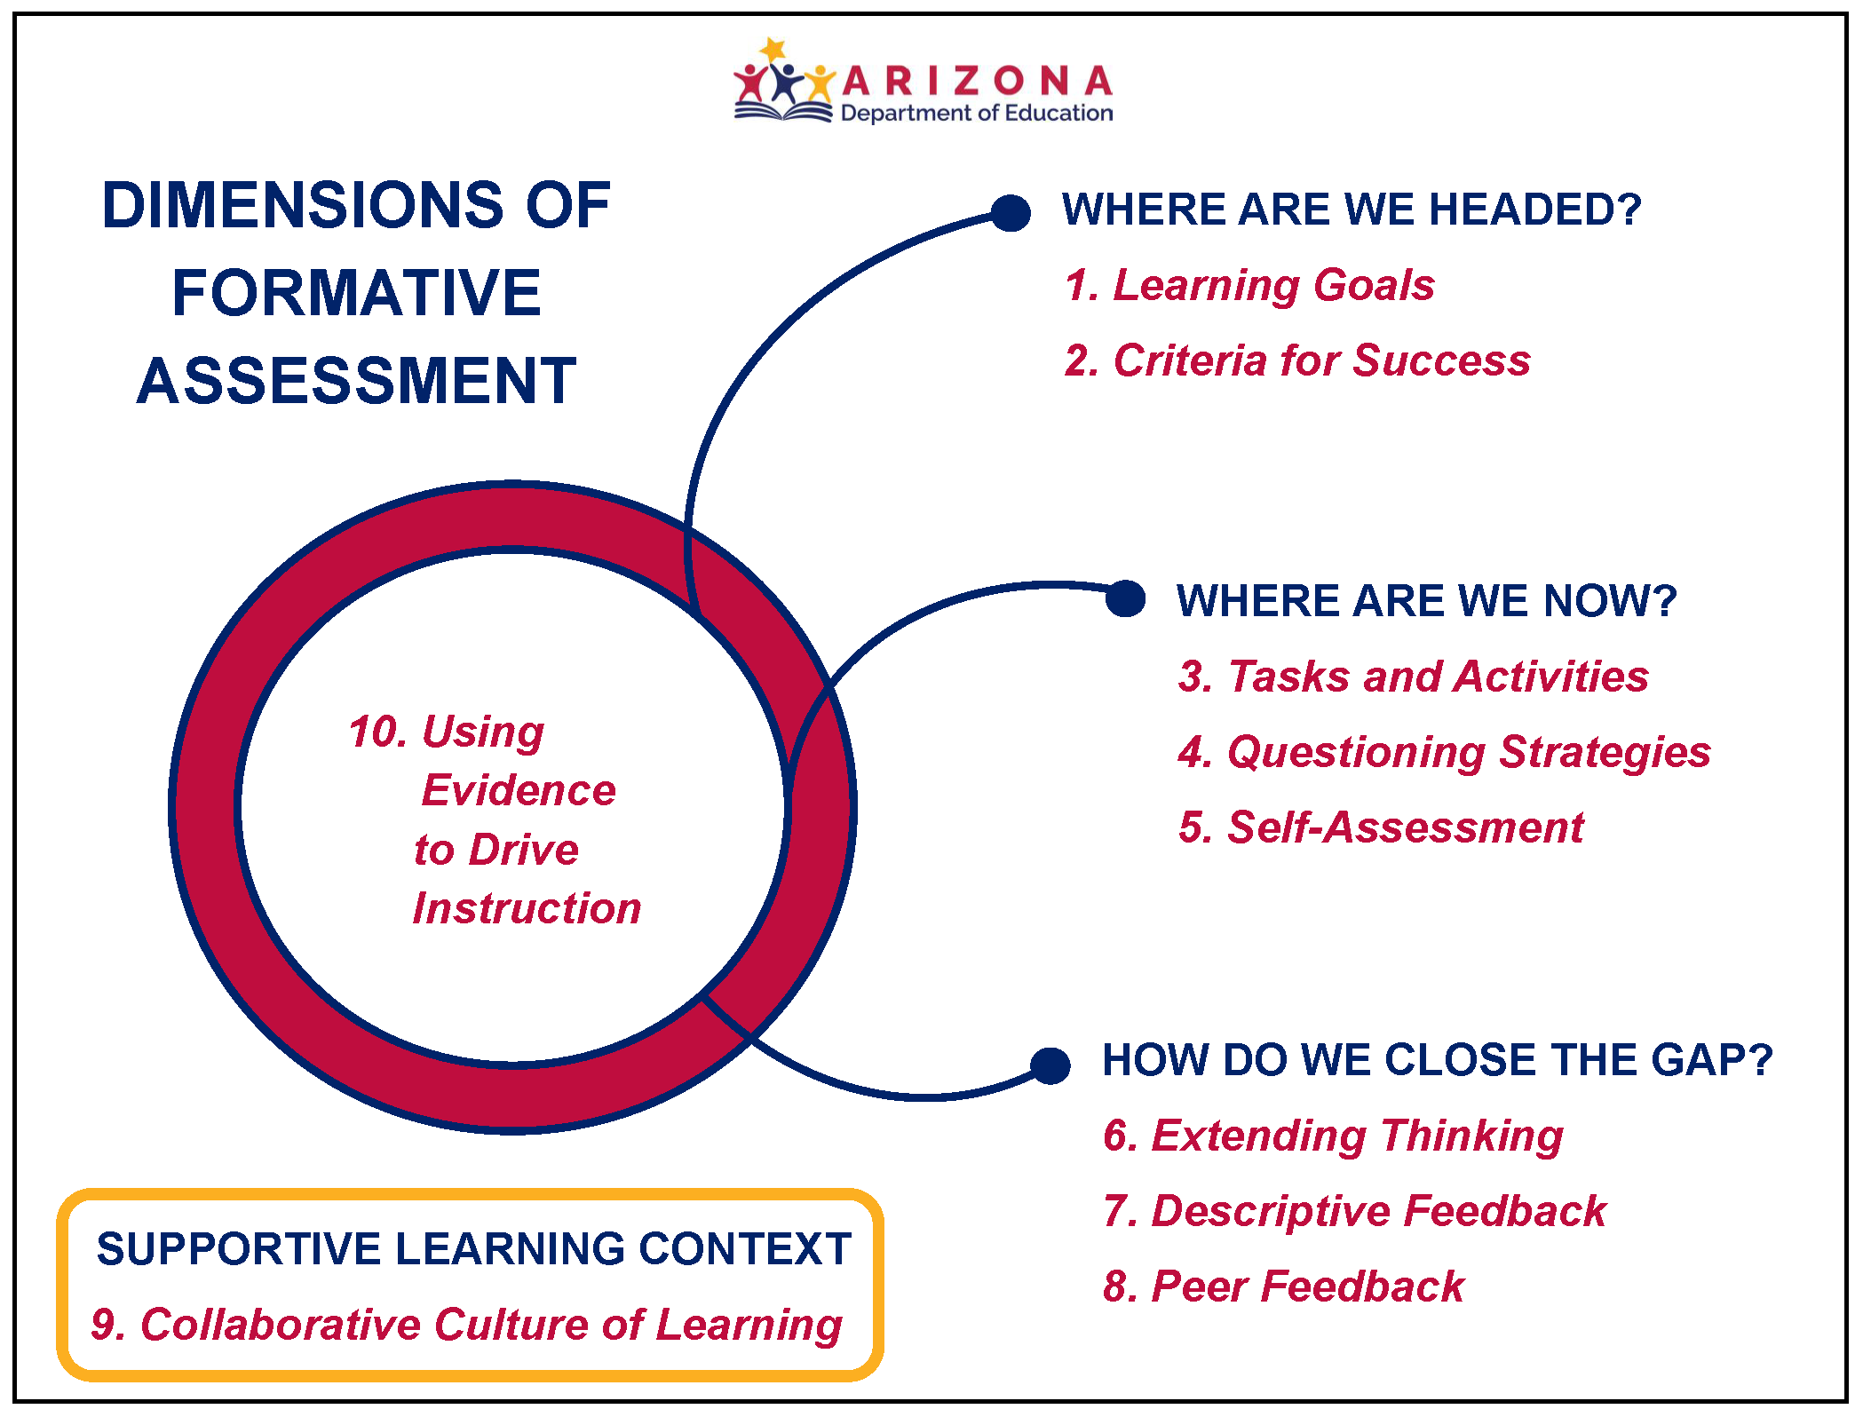
Dimensions of Formative Assessment
Notes:
You have this same graphic on page 4 of your guide. Using the definition of formative assessment and the key attributes of effective formative assessment, 10 Dimensions of Formative Assessment practice have been identified that support all students’ learning.
These dimensions represent a set of integrated formative assessment practices. This is important. The practices work together. They are not separate activities. The dimensions are only numbered for easy identification. They do not represent consecutive order. Everything relates to Number 10, Using Evidence to Drive Instruction.
On page 5, you will see a brief description of each dimension. You will refer to these as we learn about the role of the dimensions in designing lessons.
To understand the implications for practice, we will identify the student interaction with the Dimensions of Formative Assessment. On pages 6 and 7, you will see a description of the student role for each dimension. As you read these pages, highlight and annotate key ideas.

Slide 20
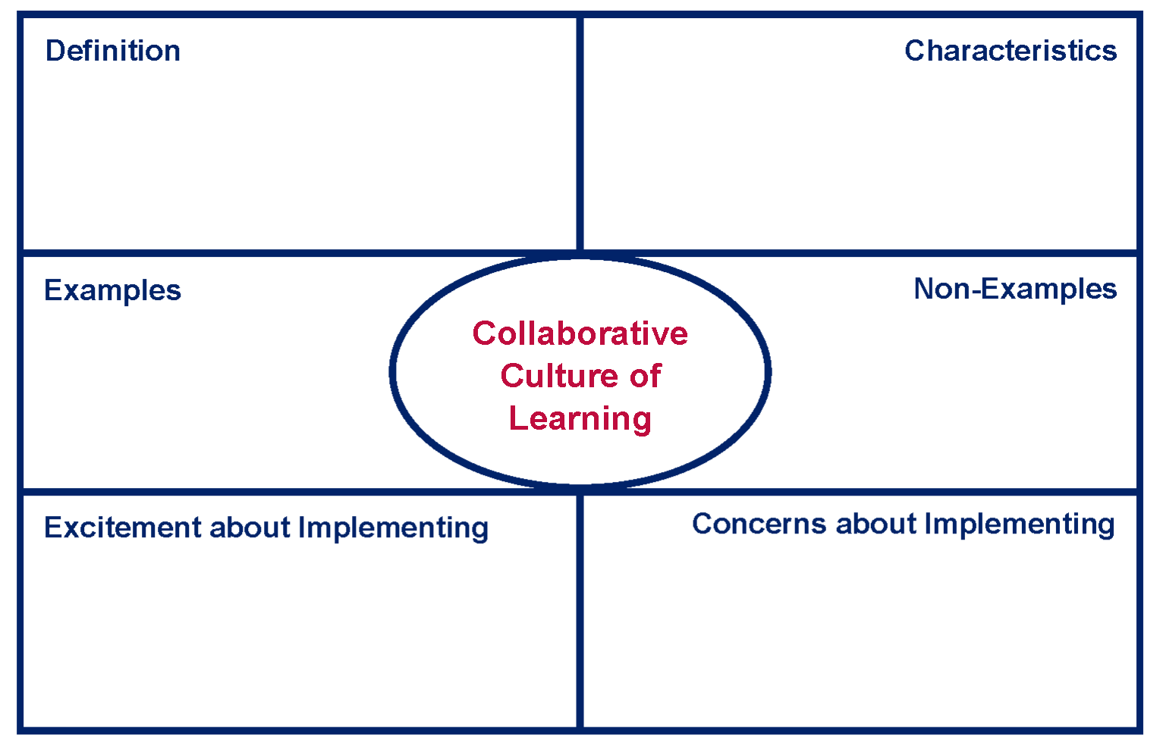
Culture Exchange
Culture Exchange
Notes:
Since the classroom culture must be positive to support formative assessment, we are going to begin with the Collaborative Culture of Learning Dimension. We will exchange information and ideas that promote a collaborative learning culture within your classroom and the school.
Please turn to page 16 in your guide. Rubrics for each dimension are provided to help you develop your implementation skills through the guiding stages of not observed, beginning, developing, progressing, and extending. Please read the Collaborative Culture of Learning Dimension rubric.
When everyone is finished reading, ask participants to count off 1–5 to establish new small groups.
Taking your guide and Handout 8: Collaborative Culture of Learning, please move to your new group and wait for instructions.
Give directions when everyone is in their new group. As a group, you will fill in the Collaborative Culture of Learning Poster. First, choose a group Facilitator, Recorder, and Reporter. Then, discuss each section and come to a consensus for what is to be recorded. Recorders should add the information to the posters. Individuals should record notes on the Handout 8: Collaborative Culture of Learning graphic organizer.
When groups are finished: Reporters, share one excitement and one concern for supporting a collaborative learning culture. Recorders add the concerns to the Action Planning Wall under the heading, Collaborative Culture of Learning.
Activity wrap up: The Collaborative Culture of Learning Dimension is significant to the development of an effective classroom. Reviewing 30 years of research, Michael Fullan (2011) found the consistent outcomes of collaborative cultures result in better learning for students. Every student must always feel safe and supported. True learning does not just happen. It is reinforced with strategies that include teachers supporting all students, students supporting each other, and individuals developing strategic methods to support their own learning.
Always be vigilant to ensure your classroom environment supports the learning of every student.

Slide 21
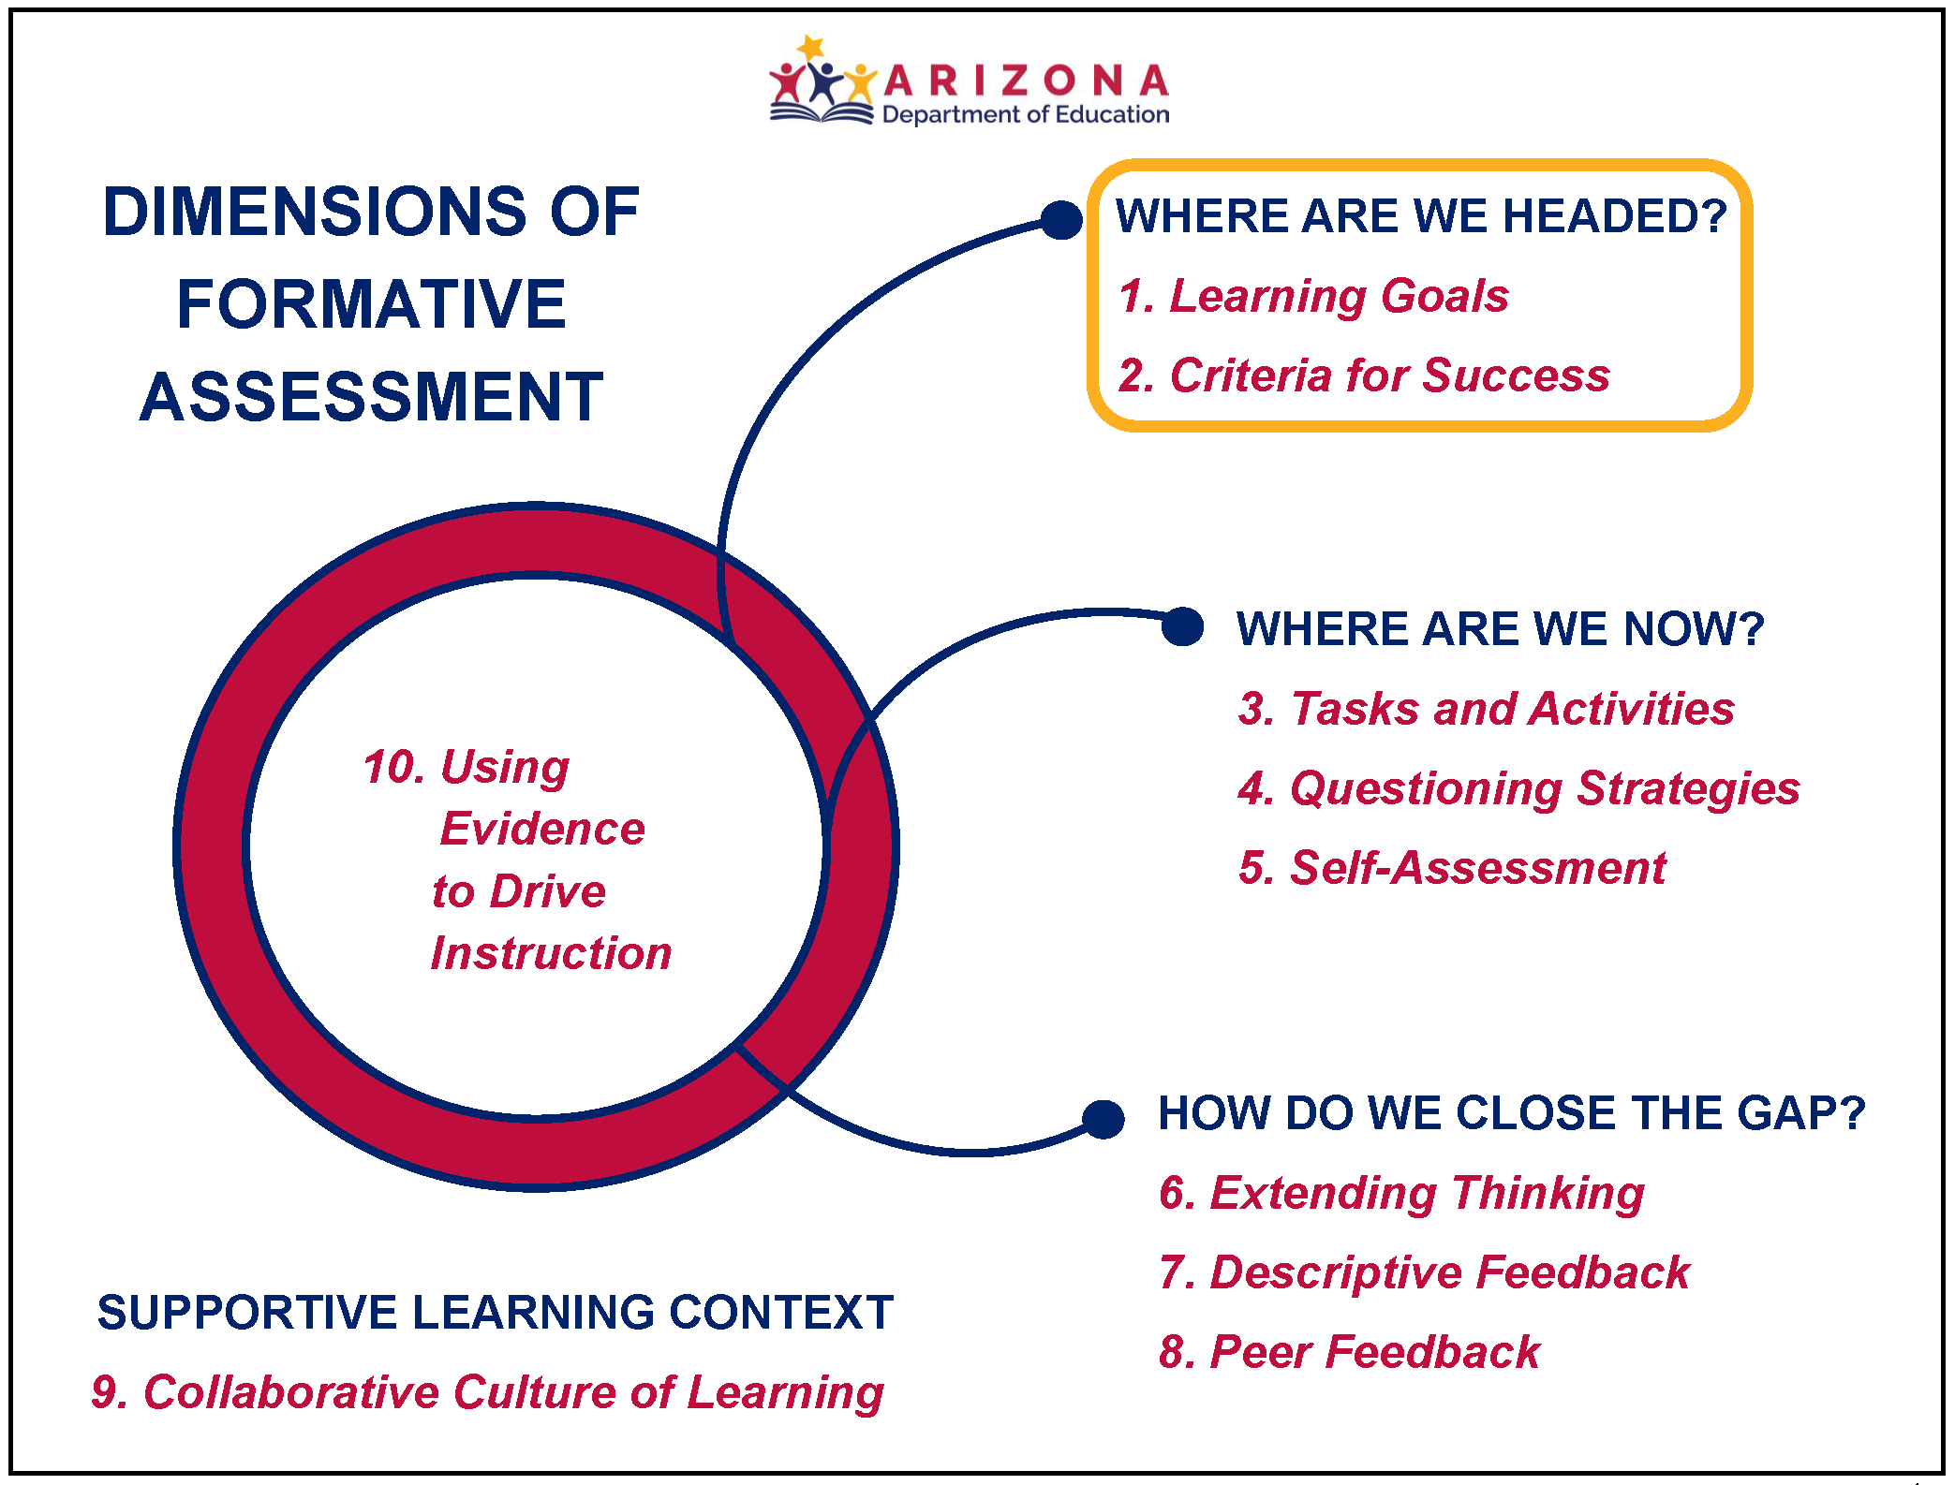
Dimension 1 & 2
Dimension 1:
Learning Goals
Dimension 2:
Criteria for Success
Notes:
We are going to focus on the Learning Goals and Criteria for Success Dimensions. We will identify what they are, their importance for student success, and how to use them effectively.
Let’s begin with the Learning Goals Dimension. Read page 8 and highlight the main ideas and key details noting implications for practice. Then, use Handout 9: Connect, Extend, Challenge: Learning Goals to reflect through the three questions on your current practice with Learning Goals.
Repeat the process for the Criteria for Success Dimension on page 9 and use Handout 10: Connect, Extend, Challenge: Criteria for Success to reflect through the three questions on your current practice with Criteria for Success.
After everyone completes Handouts 9 and 10: Facilitators, give all team members an opportunity to share examples of practices they use in their classrooms that reflect the practices defined in the rubrics. Ask Reporters to share key ideas of the discussions.
Activity wrap up: The Learning Goal is the backbone of a lesson and provides the reason for teaching and observing it. Criteria for Success describe in specific terms what successful achievement of the Learning Goal looks like. Both help students recognize if they have been successful in their learning. In simple terms, the first two dimensions help teachers and students identify where they are headed and how they will know when they get there.

Slide 22
Rubrics describe the level of implementation
Rubrics describe the
level of implementation
NOT the
level of expertise
of a teacher.
Notes:
It is important to recognize the foundation for successful implementation is to understand that the rubrics describe the level of implementation of a particular aspect of practice not the level of expertise of a teacher.
After today, your coach will work with you and your Collaborative Team to help you understand the rubrics. As you begin implementing Learning Goals and Criteria for Success, the coach will follow an observation process and introduce a self- and peer reflection process to support you.

Slide 23

Actively Connecting
Connecting
Actively
Notes:
Team Facilitators, give one Connection Card (A–D) to each team member.
Read your cards and prepare to share the information with your team.
After everyone is finished reading: Each of you will take turns as the Activity Facilitator, starting with Connection Card A and proceeding through Connection Card D. Use Handout 11: Key Points for Writing Learning Goals and Criteria for Success to record notes and summarize the information.
When the teams finish the Connection Card activity: Share and discuss your summaries. Choose one key point summary for the Reporter to share with the group.

Slide 24
Learning Goals and Criteria for Success
Criteria for Success
Learning
Topic
Learning
Goal
Learning
Task
Notes:
Note: If additional background knowledge is needed on Learning Goals and Criteria for Success, take the time now to provide more clarity. Refer to Slide 24 in the Facilitator Guide for specific information.
Note: If no additional scaffolding is needed, begin here:
You now have a deeper understanding of basic Learning Goals and Criteria for Success through the knowledge you have received with the active learning strategies providing support for your learning.
Let’s put your learning into practice. There is a Connecting Learning Goals and Criteria for Success Poster for each grade level that provides a basic example. The Learning Topic is from the Arizona English Language Arts Anchor Standards for your grade level. The Learning Goal states the learning outcome that connects to the Standard. The Criteria for Success states what needs to be accomplished to reach the Learning Goal. The Learning Task describes the activity to promote learning and provide evidence of the learning aligned to the Criteria for Success.
Read the example and work together to create your own examples for Literacy, Mathematics, Science, and Social Studies. Think of a Learning Topic you recently covered or one that you will be covering. The intention is to identify the basic connection of a Learning Topic to a Learning Goal, Criteria for Success, and Learning Task. This is the foundation for extending our learning in the next module.

Slide 25




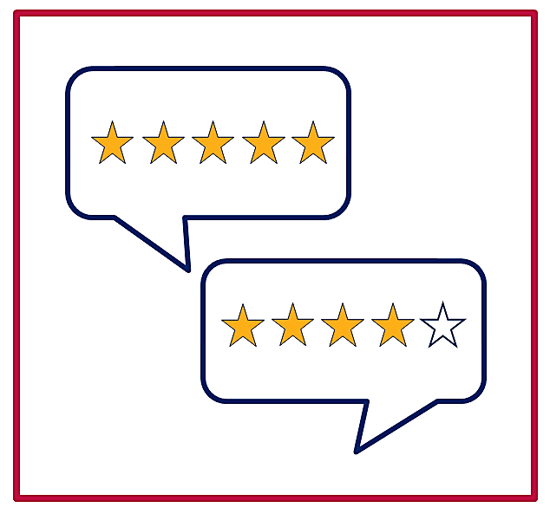
Gallery Walk
Gallery
Walk
Peer Feedback
Notes:
We are going to do a peer feedback gallery walk of praise and possibilities. Teams will review each other’s work and offer one praise and one possibility of something to consider. Feedback should be specific.
Just putting good job is not enough. A complete feedback statement would include what specifically was done well. For example, it might say excellent connection of the Learning Goal, Criteria for Success, and Learning Task or good verb choices for the Learning Goal and Criteria for Success.
I will let you know when to move to the next poster. Let’s begin with everyone moving to your right. Watch for teams to finish to keep them moving.
When teams return to their own posters: Review and discuss your peer feedback. Ask each Reporter to share one insight.

Slide 26
Leaf rippling in water
What will be the outcome of schoolwide efforts to implement Learning Goals and Criteria for Success?
What support will you need?
Notes:
Discuss your shared understanding of Learning Goals and Criteria for Success by answering:
What will be the outcome of a schoolwide effort to implement Learning Goals and Criteria for Success?
What support will you need?
After the discussion: Reporters, share the support your team needs for collectively implementing Learning Goals and Criteria for Success. Recorders, add your team’s suggestions under the Action Planning Wall Heading: Learning Goals and Criteria for Success.

Slide 27
Root word
What Do You Want to Know?
What Do You Know?
What Did You Learn?
Formative Assessment
Notes:
Let’s return to Handout 5: Formative Assessment KWL Chart. Review your first two questions and fill in: What Did You Learn? Discuss what you learned with your team.
Recorders, fill in your Formative Assessment KWL Chart poster with collective responses for the third question.
Reporters, share what your teams learned. Note similarities and differences.

Slide 28

Your Collaboration Skills
Your Collaboration Skills
Notes:
You participated in many collaborative activities today. Take a moment to reflect on your personal collaboration skills. Turn to Handout 12: Collaboration Skills and complete the checklist.
Discuss how each team member’s participation supported each other and the work of your Collaborative Team.

Slide 29

Action Planning
Action
Planning
Collective Input
Final Action Plan
Implementation
Coaching
Notes:
Previously, you created foundations to support your AZPLS work. Today, you are creating a supportive schoolwide collaborative learning culture with collective use of Learning Goals and Criteria for Success to increase literacy achievement for all students, including students with specific learning disabilities.
Your Building Leadership Team will review your input and synthesize the information to create measurable Action Plan items for Module 3. The final Action Plan will be shared with every team. These are the items that everyone will work toward while implementing your Collaborative Team’s specific module strategies. Your AZPLS Coach will provide support for both activities. Handout 13: Module 3 Action Plan is the form the Building Leadership Team will use.

Slide 30
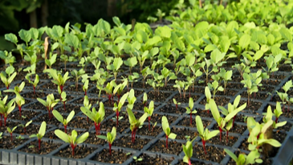

AZPLS strategy implementation
Formative Assessment Supports
Growth for All Students
Notes:
Formative assessment supports the skill development of every student. Collaboratively use the teaching and learning strategies shared today and watch the schoolwide growth in literacy skills and achievement increase for all students in all classes.

Slide 31
Arizona Dept of Ed Exceptional Student Services
Arizona Department of Education
Exceptional Student Services
Notes:
If using the Module 3 Professional Learning Survey, ask participants to complete it now.

