Slide 1

Module 6
Arizona Department of Education
Arizona Professional Learning Series: Increasing Literacy Achievement for All Students
Module 6
Notes:
Today, we continue our AZPLS journey of schoolwide systems change that will lead to increased literacy achievement for all students. Specifically, we will focus on inclusionary practices of differentiation and the Universal Design for Learning (UDL).

Slide 2
AZPLS Norms
AZPLS
Begin and end on time.
Silence cell phones.
Limit distractions to breaks.
Respect all voices.
Others?
NORMS
Notes:
Process norms set ground rules or expectations for how people treat each other at a meeting or professional learning. The AZPLS Norms focus on respecting all participants. Look over the norms listed on the poster. Are there additional norms you would like to discuss?
Please raise your hand if you agree with the norms we have.

Slide 3

Collaborative Teams
Collaborative Teams
Notes:
To assign roles for our work today, we are looking to the four borders of the United States. The person who most recently traveled to (or closest to) Canada is the Facilitator. The person who most recently traveled to (or closest to) Mexico is the Reporter. The person who most recently traveled to (or closest to) the Pacific Ocean is the Recorder. The person who most recently traveled to (or closest to) the Atlantic Ocean is the Timekeeper. The remaining team members are Engaged Participants.
Please place your Role Cards in front of you.
Take a moment to review your Team Norms and come to consensus on your learning culture for today. If any norms need to be discussed or added, please do so. This sets the tone for your collective commitment as a team.
Your individual commitment today will support your team. Review Handout 8: Collaboration Skills. Don’t write anything down. Just read through it and reflect on how you can effectively collaborate with your team. We will come back to this handout and self-assess at the end of our professional learning today.

Slide 4







Series Module Overview
Module 3 Formative Assessment
Module 4 Literacy Strategies
Module 5
Literacy
Strategies
Module 2 Collaboration
Module 1 Introduction
Module 6 Differentiation
Notes:
Handout 1: Arizona Professional Learning Series Module Overview is the brief outline of the modules and indicates how they build on each other.
The first three modules laid the foundation that supports the teaching and learning strategies of Modules 4 and 5.
Module 4 connected Handout 2: Arizona English Language Arts Anchor Standards and Institute of Education Sciences (IES) Recommendations 1 and 2 for specific strategies that support explicit vocabulary and direct and explicit comprehension skills throughout the grade levels and content areas.
Module 5 connected Handout 2: Arizona English Language Arts Anchor Standards and IES Recommendation 3: Provide opportunities for extended discussion of text meaning and interpretation.
Today, we are exploring strategies with the Universal Design for Learning and differentiated instruction connected to Handout 2: Arizona English Language Arts Anchor Standards and IES Recommendation 4: Increase student motivation and engagement in literacy learning.

Slide 5
Provide explicit vocabulary instruction
4
Increase Student Motivation and Engagement in Literacy Learning.
Notes:
To meet the Arizona English Language Arts Anchor Standards, students must read and understand complex text. They are expected to make meaningful connections within and across texts. In Best Practices for Motivating Students to Read, John Guthrie discusses if students are to successfully meet the standards, they must be motivated. They need the confidence to keep trying in the face of difficulty; they need the reading interests to make their effort worthwhile; they need the social belief that they can give and receive help from peers effectively; and they will have to read more widely and deeply than ever.
Read the top section of Handout 3: IES Recommendation 4 and discuss the definitions of reading motivation and reading engagement and how reading motivation produces reading engagement, which promotes achievement.
After your discussion, review the Checklist and discuss how you are currently meeting each goal or how you might begin implementing them. Then, answer the discussion questions.
After team discussions: Throughout the module, think about how all students will feel when you begin collaboratively implementing or improving the checklist goals.

Slide 6

Explicit comprehension strategies
Differentiated Instruction
Universal Design for Learning
Collaborative Planning
Action Plan Priorities
6
Notes:
Today’s focus connects IES Recommendation 4: Increase student motivation and engagement in literacy learning to all Arizona English Language Arts Anchor Standards.
We will identify strategies for differentiated instruction and Universal Design for Learning and how the combination of the two provides teachers with both theory and practice to increase student motivation and engagement in literacy learning.
We will review current collaborative lesson planning and connect to lesson planning that includes formative assessment, differentiation, self-assessment, and peer feedback.
Everyone has input as to what the Action Plan should include. At specific points during today’s work, you will clarify action items to continue your learning and support. From that input, the Building Leadership Team will create and share the formal Action Plan with you. Everyone will be responsible for implementation and will be supported by the Building Leadership Team and coach.

Slide 7
Professional Learning Process
Professional Learning Process
Where are we headed?
Where are we now?
How will we close the gap?
Notes:
Let’s review our strategy that centers your professional learning for this module and frames our intention.
Where are we headed? Today, we are exploring literacy strategies connected to the Arizona English Language Arts Anchor Standards and IES Recommendation 4: Increase student motivation and engagement in literacy learning.
Where are we now? We apply the Dimensions of Formative Assessment Learning Goals, Criteria for Success, and Tasks and Activities; connect with the Arizona English Language Arts Anchor Standards; and implement strategies that support IES Recommendation 1: Provide explicit vocabulary instruction; IES Recommendation 2: Provide direct and explicit comprehension strategy instruction; and IES Recommendation 3: Provide opportunities for extended discussion of text meaning and interpretation.
How do we close the gap between our current reality and where we are headed? We close the gap between where we are now and where we are headed with all teachers collaboratively implementing inclusionary practices that support the literacy needs of every student.

Slide 8
Differentiation
What Are Your Thoughts about Differentiation?
Notes:
What are your thoughts about differentiation? Using the top half of Handout 4: My Thoughts about Differentiation, jot down what you know and think about differentiation.
When participants are finished: Turn to a partner and share your thoughts.
When pairs are finished: We will come back to the bottom half later in the module.
With your Collaborative Team members, share one differentiated instruction strategy you currently use with your students. Use the top section of Handout 5: Strategic Conversations for Differentiation to record the shared strategies.

Slide 9

UDL DI
UDL
Inclusionary Practices
DI
Notes:
We will be working with the Differentiation Guide. Skimming is a previewing strategy to give you the big picture of a text. Take a moment and skim the table of contents and pages of the guide.
When participants are finished skimming the guide: We are beginning with an overview to identify Universal Design for Learning or UDL, differentiated instruction, and how the practices and principles of UDL link with differentiated instruction.

Slide 10
Close Read Annotations
 | Main Idea
Underline | Important Details
 | Important Words
 | Question
 | Interesting/Surprising
 | Connection to Me
 | Evidence
 | Favorite Part
!
C
E
?
Close Read Annotations
Notes:
In your Differentiation Guide, read pages 1–2 to gain a basic understanding of differentiation and Universal Design for Learning. Use the close read annotations. When everyone in your team is finished reading, share and discuss your annotations. What was interesting or surprised you? What connections did you make with the text?
After participants finish sharing and discussing: Share your thoughts on how close read annotations can support students in all classes and discuss the benefits of all classes using this strategy. Using Handout 5: Strategic Conversations for Differentiation, record your notes in the middle section, Strategies Used for Differentiated Instruction.

Slide 11
Research-Based UDL Guidelines
Research-Based UDL
Guidelines
CAST (2018). Universal Design for Learning Guidelines version 2.2. Retrieved from http://udlguidelines.cast.org
Notes:
The Center of Applied Special Technology or CAST created the UDL framework. The framework is based on neuroscience research evidence that individual learners differ in the ways in which they are motivated (affective network), how they comprehend information (recognition network), and how they express what they know (strategic network).
Look at the graphic on page 3. To guide educators in creating lessons, curricula, and learning systems that are engaging, maximize flexibility, and optimize learning, the three primary brain networks are translated into three UDL principles of design (Rose, Meyer, and Gordon 2014):
Provide multiple means of engagement;
Provide multiple means of representation; and
Provide multiple means of action and expression.
The UDL content was revised in 2011 and has remained the same since then. In 2018, they updated the presentation of the UDL Guidelines with the tool on page 4. This tool can be used to design learning experiences that meet the needs of all learners. Skim the columns then I will breakdown the information.

Slide 12
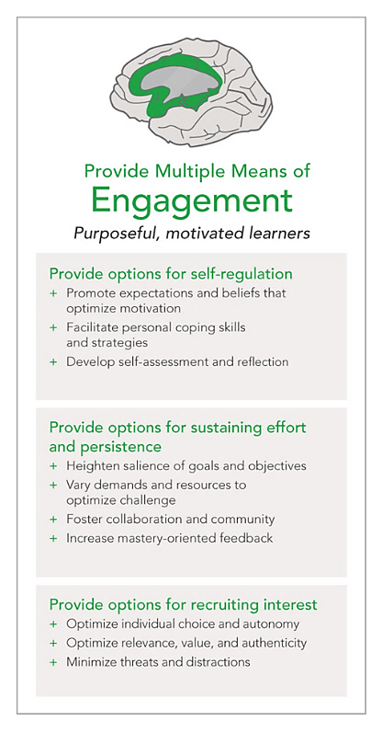


Why What How of Learning
Affective Networks The WHY of Learning | Recognition Networks The WHAT of Learning | Strategic Networks The HOW of Learning
Notes:
The Guidelines are organized according to the three principles of UDL: engagement, representation, and action and expression. The first column represents affective networks or the “ why” of learning by providing multiple means of engagement.
The middle column represents recognition networks or the “what” of learning by providing multiple means of representation.
The third column represents strategic networks or the “how” of learning by providing multiple means of action and expression.
The bullets under each of the Guidelines are corresponding “checkpoints” that provide more detailed suggestions. We’ll look at those checkpoints in a moment.

Slide 13
Access
ACCESS
BUILD
INTERNALIZE
GOAL
Notes:
The Guidelines are also organized horizontally. The “access” row includes the Guidelines that suggest ways to increase access to the Learning Goal by recruiting interest and by offering options for perception and physical action.
The “build” row includes the guidelines that suggest ways to develop effort and persistence, language and symbols, and expression and communication.
The “internalize” row includes the guidelines that suggest ways to empower learners through self-regulation, comprehension, and executive function.
Taken together, the Guidelines lead to the ultimate goal of UDL: to develop “expert learners” who are, each in their own way, resourceful and knowledgeable, strategic, and goal-directed, purposeful, and motivated.

Slide 14

Strategic Conversations
Strategic Conversations
Notes:
Remember the theory of UDL is based on how teachers anticipate students’ needs. When you collaboratively plan your lessons, you will guide the design of learning that provides flexibility with a variety of options for learners to comprehend information, demonstrate their knowledge and skills, and be motivated to learn.
Pages 6–12 of the Differentiation Guide offers checkpoints with examples for implementing each Guideline. Many of these suggestions are things teachers use daily to meet the needs of all learners. Review the pages, highlight what you have applied, and circle a few bullet points that you are interested in applying in the future to support student success.
After reviewing: Share one highlighted item and one circled item from each of the Guidelines with your Collaborative Team members. Take note of what you have in common and what you can share.
Share your thoughts on how Engagement, Representation, and Action and Expression can support students in all classes and discuss the benefits of all classes using these strategies. Using Handout 5: Strategic Conversations for Differentiation, record your notes in the middle section, Strategies Used for Differentiated Instruction.

Slide 15

Differentiated instruction
Success for All Students!
Differentiated Instruction
Notes:
Differentiated instruction is rooted in years of educational research. It is both a philosophy and a way of teaching that respects the different learning needs of students and expects all students to experience success as learners.
Carol Ann Tomlinson, a leader in differentiated learning, describes differentiation as responsive teaching rather than one size fits all teaching (2005). This means that teachers proactively plan varied approaches to what students need to learn, how they will learn it, and/or how they will show what they have learned in order to increase the likelihood that each student will learn as much as he or she can, as efficiently as possible (Tomlinson 2003).

Slide 16
ICE
 | Main Idea
Underline | Important Details
 | Important Words
 | Question
 | Interesting/Surprising
 | Connection to Me
 | Evidence
 | Favorite Part
!
C
E
?
Close Read Annotations
Notes:
Let’s use our annotations again as you read additional information about differentiated instruction on page 13 of the Differentiation Guide. When everyone in your team is finished reading, share and discuss your annotations. What was interesting or surprised you? What connections did you make with the text?
After participants finish discussing: Reporters, share one annotation your team had in common.

Slide 17

Effective differentiated instruction
Effective Differentiated Instruction
Environment
Curriculum
Assessment
Instruction
Management
Notes:
Effective differentiated instruction is effective instruction. They share the same qualities we previously discussed. There are four principles plus one that are foundational to differentiated instruction. Carol Ann Tomlinson added the fifth because the four won’t be successful without it.
The learning environment needs to be open and inviting so all students feel safe to fully engage in their learning.
The curriculum needs to be of high-quality and aligned to state standards. Each lesson has clearly defined Leaning Goals with Criteria for Success that are understood by every student. All tasks and activities support the Learning Goals.
Teachers use evidence to drive instruction. Using formative assessment, teachers monitor and adjust instruction to meet the needs of all students through tasks and activities, questioning strategies, self-assessment, extending thinking, descriptive feedback, and peer feedback.
Classroom management is a key factor in creating a collaborative culture of learning to support effective instructional teaching and learning. Clear classroom procedures and routines need to be established, consistent, supportive, and positive.

Slide 18
The key elements that guide differentiated instruction
Learning Profiles
Choices
Flexible Grouping
Readiness
Interests
Respectful Tasks
Notes:
The key elements that guide differentiated instruction are content, process, product, and environment. For these to effectively support student learning, we must first consider each student’s readiness, interests, and learning profiles. That will guide the choices, flexible grouping, and respectful tasks that will be used with content, process, and product.
Readiness is not referring to a student’s ability. It refers to a student’s current proximity to specific learning goals, targets, or outcomes (Tomlinson, 2011). It is not a universal readiness. A student may have differing readiness levels for a specific subject area, topic, or skill. The readiness levels change as learning occurs so with that the complexity of work must change (Tomlinson, 2003).
When a student’s interests are tapped, that student is more likely to be engaged and to persist in learning (Csikszentmihalyi, 1990; Maslow, 1962; Sousa, 2001; Wolfe, 2001). This personal learning connection will motivate students to be more involved in the topic. When students are interested, they are more likely to pay attention, stay engaged, and process information more effectively (Hidi and Harackiewicz, 2000).
Learning profile refers to a wide variety of ways in which learners vary in how they prefer to deal with content, process, and product. Learning profile includes attention to intelligence preferences, learning styles, and cultural and gender differences. Teachers may differentiate for learning profile by offering options for how to demonstrate learning. When different modes of learning are offered and supported, more students successfully complete learning tasks (Campbell and Campbell 1999; Sternberg et al., 1998).
Student choice may refer to organization (e.g., choosing group members or participating in establishing classroom rules), procedural (e.g., choosing how to demonstrate learning), or cognitive (e.g., finding multiple solutions to problems, aligning tasks to interests, or debating ideas freely). By empowering students to exercise a degree of autonomous decision making, student choice makes students active participants in their educations (Hanover, 2014).
Flexible grouping is a central part of respect for all learners, honoring individual differences, collaboration, teaching for success, and collaboration in a differentiated classroom (Tomlinson, 2001). In planning for flexible grouping, teachers must consider the strengths and weaknesses of each grouping approach—large group, small group, partner, and individual to best meet the learning needs of the students. Groups are to be formed and dissolved as needs change (Radencich and McKay, 1995; Ford, 2005).
Requiring tasks to use skills far above or far below students’ skill levels impedes learning, so it is essential to create respectful tasks. Respectful tasks are based on high expectations and require teaching up. While different tasks will require varied skill levels, it is important to provide each student with tasks that are slightly challenging. This generates learning (Tomlinson, 2008).
A reference page for these supports is on page 14 of the Differentiation Guide.
Each of you choose one of the supporting elements: readiness, interests, learning profile, choice, flexible grouping, and respectful tasks. Discuss how you currently use the topic to support student learning. Record the shared strategies in the top section of Handout 5: Strategic Conversations for Differentiation.
A reference page for Readiness, Interests, Learning Profiles, Choices, Flexible Grouping, and Respectful Tasks is on page 14 of the Differentiation Guide. Each of you choose one of these supporting elements. Discuss how you could implement the topic to support student learning. Record the shared strategies in the middle section of Handout 5: Strategic Conversations for Differentiation.

Slide 19

Content, process, product, and environment
Differentiated Instruction
Content
Process
Environment
Product
Notes:
There are four core elements to differentiating instruction: content, process, product, and environment. All are necessary and interconnect to offer effective differentiated instruction. This progresses into the Dimensions of Formative Assessment 3–10 with our formative assessment rubric from Tasks and Activities to Elicit Evidence of Student Learning that guide students toward successful learning.
Content of instruction should address the same concepts with all students, but the degree of complexity should be adjusted to suit diverse learners (National Center on Accessing the General Curriculum).
Process is how students will learn the content you teach. Inclusionary classrooms are student-centered and collaborative with flexible groupings. This means that the teacher plans to use materials for different learning styles and offer support for different student’s needs. Students work together, but the groups need to be fluid and change to fit the needs of all students for the activity. Rather than just listing the activity in your plans, you need to think of how you will offer varying levels of the activity and how you will use evidence to drive instruction to know where your students are in real time.
The product, or evidence of learning, is what the students create at the end of a lesson, series of lessons, or unit to demonstrate the mastery of the content. The important aspect is to offer choices, so all students can express their level of learning in a manner that fits their strengths.
Learning environment adjustments can include time, space, materials, and room arrangement (Tomlinson and Imbeau, 2010). Your classroom needs to be inviting in the way it looks and the way it feels. Every student should feel safe, secure, and supported to learn in the way that best works for them. Everyone should share in and support the learning of every student.

Slide 20
What literacy skills do students need to have success?
Learning Goal:
We will be able to share information about one differentiated instruction core element.
Criteria for Success:
We can collaboratively summarize, brainstorm, plan, and share one differentiated instruction core element through a presentation.
Notes:
We are going to do a team activity to learn more about the core elements of differentiated instruction. Your reference will be within pages 15–18 of our Differentiation Guide. You will use the page of your assigned core element to create a short presentation.
Our Learning Goal: We will be able to share information about one differentiated instruction core element.
Our Criteria for Success: We can collaboratively summarize, brainstorm, plan, and share one differentiated instruction core element through a presentation.

Slide 21
Assign one core element to each Collaborative Team
Elements of
Differentiated Instruction
10 minutes for Readings
6 minutes for Summarizing
6 minutes for Brainstorming
25 minutes for Planning
Notes:
Your team will read about one core element and summarize the key points. Next, you will brainstorm ways you might present your information to the whole group. You will plan a way that involves everyone in your group. Timing for your presentation should be 3–5 minutes. Assign one core element to each Collaborative Team.
Timekeepers, you will keep your team on target by following the schedule:
10 minutes for Readings
6 minutes for Summarizing
6 minutes for Brainstorming
25 minutes for Planning
Keep track of the time. When 47 minutes pass, start the presentations.
After the presentations: Celebrate the presentations!

Slide 22
Handout 5: Strategic Conversations for Differentiation
Strategic Conversations
Notes:
Discuss the information you received from the presentations and pages 15–18 of the Differentiation Guide. Share your thoughts on how Content, Process, Product, and Learning Environment can support students in all classes and discuss the benefits of all classes implementing these strategies. Using Handout 5: Strategic Conversations for Differentiation, record your notes in the middle section, Strategies Used for Differentiated Instruction.

Slide 23
Inclusionary Practices
UDL
Inclusionary Practices
DI
Notes:
The diagram on page 19 of the Differentiation Guide illustrates how UDL and differentiated instruction link together. Review the linked attributes and discuss how UDL and differentiated instruction will be positive additions to your teaching strategies and your students’ learning strategies.

Slide 24
What Are Your Thoughts about Differentiation?
What Are Your Thoughts about Differentiation?
Notes:
What are your thoughts about differentiation now? Go back to Handout 4: My Thoughts about Differentiation. In the bottom half, jot down what you now know and think about differentiation.
When participants are finished: How has your thinking changed? Turn to a partner and share your thoughts.
When pairs are finished: Pairs, share one common change in thinking with your Collaborative Team. Reporters, choose one common change in thinking to share with the group.

Slide 25

Discuss how differentiation will impact their learning as individuals
How Will Differentiation Impact All Students?
Notes:
Think about your current students. As a team, discuss how differentiation will impact their learning as individuals and as class members?
Reporters, share the biggest impact from your team’s discussion.

Slide 26

Team support
Team Support
Implementation
Action Planning
Notes:
As a team, discuss the module differentiation strategies presented today. Complete the if/then statement at the bottom of Handout 5: Strategic Conversations for Differentiation. Choose one module differentiation strategy to implement across your grade level next week.
When all teams are finished: Answer the action planning question: What is needed to create, support, and sustain a schoolwide effort to collaboratively use differentiation strategies?
When all teams are finished: Recorders, using the half sheets of paper and markers, add your team’s needs under the Action Planning Wall Heading: Differentiation Strategies.
Reporters, share the support your teams need for collectively implementing differentiation strategies. Point out commonalities among the teams.

Slide 27
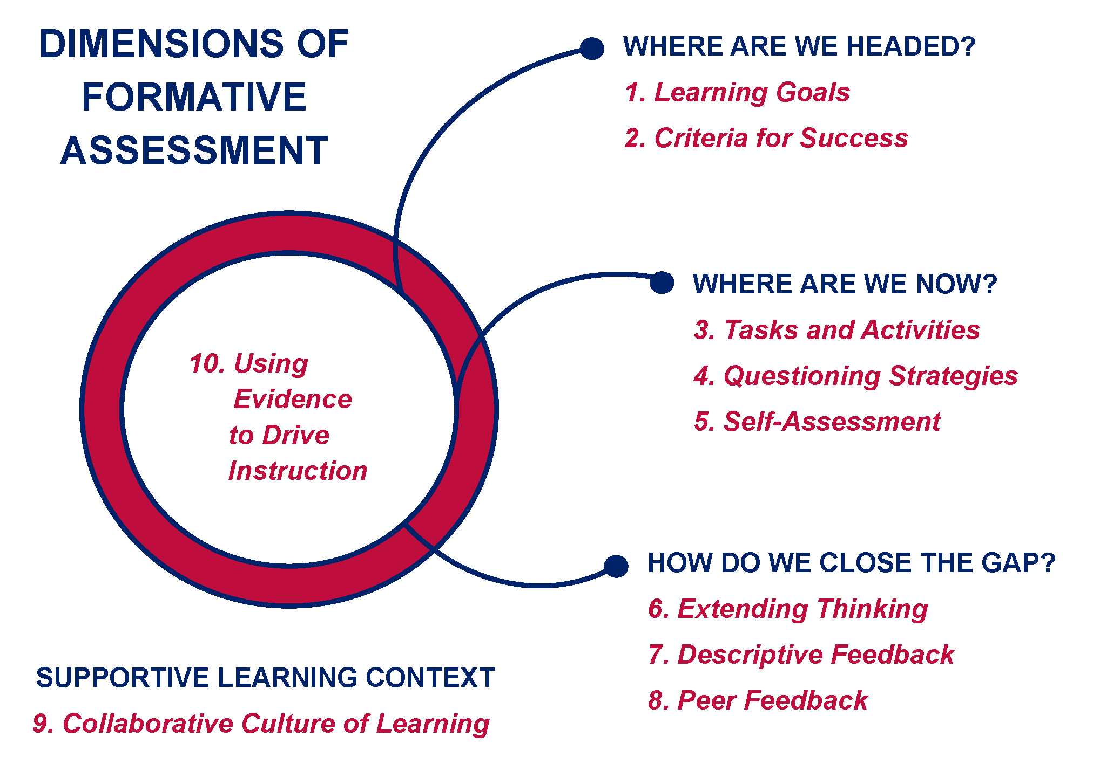
Collaborative Planning
Collaborative Planning
Notes:
The AZPLS is structured around Collaborative Teams implementing the Dimensions of Formative Assessment, inclusionary practices, and teaching and learning strategies. The following activities are designed to examine your current collaborative planning and extend your collaborative planning to include differentiation.
Pages 20–26 in the Differentiation Guide are dedicated to organizing collaborative planning. You have the same information in Handouts 6A–6E to use for the next few activities. Let me preview the handouts before you begin.

Slide 28
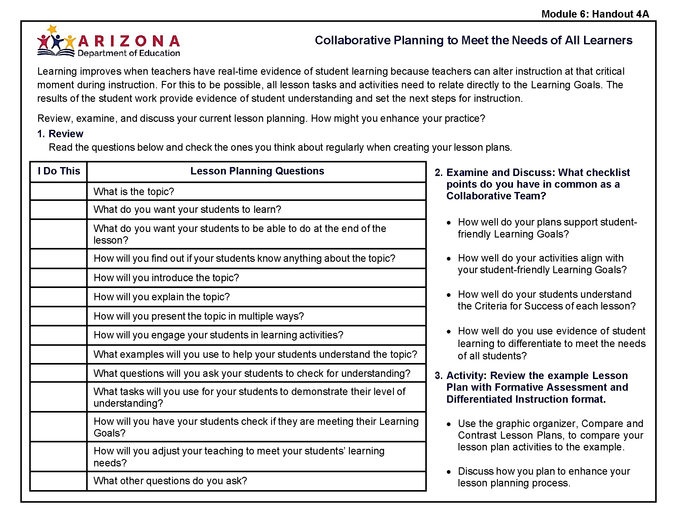
Handout 6A
Notes:
The activity for Handout 6A: Collaborative Planning to Meet the Needs of All Learners has three steps. Step 1: You complete the checklist individually to identify what you think about when creating your lesson plans.
Step 2: As a Collaborative Team, you discuss what you have in common from the checklist.

Slide 29
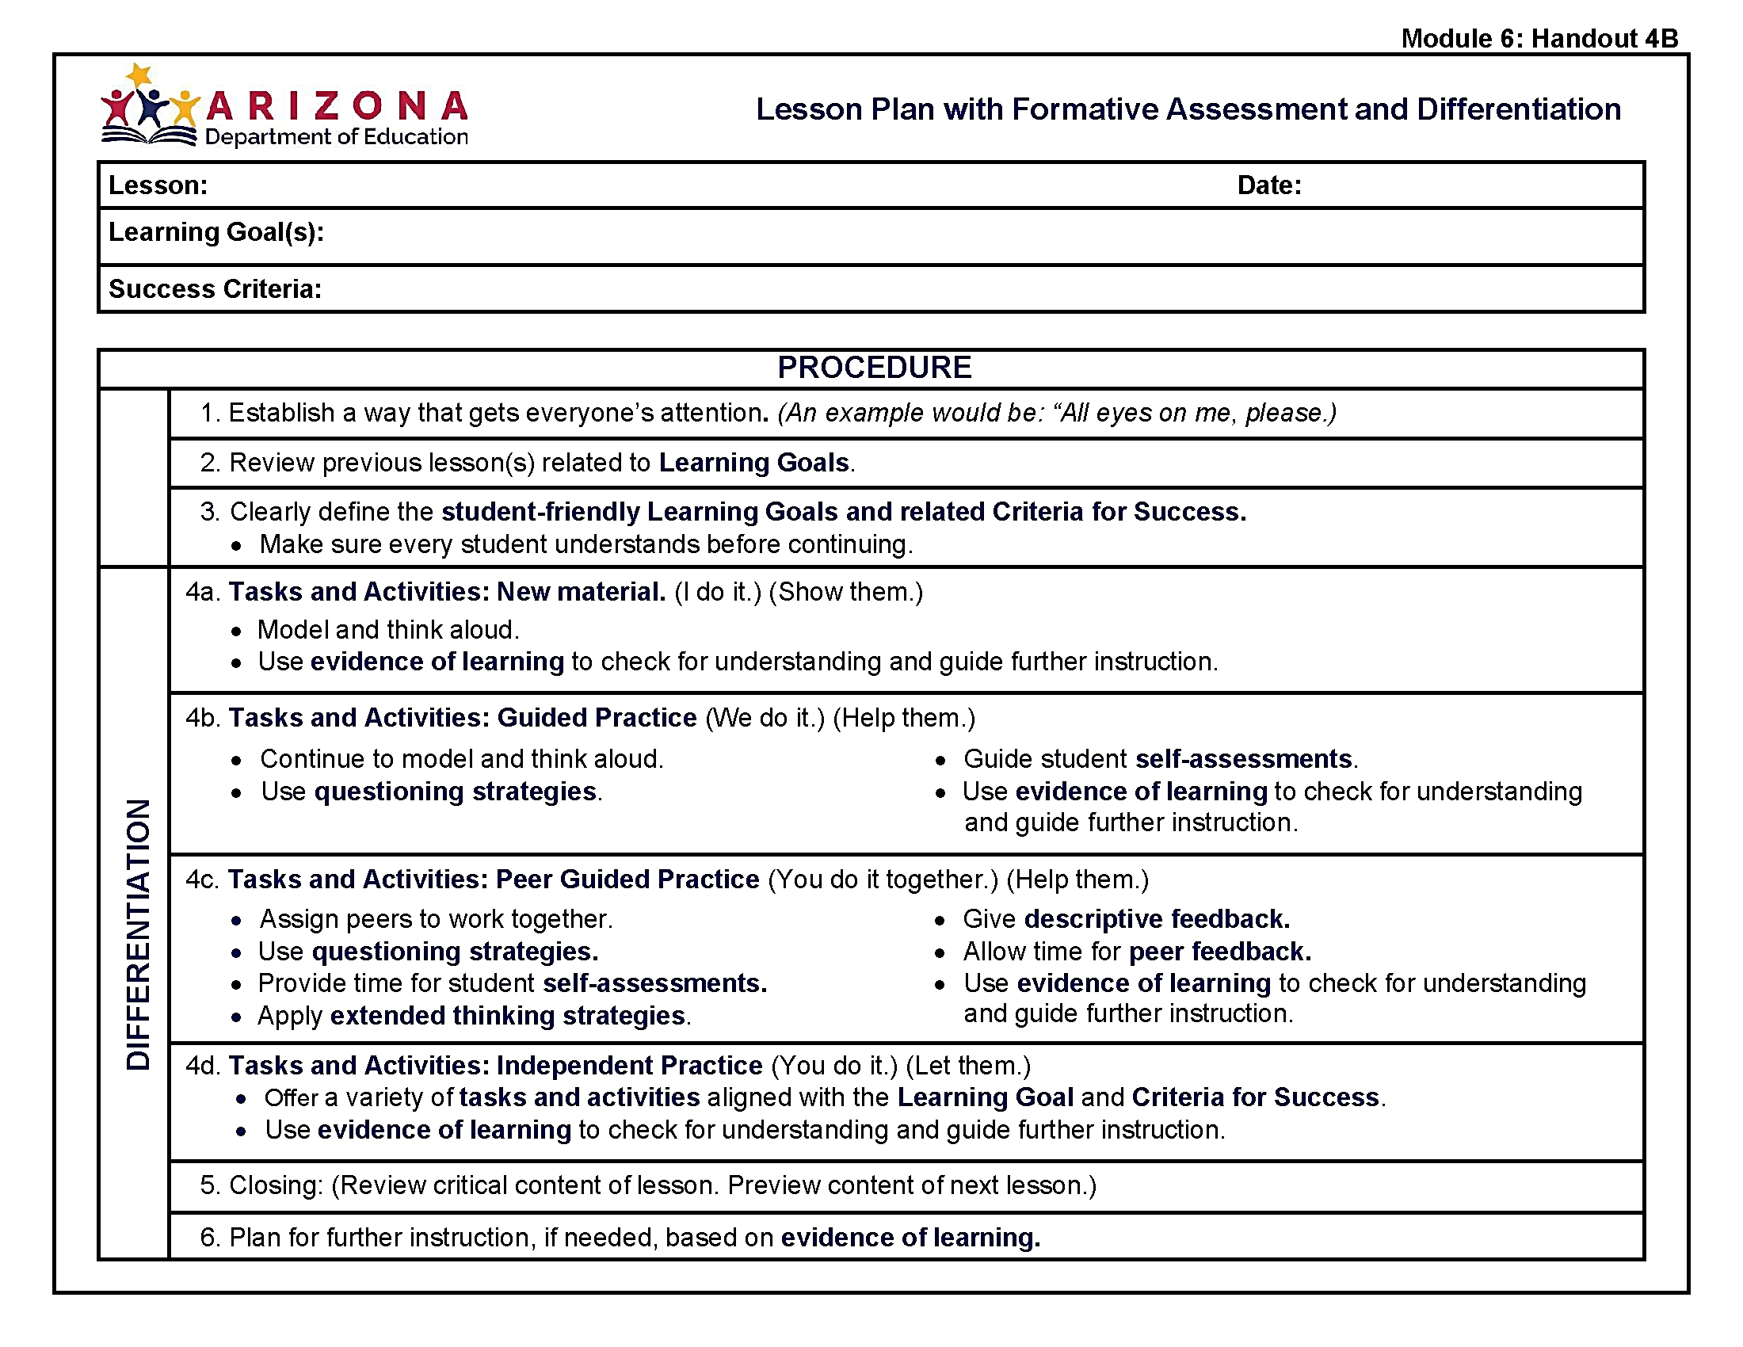
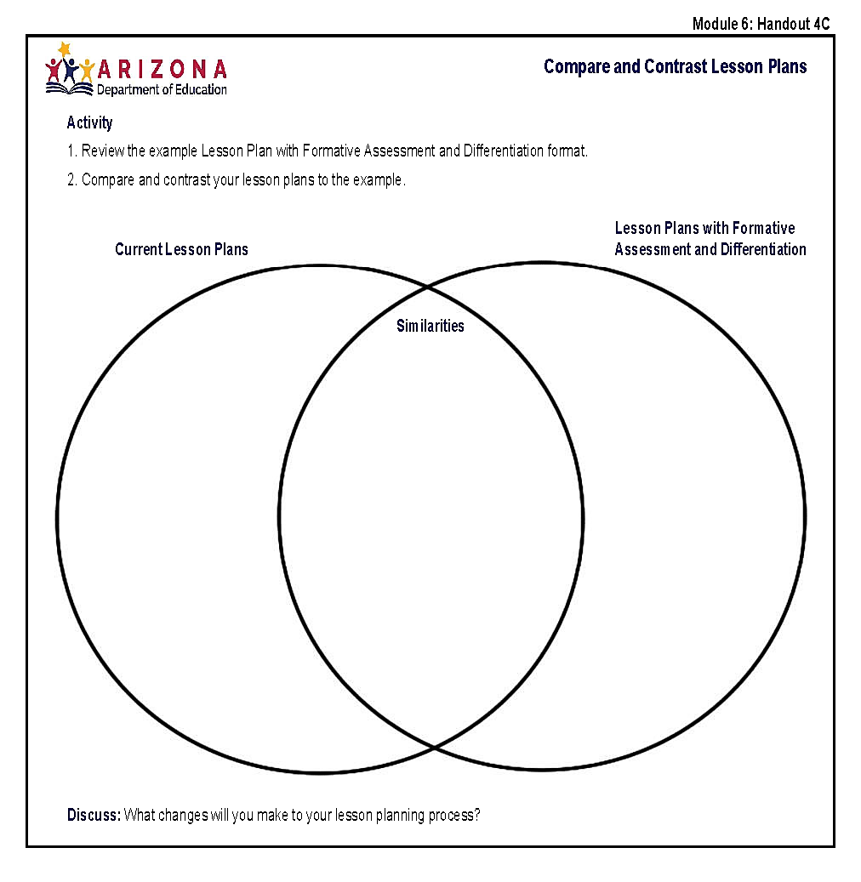
Handout 6B
Notes:
Step 3: You review Handout 6B: Lesson Plan with Formative Assessment and Differentiated Instruction to examine lesson planning that integrates the Dimensions of Formative Assessment and differentiation. Use Handout 6C: Compare and Contrast Lesson Plans to identify the similarities between your current lesson planning and adding differentiation.

Slide 30
Teamwork
Notes:
Using your Lesson Connection Posters from Module 5 and Handout 6D: Lesson Planning Connections, it’s time to apply your knowledge to include differentiation in your lesson planning. Discuss how you could differentiate your Module 5 Lessons and meet each student’s needs through Content, Process, Product, and Learning Environment.
Handout 6E: Self-Assessment and Peer Feedback is a revised form of the handout from Module 5. A section for differentiated instruction is included as a reference for today and for all future self-assessment and peer feedback. Complete a team self-assessment now.

Slide 31
Peer Feedback
Peer Feedback
Notes:
Partner with another Collaborative Team. Each person trades Handout 6E: Self-Assessment and Peer Feedback with a member of their partner team.
Go to your partner team’s Learning Connection Poster. Using your partner’s Handout 6E: Self-Assessment and Peer Feedback, go to Differentiated Instruction. Record your thoughts under Peer Feedback. Remember this is descriptive feedback pertaining to the features of Differentiated Instruction. Do this even if you agree with the self-assessment.
When teams are finished: Go to your partner team and trade back your Handout 6E: Self-Assessment and Peer Feedback. With your own Collaborative Team, review the peer feedback for your work. Discuss how you can collaborate to include differentiation in your lessons.
After discussions: Reporters, share one way your teams plan to collaborate for including differentiation in their lessons.
After reporters share: Collaborative Team members share your thoughts on how collaborative planning will support students in all classes. Using Handout 5: Strategic Conversations for Differentiation, record your notes in the middle section, Strategies Used for Differentiated Instruction.

Slide 32
Handout 5
Collaborative Planning
Implementing
Action Planning
Notes:
Using the bottom section of Handout 5: Strategic Conversations for Differentiation, finish the sentence stem for the if/then statement to discuss the student impact of collaboratively using differentiation strategies.
As a team choose one module collaborative planning strategy to implement across your grade level next week.
When Collaborative Teams are finished: Through the AZPLS you have experienced the benefits of working with your Collaborative Team to plan lessons and implement strategies to increase achievement for every student.
Answer the action planning question: What support is needed to meet the needs of all students and sustain a schoolwide effort to collaboratively plan and implement teaching and learning strategies with differentiation?
When all teams are finished: Recorders, using the half sheets of paper and markers, add your teams’ needs under the Action Planning Wall Heading: Collaborative Planning and Implementing.
Reporters, share the support your teams need for sustaining collaborative planning and implementing strategies to increase achievement for all students.

Slide 33

Action Planning
Action
Planning
Collective Input
Final Action Plan
Implementation
Coaching
Notes:
Today, you continued creating a sustainable schoolwide collaborative learning culture with collective use of differentiation to increase literacy achievement for all students, including students with specific learning disabilities.
The Building Leadership Team will review your input and synthesize the information to create measurable Action Plan items for Module 6. The final Action Plan will be shared with every team. These are the items that everyone will work toward while implementing your Collaborative Team’s specific module strategies. Your AZPLS Coach will provide support for both activities. Handout 7: Module 6 Action Plan is the form the Building Leadership Team will use.

Slide 34

Your Collaboration Skills
Your Collaboration Skills
Notes:
Before we wrap up our collaborative work today, take a moment to reflect on your personal collaboration skills. Turn to Handout 8: Collaboration Skills and complete the checklist.
Discuss how each team member’s collaborative skills increased and supported the work of your Collaborative Team.

Slide 35

Team
Notes:
Each part of the AZPLS supports the highest level of strategic teaching and learning. Implementing the strategies of each AZPLS module, your Collaborative Teams work together to meet the needs of all learners within the frame of the Arizona English Language Arts Anchor Standards, the Dimensions of Formative Assessment, evidence-based literacy strategies, and differentiation. The essential interrelationships of staff, parents, and students work together to sustain increased achievement for every student.

Slide 36

Student Impact
AZPLS: Student Impact
Notes:
Your dedication to learning, collaborating, and implementing the AZPLS strategies boosted the learning power of every student.
Think about the positive ways the AZPLS impacted your students. There are student paper cutouts in the middle of your tables. Take one and cover it with those impacts.
After everyone is finished: Share your impact statements with your team. Reflect on how the work of each of you collectively impacts the students at your grade level and discuss how the AZPLS strategies are increasing literacy achievement for all students in all classes.
After reflection: To celebrate, connect all your paper students on the wall of the hallway, entrance way, or some other prominent spot. Share your student impact chain with your students, parents, and District Leadership Team.

Slide 37


The Path to Academic Growth
AZPLS: The Path to Academic
Growth for All Students
Notes:
Rooted in systems change, the AZPLS guided you to forge a path where every student develops strong learning skills and experiences continued growth.
The unified efforts of leadership, teachers, parents, and students are now rooted in sustained collaboration for supporting literacy achievement for all students in all classes in the present and for the future.

Slide 38
Arizona Dept of Ed Exceptional Student Services
Arizona Department of Education
Exceptional Student Services
Notes:
Optional Professional Learning Survey: Ask participants to complete surveys before they leave.

